Slide 1



HIE-ISOLDE Project:
Planning & Resources
Y. Kadi (EN-HDO)
and the HIE-ISOLDE Project team

Slide 2
Overview
HIE-ISOLDE Planning
Resource Loaded Schedule
CATHI Proposal (Marie-Curie ITN3)
Project Management Structure
R&D Activities and Outlook
Y. Kadi HIE-ISOLDE Proposal, IEFC, August 21, 2009

Slide 3
HIE-ISOLDE Schedule (1/3)
The HIE-ISOLDE project concentrates on the construction of the SC LINAC and associated infrastructure in order to upgrade the energy of the post-accelerated radioactive ion beams to 5.5 MeV/u in 2013 and 10 MeV/u by 2014/2015
The design study for the intensity upgrade, also part of HIE-ISOLDE, starts in 2011/2012, and addresses the technical feasibility and cost estimate for operating the facility at 10 kW once LINAC4 and PS Booster are online. The 30 kW option (SPL beam) will be studied at a later stage

Slide 4
HIE-ISOLDE Schedule (2/3)
Energy Upgrade
Stage-1: 5.5 MeV/u SC Linac (2013)
  New service buildings (CV, electrical systems, …) ->
  Cryogenics station (Cold box, compressors, control systems) ->
  SC linac (2 cryomodules, 10 β_{high} cavities, 2 solenoids and 10 RF stations) ->
Stage-2: 10 MeV/u SC Linac (2014/2015)
  SC linac (4 cryomodules, 10 β_{high} + 12 β_{low} cavities, 6 solenoids and 22 RF stations) ->
  New transfer line ->

Slide 5
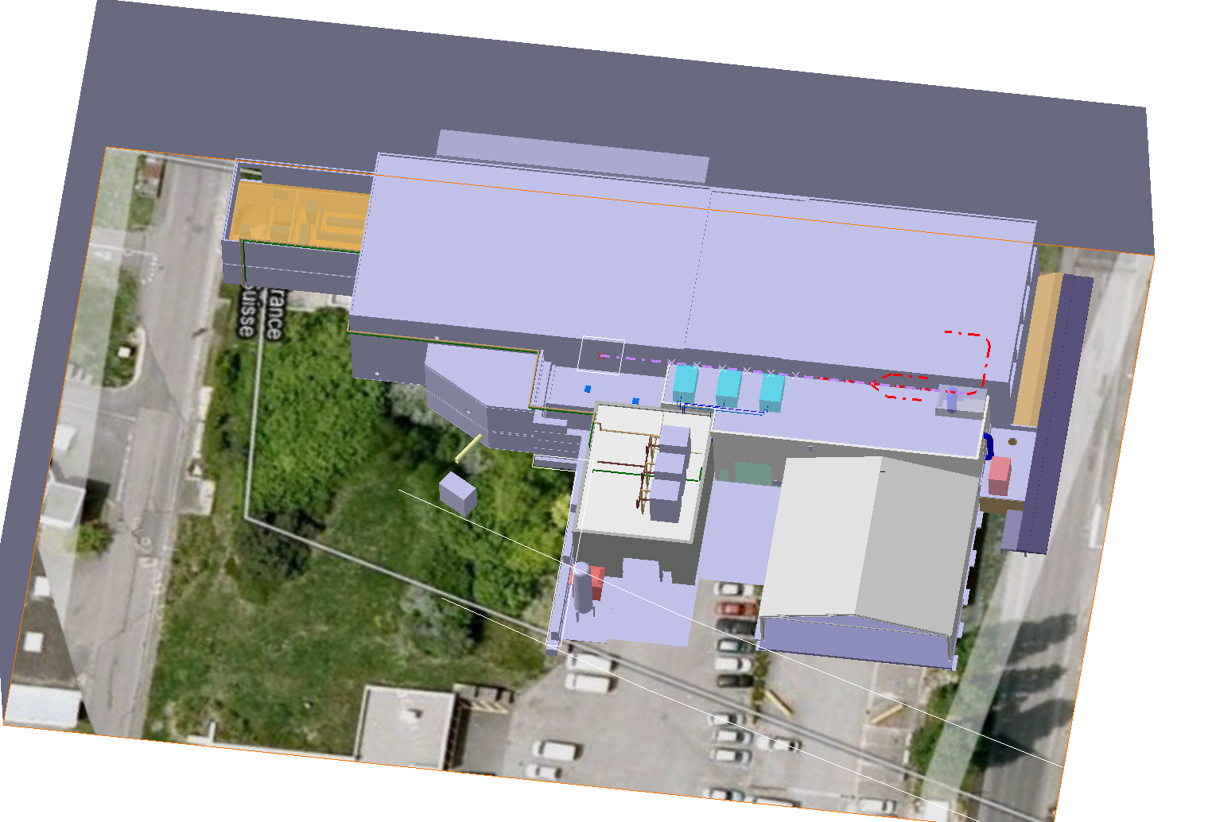
HIE-ISOLDE Layout

Slide 6
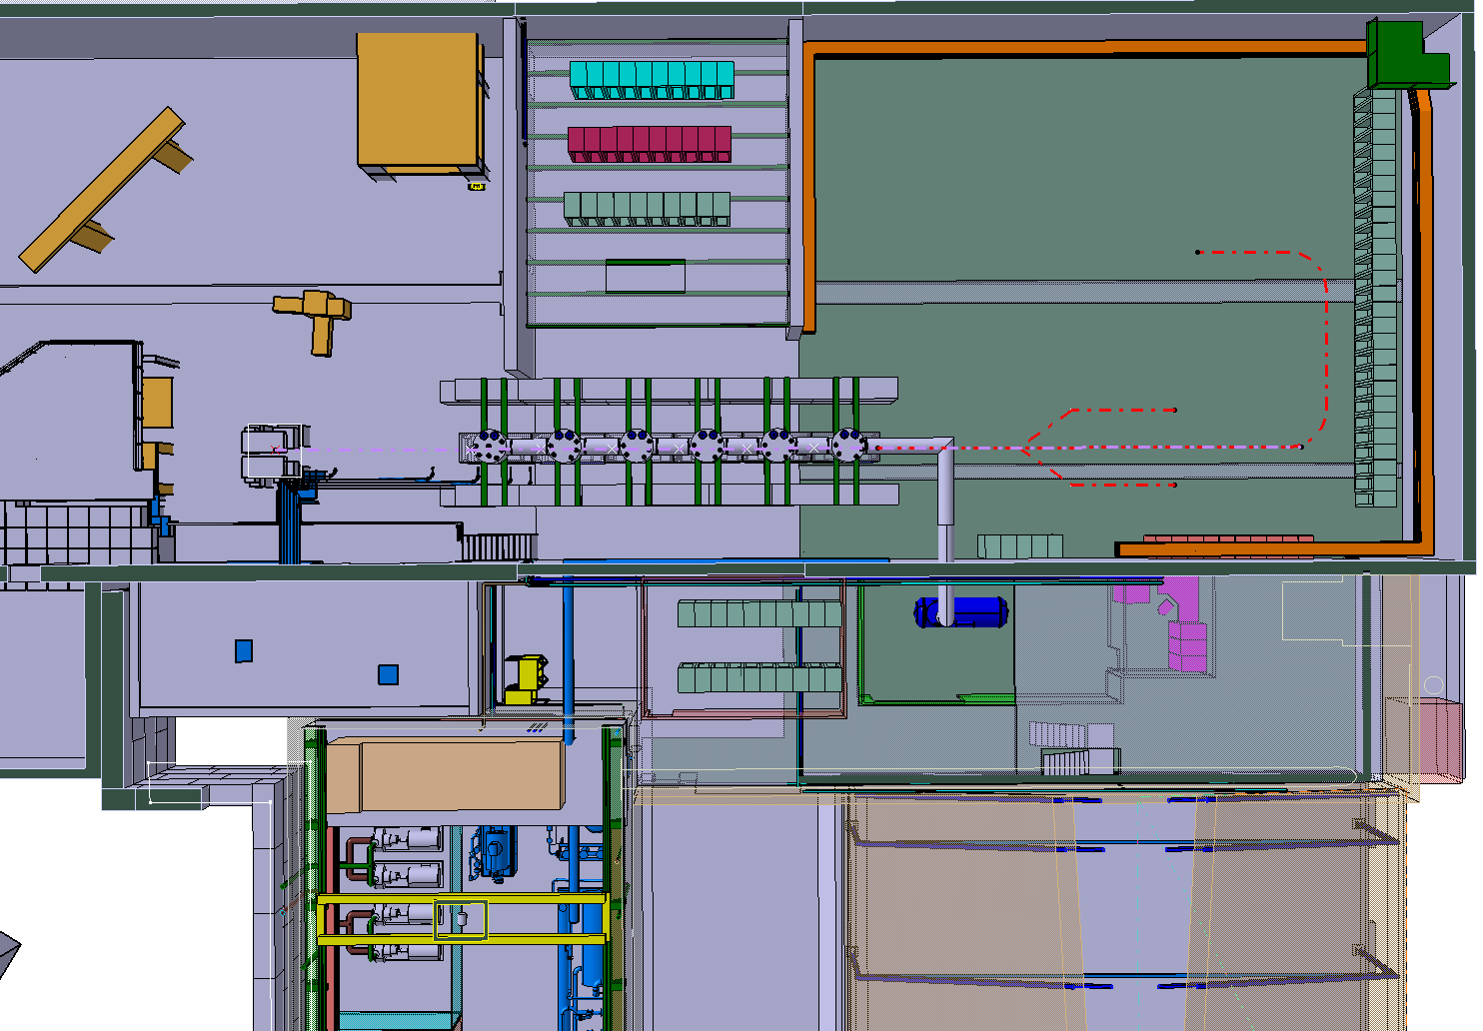
HIE-ISOLDE Layout

Slide 7
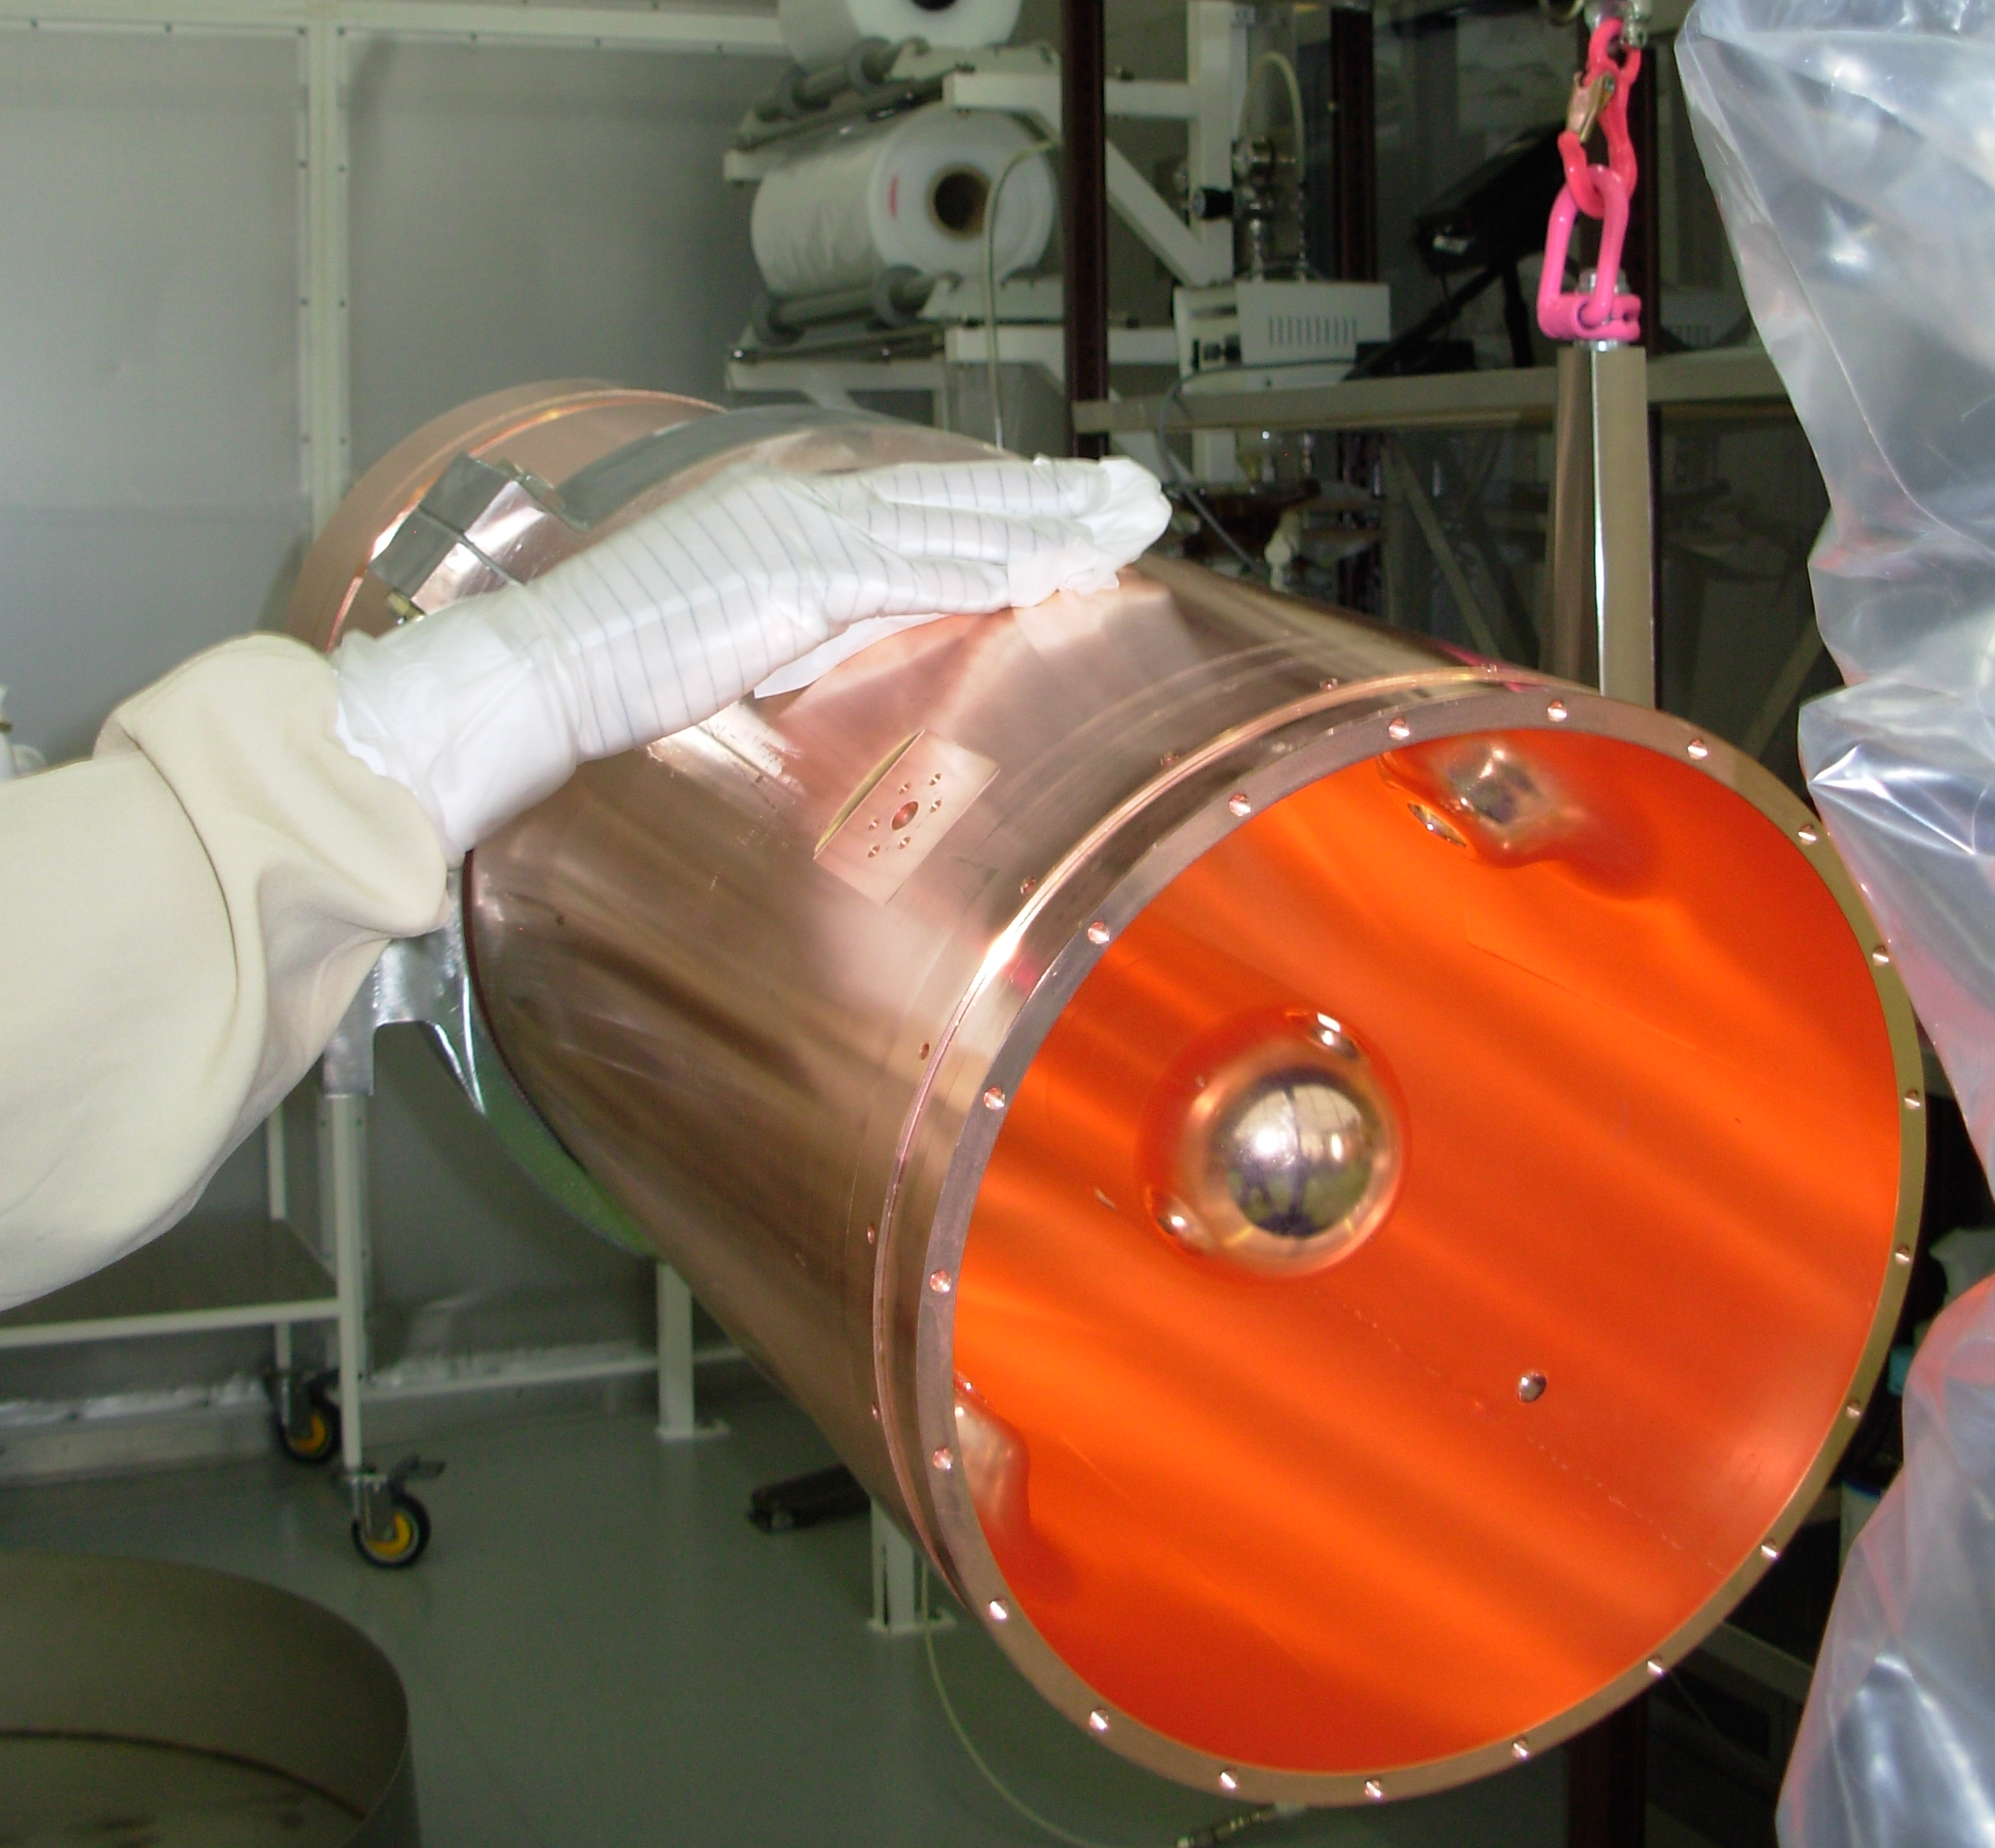
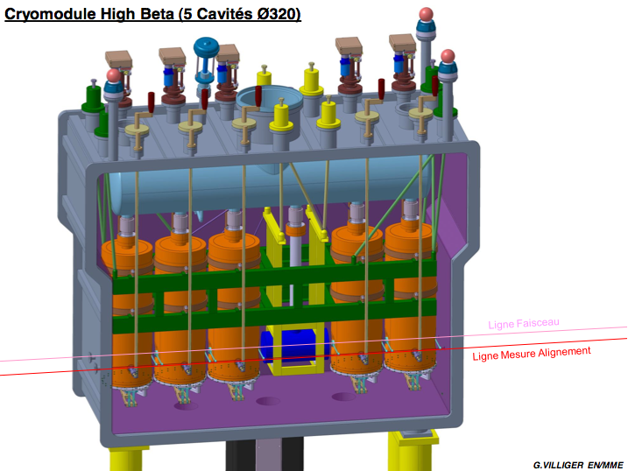
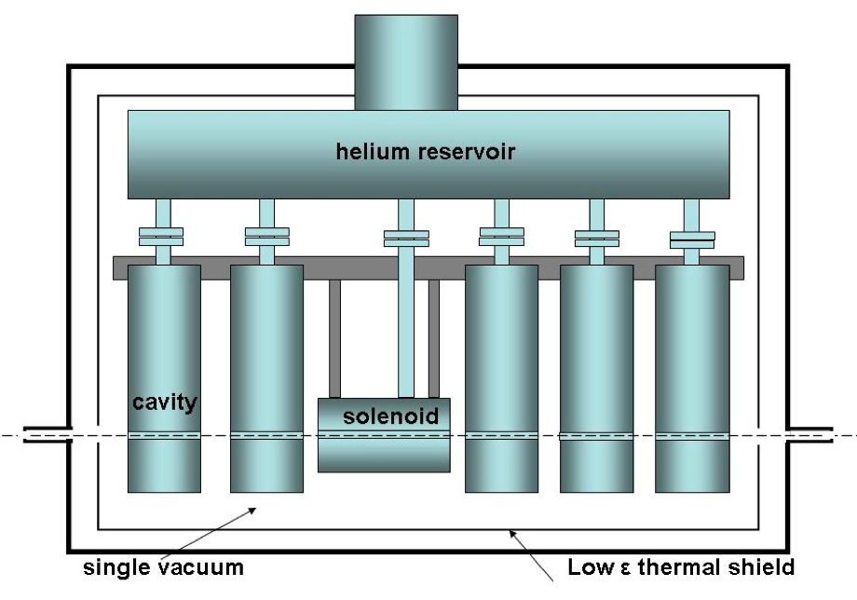
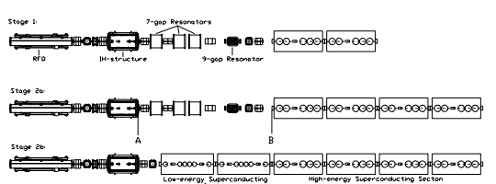
SC Linac Layout staged installation
1.2 MeV/u
3
MeV/u
5.5 MeV/u

Slide 8
SC Linac Layout staged installation
1.2 MeV/u
3
MeV/u
5.5 MeV/u
8
MeV/u
10 MeV/u

Slide 9
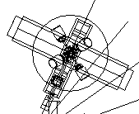
New Transfer Line
HEBT3
HEBT2
HEBT1

Slide 10
HIE-ISOLDE Schedule (3/3)
Design Study for Intensity Upgrade
Various issues associated with the target area will have to be addressed.
These include:
Target and Frontend
  Radiation hard systems, minimum intervention, high voltage systems,
  remote maintenance, beam extraction and optics
Shielding and air activation
  Improved shielding for neighboring work areas
  Independent and minimum volume ventilation systems
Vacuum Systems
  Radioactive gas storage capacity and treatment
  Radiation hard systems with minimum maintenance
  Access and remote maintenance
Civil Engineering and Survey
  Possible modification of area due to upgrade
Access and Operational Aspects
  Interlocks, protocols
Injection magnets and beam line
  Study required for 30kW intensity upgrade
Off line Separator
  Preparation and characterization of targets before on-line use. Target/Frontend interface checks.
Separator area modifications
  Mass pre-separator to minimize propagation of radioactive species.
  Study of Super-HRS
    New separator magnet for higher resolution
    New RFQ before 90 degree magnet
Experimental hall and beam line modifications
  Beam distribution bottlenecks
  Experimental zones and layout
  Secondary zone access
  Shielding

Slide 11
Overall Current Cost Estimate
 | Materials MCHF | Staff FTE | Fellows FTE
Beam quality improvements | 4 |  | 2
Prototyping, Linac up to 5.5 MeV/u | 6.8 + 0.8 | 50 + 2 | 36 + 2
Infrastructure, Integration and Safety for 5.5 MeV/u | 12.2
Upgrade Linac up to 10 MeV/u + new transfer line | 9.5 | 10 | 0
Upgrade infrastructure to 10 MeV/u | 1.9
Design study for intensity upgrade | 2.1 | 8 | 33 (29 CATHI)
The current cost of HIE-ISOLDE 1 is 37.3 MCHF materials and 143 FTE (70 staff + 73 Fellows/Phd)
This includes the beam quality improvement and part of the linac design study & prototyping costs (4.8 MCHF + 6 FTE) that have already been spent, and necessary consolidation costs.

Slide 12
Resource Loaded Schedule to fulfill 5.5 MeV/u SC Linac
(w/o Design Study)
 | CERN (infrastructure and safety) kCHF | Ext. Funding (Linac) kCHF | Total kCHF | STAFF FTE | Fellow FTE ISOLDE CATHI |  | Total FTE
2010 | 1598 | 815 | 2413 | 8.95 | 3.45 | 0 | 12.4
2011 | 4734 | 2765 | 7499 | 12.45 | 3.5 | 10 | 25.95
2012 | 3817 | 2265 | 6082 | 13.9 | 1.9 | 10 | 25.8
2013 | 2010 | 758 | 2768 | 10.8 | 0 | 7 | 17.8
2014 | 0 | 209 | 209 | 4.4 | 0 | 0 | 4.4
Total | 12159 | 6812 | 18971 | 50.5 | 8.85 | 27 | 86.35
External funding:
From the 1357 kCHF (900 k€) of the Belgian Grant initially paid to CERN, 578 kCHF remains unspent and 2 M€ remains to be paid
Isolde Coll. promised 1000 kCHF + 4.5 FTEs for cryomodule design & RF tests + 2 FTE for beam instrumentation (Spain) + 2.35 FTE for beam dynamics & cavity design (Cockroft)
Total available from IS-Collaboration + Belgian Grant = 4578 kCHF + 8.85 FTEs

Slide 13
CATHI Proposal:
Cryogenics, Accelerators and Targets at HIE-ISOLDE
Mono-site Initial Training Network in cryogenics, accelerators, and targets, for the future upgrade of the ISOLDE facility;
The majority of the research topics presented in this proposal will be carried out within the accelerators and technology sector of CERN, complemented with the 13 associated partners, of which 5 are from industry;
The research training topics of the proposed ITN are in accelerator physics, cryogenics, applied informatics, mechanical and electronics engineering projects related to the design and construction of a 10 MeV/u super-conducting linac and R&D for the future intensity upgrade of the HIE-ISOLDE facility.
Y. Kadi HIE-ISOLDE Proposal, IEFC, August 21, 2009

Slide 14
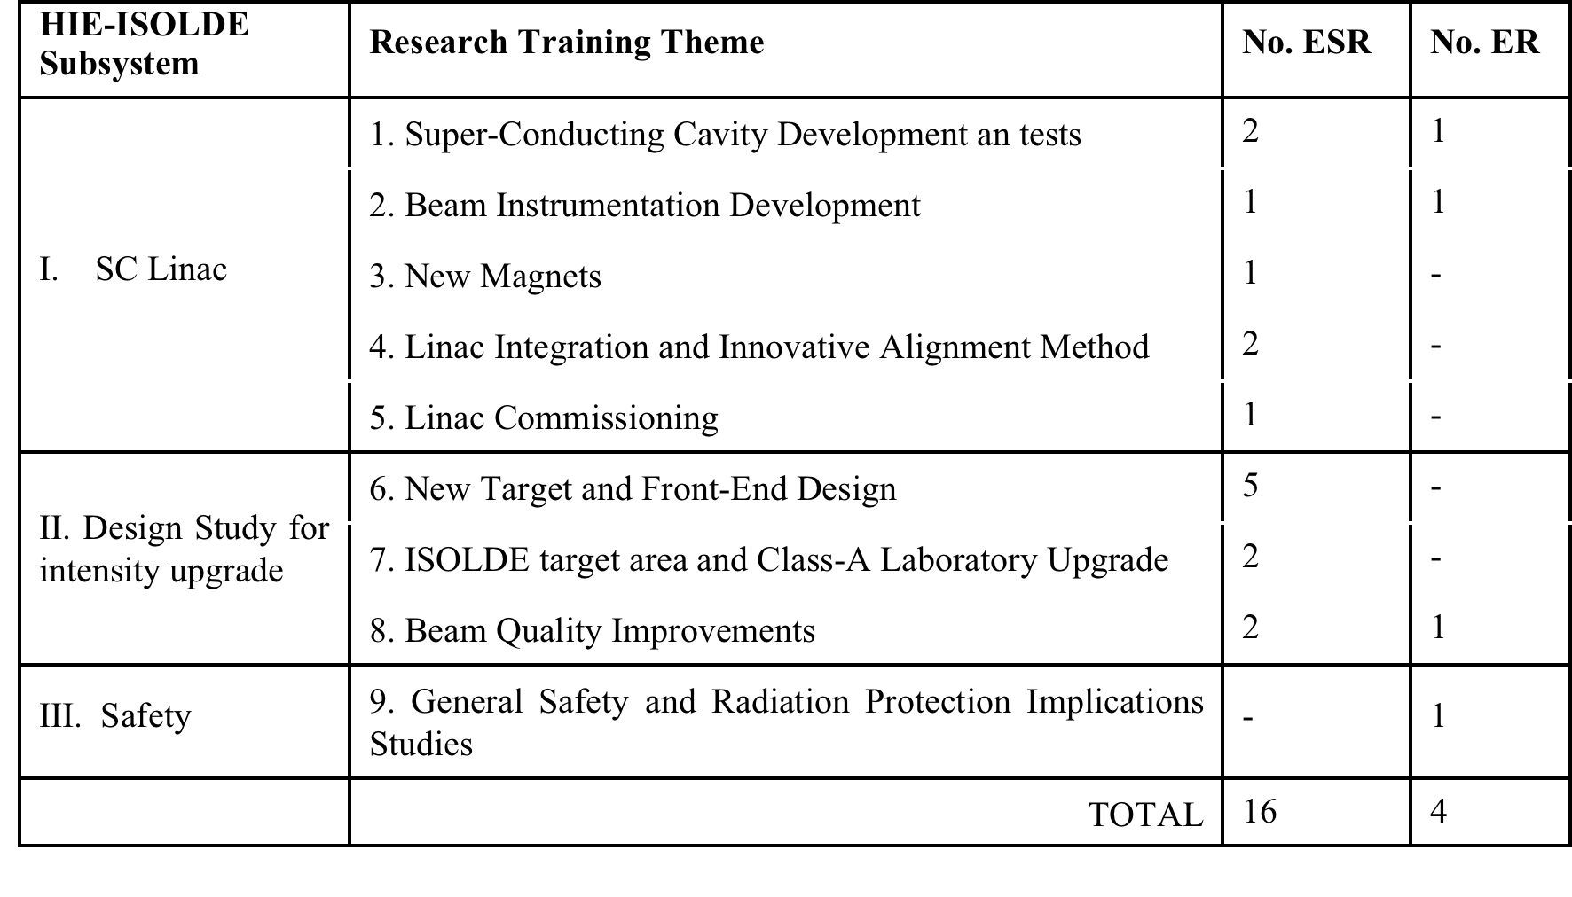
Research Training Themes Addressed by the CATHI Proposal
(56 FTE over 4 years)
Y. Kadi HIE-ISOLDE Proposal, IEFC, August 21, 2009

Slide 15
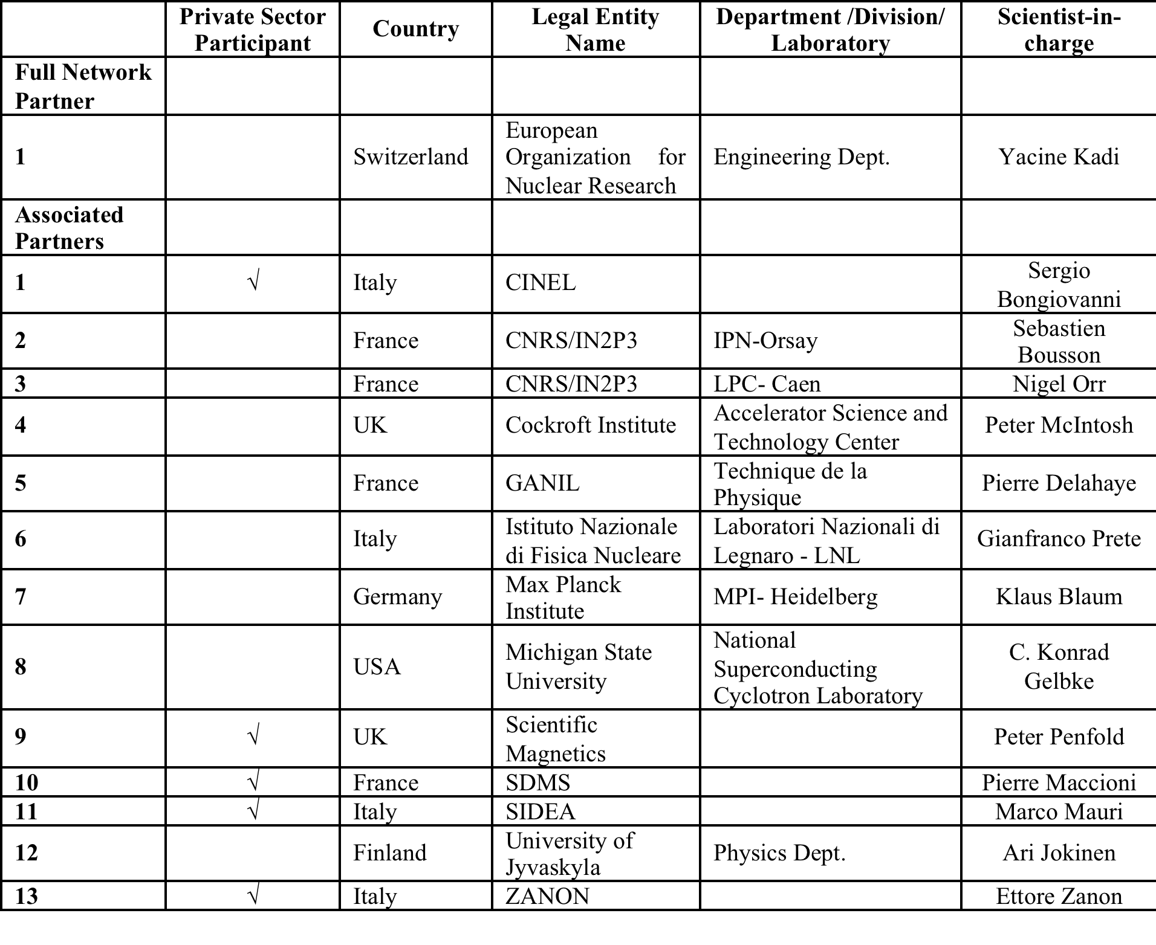
List of Participants
Y. Kadi HIE-ISOLDE Proposal, IEFC, August 21, 2009

Slide 16
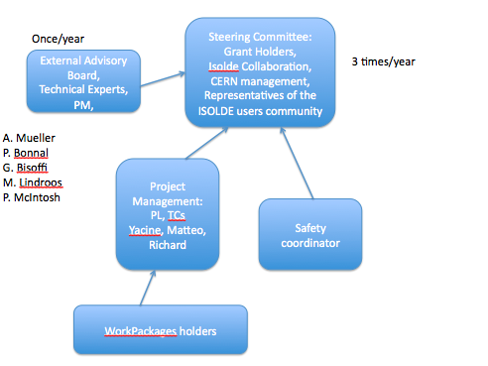
Project Breakdown Structure Overview

Slide 17
Proposed Management Structure
Project Leader: Y. Kadi (EN/HDO)
Technical Coordinator: M. Pasini (BE/RF)
Safety Coordinator: tbd
Design Study Coordinato: R. Catherall (EN/STI)
Integration/Infrastructure/Installation Coordination: D. Parchet (GS/SEM)
EDMS/MTF and QAP: support from EN and GS

Slide 18
Proposed Working Groups
(meets every two weeks)
RF Accelerating Structures (WP2.1, 2.2, 4.1)
Beam Dynamics (WP2.3-2.7, 3.8, 4.3, 7.5)
Cryomodules (WP2.1, 2.3, 2.4, 2.6, 3.4, 3.5, 3.8)
Integration and Infrastructure (WP2.8, 3.1-3.8)
Safety (WP8.1-8.4)
Design Study (WP5.1-5.3, 6.1-6.7, 7.1-7.5)

Slide 19
Outlook
Cavity prototype completed. Tests scheduled @ TRIUMF by March 2010
Cryomodule conceptual design completed, will start detailed design as soon as manpower is available
Preparation of test bench at CERN of QWR resonators (new test cryostat is planned to be ready by Feb/Mar 2010)
Complete Cavity configuration test @ SM18 is planned by the end of 2010.
M. Pasini SRF09 Berlin, 20-25.09 2009

Slide 20
Thank you for your attention!
M. Pasini SRF09 Berlin, 20-25.09 2009

Slide 21
 |  |  |  |  |  |  | Budget (kCHF) |  |  |  |  |  | Man Power (FTE)
 |  |  |  |  |  |  | 2010 | 2011 | 2012 | 2013 | 2014 | 2015 | 2010 | 2011 | 2012 | 2013 | 2014 | 2015
1.0 Project Management |  |  |  |  |  |  |  |  |  |  | operation | operation |  |  |  |  | operation | operation
2.0 Linac system
 | 2.1 Cavity RF |  |  |  | BE/RF
 |  | 2.1.1 Cavity Design |  |  |  |  |  |  |  |  |  |  | 0.25 | 0.2
 |  | 2.1.2 LLRF system |  |  |  |  | 100 | 400 | 300 |  |  |  | 1 | 1.5 | 1.5 | 0.5 | 0.2
 |  | 2.1.3 Power RF system |  |  |  |  |  | 100 |  |  |  |  |  | 0.3 | 0.5
 |  | 2.1.4 Tuning and interlocks |  |  |  |  | 20 | 145 |  |  |  |  | 0.5 | 0.5 | 1 | 1 | 0.2
 | 2.2 Cavity Manufacturing |  |  |  | EN/MME
 |  | 2.2.1 Copper Substrate |  |  | EN/MME |  | 250 | 500
 |  | 2.2.2 Surface treatment NB Sputttering |  |  | TE/VSC |  | 60 | 120 |  |  |  |  | 1.5 | 1.5 | 1.5 | 1.5
 |  | 2.2.3 FSU TE-VSC |  |  |  |  | 25 | 110 | 80
 | 2.3 Beam Dynamics |  |  |  | BE/RF |  |  |  |  |  |  |  | 1 | 0.5
 | 2.4 Cryomodules |  |  |  | TE/MSC |  |  | 570 | 971 | 387 |  |  | 1.35 | 1.85 | 2.1 | 1 | 0.2
 |  | EN-MME |  |  | EN/MME |  | 86 | 84 | 38 | 22
 | 2.5 Beam Instrumentations |  |  |  | BE/BI |  | 100 | 350 | 350 | 150 | 160 |  | 1.1 | 3.5 | 2.9 | 1.5 | 0.7
 | 2.6 SC solenoids |  |  |  | TE/MSC
 |  | Solenoid |  |  |  |  | 45 | 45
 |  | Current leads |  |  |  |  | 30 | 30
 |  | Power supply |  |  |  |  | 7 | 7
 | 2.7 Beam transfer line |  |  |  | TE/MSC
 |  | Magnets |  |  |  |  |  | 100 | 200 |  |  |  |  | 1.5 | 1.5 | 1.5
 |  | Supports |  |  |  |  |  |  | 50
 | 2.8 Linac integration |  |  |  | EN/MEF |  | 80 |  |  |  |  |  | 0.2 | 1.2 | 1.2 | 1.2 | 0.2
3.0 Infrastructure & Integrations
 | 3.1 Civil engineering |  |  |  | GS/SEM |  | 292 | 1168 | 300 |  |  |  | 1 | 1 | 1
 | 3.2 Cooling & ventilation |  |  |  | EN/CV |  | 298.8 | 2128.6 | 634.6 |  |  |  | 0.8 | 1 | 1
 | 3.3 Electrical systems |  |  |  | EN/EL |  |  | 367 | 367
 | 3.4 Vacuum |  |  |  | TE/VSC |  |  | 100 | 100 | 100 |  |  | 1.2 | 1.8 | 0.3 | 0.2 | 0.2
 | 3.5 Cryogenic system |  |  |  | TE/CRG |  | 1007.5 | 790 | 1825 | 1580 |  |  | 0.8 | 0.7 | 3.4 | 3.8 | 0.2
 | 3.6 Power converters |  |  |  | TE/EPC |  |  | 280 | 200 |  |  |  | 0.7 | 2.7 | 2.5
 | 3.7 Control system & Interlocks |  |  |  | BE/CO & TE/MPE |  |  |  | 200 | 15 |  |  |  |  | 0.2 | 0.5 | 0.5
 | 3.8 Survey |  |  |  | BE/ABP |  | 11.6 | 104.16 | 175.68 | 99 | 49 |  |  | 1.4 | 1.4 | 1.4 | 0.2
4.0 Installations and commissioning
 | 4.1 Single cavity test |  |  |  | BE/RF |  |  |  |  |  |  |  | 0.5 | 2 | 1
 | 4.2 Cryomodule test |  |  |  | BE/RF & TE/MSC |  |  |  |  |  |  |  |  |  |  | 1
 | 4.3 Linac commissioning |  |  |  | BE/RF |  |  |  |  |  |  |  |  |  |  |  | 0.3
 |  | 4.3.1 Control applications |  |  | BE/OP |  |  |  |  |  |  |  |  | 1 | 1 | 1 | 1
8.0 Safety
 | 8.1 Radioprotection
 |  | 8.1.1 Linac |  |  | DGS/RP |  |  |  | 250 | 250 |  |  | 0.5 | 1.5 | 1.5 | 1 | 0.5
 |  | 8.1.2 Design study |  |  | DGS/RP |  |  |  |  |  |  |  | 0.1 | 0.1 | 0.1 | 0.2
 | 8.2 Safety |  |  |  | EN/GMS |  |  |  |  |  |  |  | 0.1 | 0.1 | 0.1 | 0.2
 | 8.3 Access system |  |  |  | GS/ASE |  |  |  |  | 165 |  |  |  |  |  | 0.2
 | 8.4 Fire detector |  |  |  | GS/ASE |  |  |  | 40 |  |  |  |  |  |  | 0.1

Slide 22
Material Cost for Design Study (kCHF)
 |  |  |  |  |  |  |  |  | Phase 2
 |  |  |  |  | Design Study
5.0 Target Study |  |  |  |  |  | 2011 | 2012 | 2013 | 2014
 | 5.1 Target design
 |  | 5.1.1 Target Material |  |  |  | 75 | 75
 |  | 5.1.2 Target Design |  |  |  | 100 | 100
 | 5.2 Front ends
 |  | 5.2.1 HV and high current systems |  |  |  | 50 | 75 | 75 | 50
 |  | 5.2.2 Extraction optics |  |  |  |  | 50
 |  | 5.2.3 FE design |  |  |  | 100 | 100
 | 5.3 Beam diagnostics
 |  |  |  | Total | 850 | 325 | 400 | 75 | 50
6.0 target Area and Class-A lab Integration
 | 6.1 Layout upgrade |  |  |  |  |  | 120
 | 6.2 Cooling and Ventilation |  |  |  |  |  | 60 | 60 | 250 | 250
 | 6.3 Electrical systems
 | 6.4 Vacuum |  |  |  |  | 50 | 50
 | 6.5 Survey
 | 6.6 Civil engineering |  |  |  |  |  | 50
 | 6.7LL controls |  |  |  |  |  | 50 | 50
 |  |  |  | Total | 490 | 50 | 330 | 110
7.0 Injection and beam preparation
 | 7.1 Off line separator |  |  |  |  | 100 | 100
 | 7.2 Separator areas
 |  | 7.2.1 HRS magnet |  |  |  |  | 25
 |  | 7.2.2. RFQ cooler |  |  |  | 50 | 50
 |  | 7.2.3 Pre Separator |  |  |  | 50 | 50
 | 7.3 Experiment Hall |  |  |  |  |  | 50 | 50
 | 7.4 Beam lines
 |  | 7.4.1 REX EBIS upgrade |  |  |  | 50 | 50
 |  | 7.4.2 Beam line modifications |  |  |  |  | 50 | 50
 |  |  |  | Total | 775 | 250 | 375 | 100 | 50
 |  |  | Overall Total |  | 2115

Slide 23
Manpower Needs for Design Study (FTE)
 |  |  |  |  |  |  |  | ITN requests
 |  |  |  |  | Group |  | 2011 |  | 2012 |  | 2013 |  | 2014
 |  |  |  |  |  |  | CERN | Fellow | CERN | Fellow | CERN | Fellow | CERN | Fellow
5.0 Target Study |  |  |  |  |  |  | FTE
 | 5.1 Target design
 |  | 5.1.1 Target Material |  |  | EN-STI |  | 0.2 | 1 | 0.2 | 1 | 0.2 | 1
 |  | 5.1.2 Target Design |  |  | EN-STI |  | 0.2 | 2 | 0.2 | 2 | 0.2 | 2
 | 5.2 Front ends
 |  | 5.2.1 HV and high current systems |  |  | TE-ABT |  | 0.1 | 1 | 0.2 | 1 | 0.1 | 1 | 0.1 | 1
 |  | 5.2.2 Extraction optics |  |  | EN-STI |  | 0.1 | 0.5 | 0.1 | 0.5 |  | 0.5
 |  | 5.2.3 FE design |  |  | EN-STI |  | 0.5 | 0.5 | 0.5 | 0.5 | 0.5 | 0.5
 | 5.3 Beam diagnostics |  |  |  | BE-BI |  |  |  | 0.1 |  | 0.1
 |  |  |  | Total |  |  | 1.1 | 5 | 1.3 | 5 | 1.1 | 5 | 0.1 | 1
6.0 Target Area and Class-A lab Integration
 | 6.1 Layout upgrade |  |  |  | GS-SEM |  |  |  | 0.2 |  | 0.2
 | 6.2 Cooling and Ventilation |  |  |  | EN-CV |  | 0.1 | 1 | 0.1 | 1 | 0.1 | 1
 | 6.3 Electrical systems |  |  |  | EN-EL |  |  |  | 0.1 |  | 0.1
 | 6.4 Vacuum |  |  |  | TE-VSC |  | 0.2 | 1 | 0.2 | 1 | 0.2 | 1
 | 6.5 Survey |  |  |  | BE-ABP |  |  |  | 0.1 |  | 0.1
 | 6.6 Civil engineering |  |  |  | GS-SEM |  |  |  | 0.2 |  | 0.2
 | 6.7LL controls |  |  |  | EN-STI |  | 0.1 | 1 | 0.1 | 1 | 0.1 | 1
 |  |  |  | Total |  |  | 0.4 | 3 | 1 | 3 | 1 | 3 | 0 | 0
7.0 Injection and beam preparation
 | 7.1 Off line separator |  |  |  | EN-STI |  | 0.2 | 0.5 | 0.2 | 0.5 | 0.2 | 0.5
 | 7.2 Separator areas
 |  | 7.2.1 HRS magnet |  |  | EN-STI |  | 0.1 | 0.5 | 0.1 | 0.5 | 0.1 | 0.5
 |  | 7.2.2. RFQ cooler |  |  | EN-STI |  | 0.1 | 0.5 | 0.1 | 0.5 | 0.1 | 0.5
 |  | 7.2.3 Pre Separator |  |  | EN-STI |  | 0.1 | 0.5 | 0.1 | 0.5 | 0.1 | 0.5
 | 7.3 Experiment Hall |  |  |  | GS-SEM |  |  |  | 0.1 |  | 0.1
 | 7.4 Beam lines
 |  | 7.4.1 REX EBIS upgrade |  |  | BE-ABP |  | 0.1 | 1 | 0.1 | 1
 |  | 7.4.2 Beam line modifications |  |  | PH-SME |  |  |  | 0.2 |  | 0.2
 |  |  |  | Total for beam preparation |  |  | 0.6 | 3 | 0.9 | 3 | 0.8 | 2 | 0 | 0
 |  |  |  | Overall Total |  |  | 2.1 |  | 3.2 |  | 2.9 |  | 0.1
 |  |  |  |  |  |  |  | 11 |  | 11 |  | 10 |  | 1

Slide 24
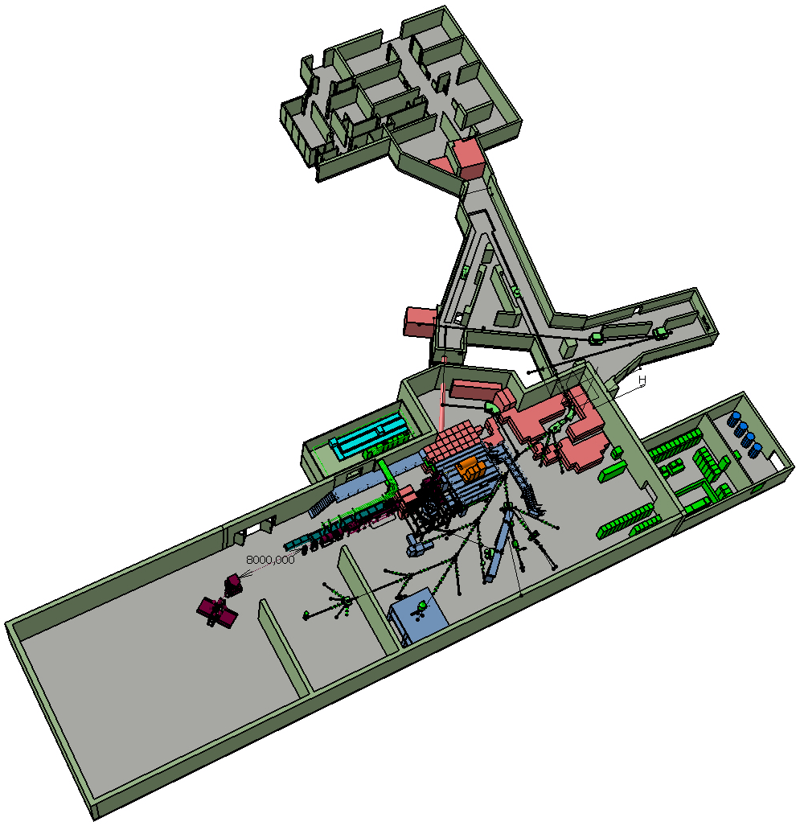
The Scope of the Project
Intensity Upgrade:
Design Study of target Area, Class-A Lab and beam lines
Energy Upgrade:
Construction of SC Linac
& service building
Solid state laser, prototype RFQ cooler for beam purification and quality improvement (complete)
Prototyping of linac cavities (ongoing), energy upgrade up to 5.5 MeV/u
Installation of cryogenic infrastructure
Energy upgrade to 10 MeV/u,
Design study of the intensity upgrade for SPL beams

Slide 25
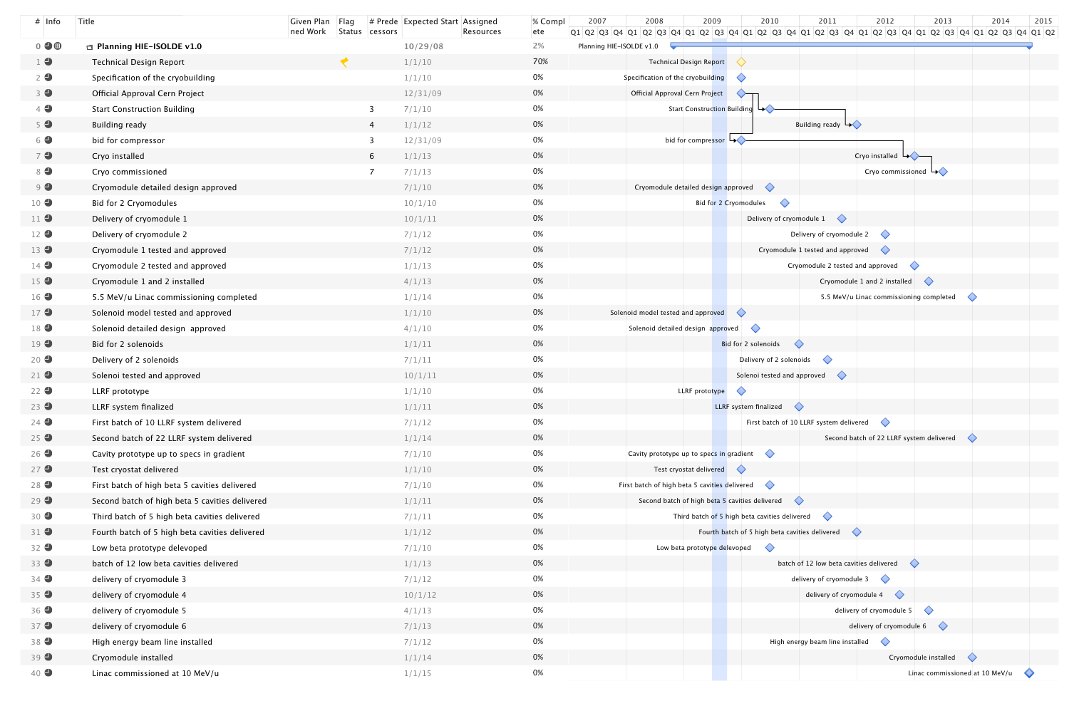
HIE-ISOLDE Schedule
Important milestones for Energy Upgrade:
Start project Jan 1st 2010
Start construction by Jun 2010
Launch Procurement of Cryogenics equipment:
  Market survey by Mar 2010
  Tech. Specific. By May 2010
  Finance Committee by Sep. 2010
Cryogenics installed and commissioned Jun 2013
High energy beam line (5.5 MeV/u) installed by March 2013
Full Linac (10 MeV/u) installed by 2014/2015
Commissioning organized inline with L4 and PSB commissioning

Slide 26
HIE-LINAC WBS
2.0 Linac system |  |  |  | Groups
 | 2.1 Cavity RF |  |  | BE/RF
 |  | 2.1.1 Cavity Design
 |  | 2.1.2 LLRF system
 |  | 2.1.3 Power RF system
 |  | 2.1.4 Tuning and interlocks
 | 2.2 Cavity Manufacturing |  |  | EN/MME-TE/VSC
 |  | 2.2.1 Copper Substrate
 |  | 2.2.2 Surface treatment Nb Sputtering
 | 2.3 Beam Dynamics |  |  | BE/RF-ABP
 | 2.4 Cryomodules |  |  | TE/MSC-EN/MME
 | 2.5 Beam Instrumentation |  |  | BE/BI
 | 2.6 SC solenoids |  |  | TE/MSC
 |  | 2.6.1 Solenoid
 |  | 2.6.2 Current leads
 |  | 2.6.2 Power supply
 | 2.7 Beam transfer line |  |  | TE/MSC
 |  | 2.7.1 Magnets
 |  | 2.7.2 Supports
 | 2.8 Linac integration |  |  | EN/MEF
3.0 Infrastructure
 | 3.1 Civil engineering |  |  | GS/SEM
 | 3.2 Cooling & ventilation |  |  | EN/CV
 | 3.3 Electrical systems |  |  | EN/EL
 | 3.4 Vacuum |  |  | TE/VSC
 | 3.5 Cryogenic system |  |  | TE/CRG
 | 3.6 Power converters |  |  | TE/EPC
 | 3.7 Control system |  |  | BE/CO
 | 3.8 Survey |  |  | BE/ABP
4.0 Installations and commissioning
 | 4.1 Single cavity test |  |  | BE/RF
 | 4.2 Cryomodule test |  |  | BE/RF-TE/MSC
 | 4.3 Linac commissioning |  |  | BE/RF
 |  | 4.3.1 Control applications |  | BE/OP

Slide 27
Target Area Design Study WBS
5.0 Target Study |  |  |  | GROUPS
 | 5.1 Conceptual target design |  |  | EN/STI-HE
 |  | 5.1.1 Target Material
 |  | 5.1.2 Target Design
 |  | 5.1.3 Target handling and storage
 | 5.2 Front ends |  |  | EN/STI-TE/EPC/VSC/ABT
 |  | 5.2.1 HV and high current systems
 |  | 5.2.2 Extraction optics
 |  | 5.2.3 FE design
 | 5.3 Beam diagnostics |  |  | BE/BI
6.0 Target Area and Class-A lab Integration
 | 6.1 Layout upgrade |  |  | EN/MEF
 | 6.2 Cooling and Ventilation |  |  | EN/CV
 | 6.3 Electrical systems |  |  | EN/EL
 | 6.4 Vacuum |  |  | TE/VSC
 | 6.5 Survey |  |  | BE/ABP
 | 6.6 Civil engineering |  |  | GS/SEM
 | 6.7 LL controls |  |  | EN/STI
7.0 Injection and beam preparation
 | 7.1 Beam line magnets |  |  | TE/MSC
 | 7.2 Off line separator |  |  | EN/STI-TE/EPC/VSC/ABT
 | 7.3 Separator areas
 |  | 7.3.1 HRS magnet |  | EN/STI-TE/MSC
 |  | 7.3.2. RFQ cooler |  | EN/STI-TE/EPC/VSC/ABT
 |  | 7.3.3 Pre Separator |  | EN/STI-TE/EPC/VSC/ABT
 | 7.4 Experiment Hall |  |  | EN/MEF
 | 7.5 Beam lines |  |  | PH/SME

