Slide 1
HIE-ISOLDE Project Status Report
CERN, July 3rd 2012
Yacine.Kadi@cern.ch
Project Schedule vs LS1
R&D Activities
High-Beta cavities
Prototype cryomodule
HEBT lines
Procurement
Budget

Slide 2
HIE-ISOLDE versus LS1
Activities during LS1: Civil Engineering (tunnel in hall), Main Services, Cryogenics, Beam transfer Line
Start LS1
3 dec 2012
End LS1:Start Low E physics apr 2014
2011
2012
2013
2014
2015
2016
Q1
Q2
Q3
Q4
Q1
Q2
Q3
Q4
Q1
Q2
Q3
Q4
Q1
Q2
Q3
Q4
Q1
Q2
Q3
Q4
Q1
Q2
Q3
Q4
Beam Transfer Line
☑
TE/MSC, TE/MPE, TE/EPC, TE/VSC
BE/ABP-SU
EN/MME
BE/BI ?
Civil
-->
---->
☑
Cryo
Main services
☑
Ventilation
Cooling water
CM 1&2
Electrical syst.s
CM 3&4
CM 5&6
Handling
5.5MeV/u
10MeV/u
Timeline:
sd
sd
LS1
CM1&2
sd
sd
Dec 2012 - Apr 2014
Main services
(dismantling + installation works)
shutdown
Isolde & REX Ops
Cryo Mod 1 & 2 install
(Isolde normal operations)
Commissioning

Slide 3
R&D Activities: cavity fabrication
Item | Description | Group | Contact Person | Start/End date | Comments
Prototype cavity Q3 | Rolled sheet design | EN/MME | O. Capatina | Finished Apr2012 | Cavity is 20 mm longer (for tuning plate tests). Coated at 600ºC end of May and now undergoing cold RF tests at SM18
Pre-series cavity QP1 | Machined from 3D forged copper billet | EN/MME | O. Capatina | Finished May2012 | Cavity is 10 mm longer. Degreased and undergoing first chemical treatment
Prototype cavity Q4 | Rolled sheet design, special geometry for sputtering tests only | EN/MME TE/VSC | O. Capatina S. Calatroni | Feb2012/ ? | Cavity body and inner antenna manufactured. Still to be EB welded
Prototype cavity Q5 | Rolled sheet design, for sputtering tests @ INFN/LNL | EN/MME BE/RF | O. Capatina W. Venturini | Feb2012/ ? | Cavity body and inner antenna manufactured. Still to be EB welded
Cavity pre-heating system | Radiative screens for pre-heating of the cavity prior to sputtering | EN/MME TE/VSC | O. Capatina S. Calatroni | Jul2012 | Pre-heating system in place and being commissioned

Slide 4
R&D Activities: cavity tests
Item | Description | Group | Contact Person | Start/End date | Comments
Cavity RF tests | Validation of the high-beta prototype cavity performances | BE/RF | W. Venturini | Jan2012/Dec2012 | 10-11 Tests of prototypes (incl. pre-series QP1): 4-5 tests in SM18 until Sep.2012 then IPN-Orsay until Nov.2012 ??
RF coupler | Validation of the prototype RF coupler | BE/RF | W. Venturini/E. Montesinos | Jan2012/Dec2012 | 2 versions to test before procurement of first series
RF tuner | Validation of the prototype RF tuner | BE/RF | W. Venturini | Jan2012/Dec2012 | Simplification of initial design and test
LLRF control | Validation of the prototype LLRF control system | BE/RF | W. Venturini/D. Valluch | Jan2012/Dec2012 | In progress
Procurement of different RF amplifiers, RF cables and connectors for testing and validation underway (E. Montesinos BE/RF)
Procurement of additional temperature sensors underway (process too long and still confusion remains on who is responsible TE/CRG or BE/RF ? Need of a contact person within TE/CRG)

Slide 5
RF Tests - Summary

Slide 6
R&D Activities: Proto Cryomodule
Item | Description | Group | Contact Person | Start/End date | Comments
Vacuum Vessel (incl. top plate) | AISI 316L – 15 mm thick plate with reinforcing ribs, beam and view ports. Top loading | TE/MSC | L.R. Wiliams | May2010/Jun2012 | Design completed, technical specification and drawings in progress. Tender via CATE consortium in Sep 2012
Thermal Shield | Copper shield with brazed pipe | TE/MSC | L.R. Wiliams | May2010/Jul2012 | Design being revised following input from technical review (consider independent cooling circuit with N2 to keep cold as long as possible when He cooling station is down)
Thermal Insulation | A specifically designed clean(able) multi-layer thermal insulation could be installed provided it is not degrading, even in case of accidental venting. | TE/MSC | L.R. Wiliams | May2010/Jul2012 | Not considered for the time being
Cryogenics reservoir and piping | AISI 316L – liquid and gas He line which also cools down supporting frame | TE/MSC | L.R. Wiliams | May2010/Jul2012 | Design completed, technical specification and drawings in progress. Tender via CATE consortium in Sep 2012
Internal support structure | AISI 316L with cooling channels | TE/MSC | L.R. Wiliams | May2010/JuL2012 | Design completed and test setup in SMI2, technical specification and drawings in progress. Tender via CATE consortium in Sep 2012

Slide 7
R&D Activities: Proto Cryomodule
Item | Description | Group | Contact Person | Start/End date | Comments
Alignment / monitoring system | BCAM system (laser + camera) – reconstruct from the pictures of the targets, the position of the active components | BE/ABP | J.C. Gayde | May2010/Apr2012 | System validated and ready for installation and test on first prototype => DR in preparation
Jacks | Vacuum vessel alignment (3 jacks with 6 DOF in total) | TE/MSC | L.R. Wiliams | May2010/Apr2012 | Similar to LHC jacks => DR sent
Procurement of prototype cryomodule (CM1) via CATE collaboration
Alignment mechanism for cavities procured via CATE (design + 2 first units for CM1) => Collaboration Agreement under signature (KE2021) => supplier selected, contract pending
Resources: Tech. drawings, drafting of spec., production follow-up ?
Interconnections with RF, Vacuum and cryogenics defined

Slide 8
R&D Activities: Inter-Cryomodule
Item | Description | Group | Contact Person | Start/End date | Comments
Warm Steerer | Compact Inter-cryomodule Combined Corrector Magnets for the HIE-ISOLDE Project at CERN, MT22 | TE/MSC | J. Bauche | May2010/Jul2012 | Design completed, Prototype manufactured and magnetic measurement done. Procurement to be launched after Technical review in July 2012
Diagnostic Box | Equipped with Faraday cup and moveable slits Bakeable in-situ (temp. > 150 deg C), Cleanable to ISO 5 standard | BE/BI AVS (Spain) | E. Bravin J Galipienzo | Jan2011/Jul2012 | Design completed, Prototype under fabrication to be tested at ISOLDE in July 2012
Fast Valves | Vacuum valves on each side of the cryomodule: One being fast acting one + Important for sizing of safety relief devices and collector + Also to protect upstream and downstream elements | TE/VSC | G. Vandoni | May2010/Jul2012 | Design completed. Number and position of fast valves under study
Support Structure | Common support structure for DB+steerer magnet+vacuum chamber | TE/VSC EN/MME | G. Vandoni L. Faisandel | May2010/Jul2012 | Design in progress

Slide 9
R&D Activities: HEBT Lines
Item | Description | Group | Contact Person | Start/End date | Comments
Magnets | Dipoles: 2 in stage1 + 4 in stage2 Quadrupoles: 22 in stage1 + 14 in stage 2 Steerers: 15 in stage1 + 12 in stage2 + 5 spares | TE/MSC | J. Bauche | May2009/Aug2012 | magnet designs to be completed by August 2012. Issue for dipoles, need to check resources. Manufacturing drawings by end October 2012. Installation could start early as March 2014 – HWC only finished end October 2014. DRs sent – MS being drafted
Diagnostic boxes | DB bodies, actuators and mechanics: 15 in stage1 + 12 in stage2 3 spares | BE/BI AVS (Spain) | E. Bravin J Galipienzo | Jan2011/Jul2012 | Design completed, Prototype under fabrication to be tested at ISOLDE in July 2012. Waiting for production drawings from AVS to be able to find out the expected price. DR sent – MS being drafted ?
Vacuum System | Vacuum equipment: pumps, valves, gauges. Vacuum chambers for normal drift, quads and bending magnet. Normal support chambers Primary manifold | TE/VSC | G. Vandoni | May2011/Aug2012 | Functional Design completed. Vacuum chamber specifications received. DR pending. Chambers to be fabricated at CERN – possible issue of priorities with LS1. All other parts of the vacuum system are existing Framework contracts

Slide 10
R&D Activities: HEBT Lines
Item | Description | Group | Contact Person | Start/End date | Comments
Beamline Element Supports | Support tables: 10 in stage1 + 7 in stage2 Large magnet jacks: 12 in stage1 + 12 in stage2 Small alignment jacks: 66 in stage1 + 108 in stage2 | EN/MME | M. Timmins | Apr2012/Nov2012 | Concept decided with simple table and alignment feet for the quads and the DB/ST assembly. Costing done, DRs pending (should not need MS as below 200 kCHF)
Power Convertors | Dipole Magnets: 4 in stage1 + 4 in stage2 Quadrupole Magnets: 42 in stage1 + 14 in stage2 Steerer Magnets: 30 in stage1 + 24 in stage2 | TE/EPC | D. Nisbet M. Martino | May2009/Sep2012 | DR and MS will follow internal EPC review schedule on June 8th
Beam Optics | TRACE 3D and MADX simulations | TE/ABT BE/RF | B. Goddard A. Parfenova M. Fraser | Jan2012/Jul2012 | High-Energy operation (> 3 MeV/u) is validated. Operation at 0.3 MeV/u needs performance evaluation Error study should include real acceptance of DBs in the piecewise trajectory correction study
Interlocks/Controls | Warm magnet interlocks Beam instrumentation interlocks Vacuum interlocks | TE/MPE BE/CO BE/OP BE/OP TE/VSC | R. Mompo F. Locci E. Pisselli D. Lanai S. Blanchard | Jan2012/Apr2014 | Will need PLC-based system to survey magnets –needs to be dimensioned and DICs made – functional spec in preparation BI controls to be defined Vacuum controls OK

Slide 11
R&D Activities: HEBT Lines
Item | Description | Group | Contact Person | Start/End date | Comments
Integration | Layout, naming convention, HW baseline, survey database | EN/MEF BE/CO | S. Chemli E. Zografos P. Le Roux | May2010/Apr2012 | 3D model of magnets and DBs integrated. Layout revised periodically
Infrastructure/Installation | Cabling, Cooling and Ventilation, Civil Engineering (metallic structures) and planning | BE/OP | E. Siesling | Mar2009/Mar2014 | Need more detailed planning of installation, HWC and beam commissioning phases – to organise after the tendering planning is done
Milestones
Technical Design Review 6th July (incl. interconnection module)
Tendering by December 2012 (incl. interconnection module) => no FC approval required
U-bend moved to stage#1 ?
2012 | 2013 | 2014 | 2015 | 2016
558 | 558 | 558 | 558 | 0 | 2231 | Stage 1
0 | 450 | 450 | 450 | 450 | 1799 | Stage 2b

Slide 12
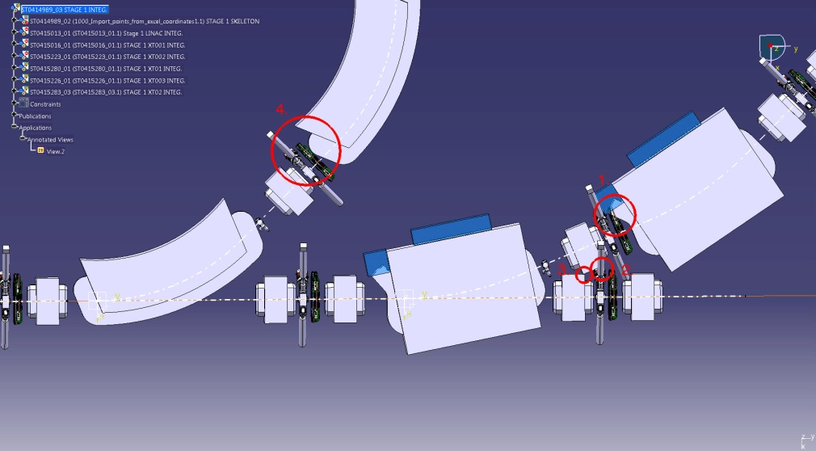
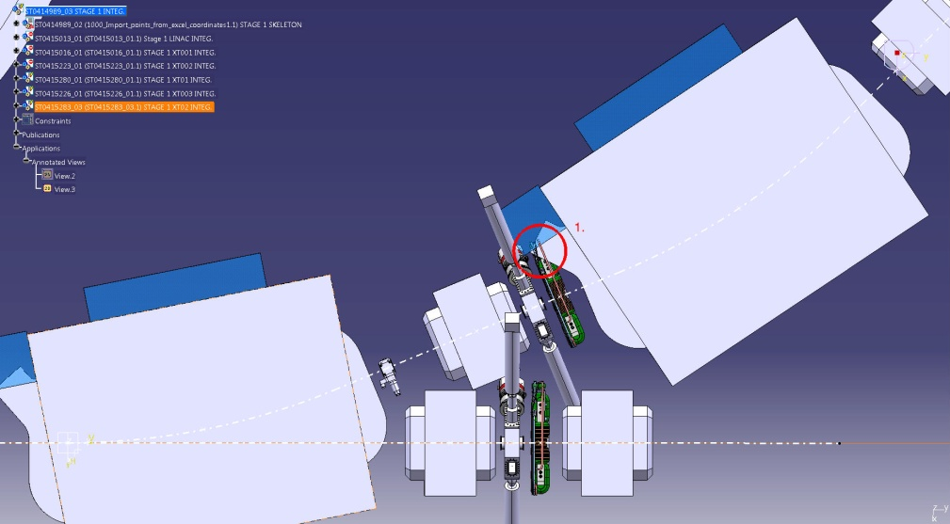
Beamline integration studies
Line and experiments included in 3D model
Several iterations on layout made to solve interferences
Continually increasing level of detail
Next steps are beam pipes and bellows, cables and connections, magnet covers and support structures
Some very tight regions which will need some discussion to approve (e.g. ease of access for maintenance)

Slide 13
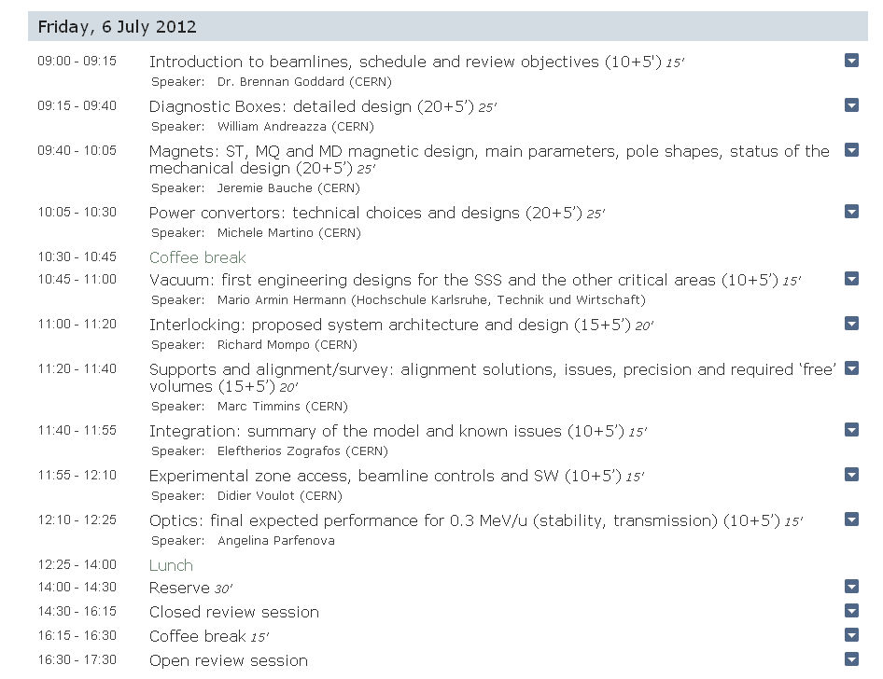
Technical design review
Agenda aimed towards the technical topics

Slide 14
Procurement
Item | Description | Group | Contact Person | Start/End date | Comments
Cavity Pre-heating system | Pre-heating system for the cavity sputtering | TE/VSC | S. Calatroni | Oct2011/Jun2012 | Done: Pre-heating system designed by INFN/LNL => screens !!!
8 kW Generator | 8 kW power supply for the cavity sputerring | TE/VSC | S. Calatroni | Apr2012/Jun2012 | Done: To be replaced by a 10 kW unit for coating of series cavities
Betascope | Betascope for visual inspection of Nb film | TE/VSC | L. Ferreira | May2012/Jun2012 | Done
HP rinsing Machine | Automatic HP pressure cavity rinsing device | TE/VSC | S. Calatroni | Jul2011/Jun2012 | Done: Not yet installed (motorisation and control !!)
RAMSES Ventilation monitors | Ventilation monitoring system for ISOLDE exp. Hall (170) | DGS/RP | J. Vollaire | May2012/Nov2012 | Done
Copper forgings | Procurement of 8 forged copper blocks from 4 different suppliers | BE/RF | K.M. Schirm | May2012/Oct2012 | Done: first 2 blocks by July 2012, then 2 per month
SC Solenoids | Procurement of 4 (+2) SC solenoids for the high-beta cryomodules | TE/MSC | D. Smekens | Aug2012/Jul2014 | On Standby: waiting for stray field tests on cavities in SM18 Solenoids 1 and 2 by T0+10 months Solenoids 3 and 4 by Oct 2013 Solenoids 5 and 6 by Mar 2014

Slide 15
Procurement
Item | Description | Group | Contact Person | Start/End date | Comments
Cryogenic Plant | Procurement of 1400 W cryogenic plant for the HIE-ISOLDE SC Linac | TE/CRG | N. Delruelle | Sep2012/Sep2014 | On Standby: staged installation Stage 1: 1400 W single refrigerator + 1/2 helium compressor + 1 LHe dewar, + cryogenic transfer line with 2 cryogenic boxes (for CM1 and CM2). Stage 2: additional 2 cryogenic boxes(CM3 and CM4) Stage 3: remaining transfer line and cryogenic boxes (CM5 and CM6) + 2 compressor + spare turbines
Clean Room Facility | A clean room facility for the assembly of the HIE-ISOLDE cryomodules | TE/MSC BE/RF | L.R. Wiliams | Jun2012/Jan2013 | On standby: Delivery, installation and validation of the clean room proper (class 100) and clean room buffer (class 10000) are foreseen 6 months from placement of contract
Cooling System | Cooling System for the HIE-ISOLDE infrastructure | EN/CV | P. Pepinster | Jun2012/May2013 | On standby: The contract is expected to be awarded in June 2012 and installation works are foreseen to take place from Nov 2012 to May 2013

Slide 16
Budget Review (MTP-2012)
Total budget of 35.8 MCHF (2010 – 2015 => + 600 kCHF) including CVI of 10% for CERN part:
Total resources of 175 FTE (2010 – 2015) => 105 FTE CERN Staff + 70 FTE External (CATHI + Isolde Coll.)
External funding (incl. Isolde Coll.)
LINAC (17.5 MCHF)
5.5 AMeV + beam line stage1 ~ 8.5 MCHF (6.3 MCHF secured) => 2.5 MEUR application to KAW not successful => funding issue !!
1 FTE from KUL (A. D’Elia: 2012/2013) + New App. to Big Science 2012 (?)
CERN (18.3 MCHF)
Management (0.2 MCHF)
Infrastructure (15.3 MCHF) => +15% (consolidation, CV, CE, HE, test infrastructure)
Design studies for intensity upgrade (1.9 MCHF)
Safety (0.9 MCHF) => +25%
Extra costs
CV (+ 0.4 MCHF) = FSU (2013) + mini-sub-station for demi-water @ 20ºC
HE (+ 0.2 MCHF) = transport of cryomodule + modifications in building 170
TE/VSC (+0.8 MCHF) = HEBT design modif. + FSU (2013-2016)
TE/CRG (+1.6 MCHF) = upgrade from 900 W to 1400 W (2013-2014)

Slide 17
5.5 AMeV Cost Estimate
CATE prototype Cryomodule CM1
Cryomodule (incl. cavities+ancillaries) = 750 kCHF
RF power + control = 300 kCHF
SC solenoid = 82 kCHF
Nb sputtering = 142 kCHF
Miscellaneous = 144 kCHF
Total = 1418 kCHF
Cryomodule CM2
Cryomodule (incl. cavities+ancillaries) = 1136 kCHF
RF power + control = 300 kCHF
SC solenoid = 82 kCHF
Nb sputtering = 142 kCHF
Miscellaneous = 144 kCHF
InterCryomodule Modules (3 units) = 45 kCHF
Total = 1849 kCHF
HEBT Stage1
Magnets = 905 kCHF
Beam Diagnostics = 880 kCHF
Vacuum System = 274 kCHF
Supports = 172 kCHF
Total = 2231 kCHF
Grand Total
5498 kCHF

Slide 18
5.5 AMeV Cost Estimate
Spendings on Team Accounts:
2008 | 2009 | 2010 | 2011 | 2012 | kCHF
455 | 444 | 359 | 394 | - | 1652 | T299558
155 | 167 | 176 | - | - | 498 | T299559
- | 84 | 154 | 223 | - | 461 | T131910
610 | 695 | 689 | 617 | - | 2611 | Total
Available on Team Accounts:
SC Linac + HEBT (stage#1) cost estimate (2012-2015) = 5498 kCHF
2012 | kCHF
- | 1841 | T299558
- | 860 | T131910
Grand Total
8110 kCHF
Missing
2115 kCHF
- | 685 | In-kind

Slide 19
International Collaboration
Technical support via Spanish Training Program
Collaboration with LRF-Huelva project => Discussions ongoing
Collaboration with IPN-Orsay Accelerator Department => cavity tests from Sept – Dec. 2012 + technical support for cryomodule assembly (MoU in discussion)
India to join the ISOLDE Collaboration (signature on April 18 2012, Kolkata) => discussion for in-kind contribution (BARC)
CATE project => Collaboration Agreement ready for signature (procurement strategy for an initial envelope of 600 kEUR) and visit to potential suppliers (cavity substrate, RF coupler, tuning system, and prototype cryomodule)

Slide 20
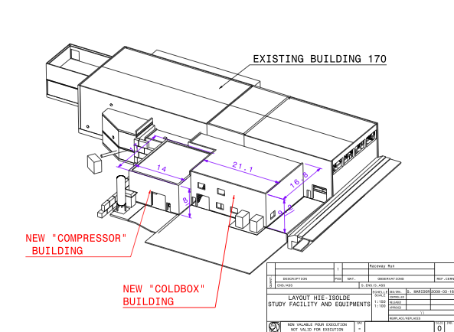
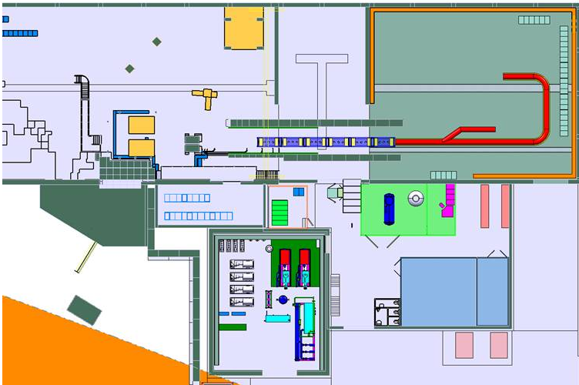
Thank you
HIE-ISOLDE web site -> http://hie-isolde.web.cern.ch/hie-isolde/
CATHI-ITN web site -> https://espace.cern.ch/Marie-Curie-CATHI/default.aspx

Slide 21
External Funds
Title | PPA | Work Package | Code | Dep. | Group | Total Request | Budget Profile Request (kCHF)
 |  |  |  |  |  |  | 2010 | 2011 | 2012 | 2013 | 2014 | 2015 | 2016
External founding |  |  | T299558 |  |  | - | 1784 | 1425 | 2345 | -1091 | -5991 | -10163 | -14682
 |  |  | T131910 |  |  | - | 518 | 647 | 724 | 874 | 1024 | 1174 | 1324
 |  | IN KIND | CATE |  |  | - | 0 | 0 | 375 | 750 | 750 | 750 | 750
 |  | IN KIND | CDTI |  |  | - | 0 | 155 | 310 | 310 | 310 | 310 | 310
 |  | IN CASH | BMB |  |  | - | 28 | 79 | 129 | 129 | 129 | 129 | 129
 |  | IN CASH | KAW |  |  | - | 0 | 0 | 0 | 0 | 0 | 0 | 0
Total |  |  |  |  |  | - | 2330 | 2307 | 3883 | 973 | -3778 | -7800 | -12169

