Slide 1
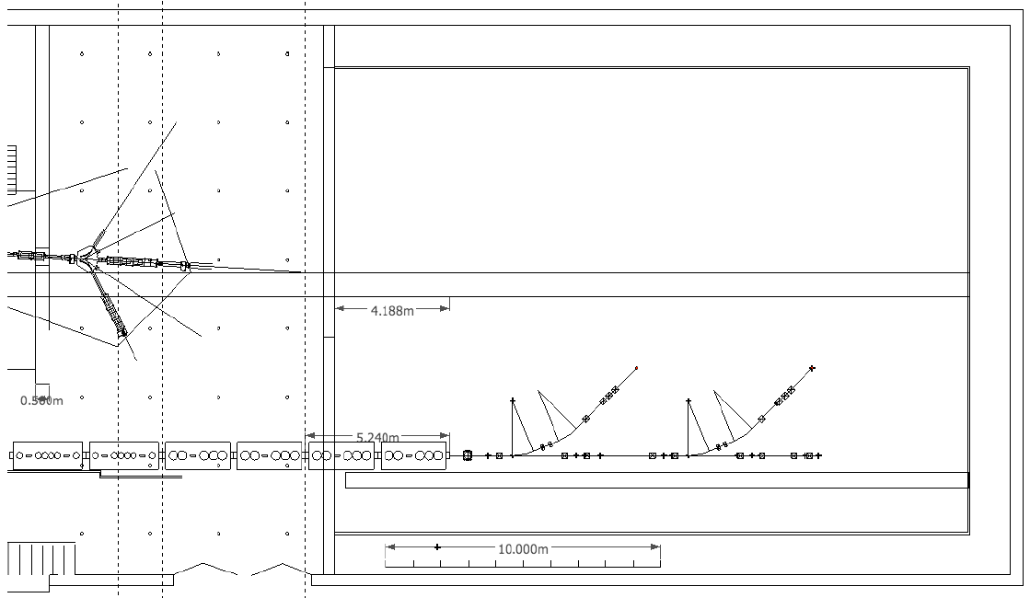
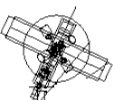
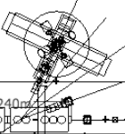
Beam Transfer Line
Actar / Helios
Miniball
Miniball
Beam diagnostics
Stage 1:
Straight line with 2 branches – July 2013-July 2014
Miniball move: Oct 2013 – July 2014
Or.. Miniball move: earlier – if 2013 shutdown

Slide 2
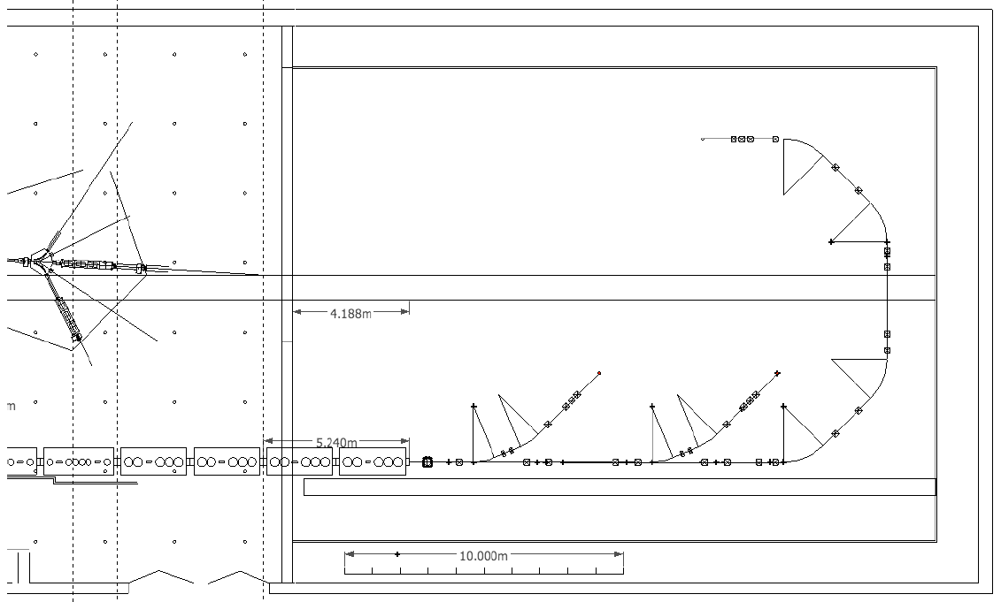
Beam Transfer Line
TSR
Spectrometer
Miniball
Actar / Helios
Miniball
Stage 2:
Stage 3:
The bend
TSR and beyond..
Spectrometer installation and 2nd Miniball move

Slide 3
PH Dept. News
Group budget 2011: 285 KCHF?
2 Students; 3 Fellows (1 MC)
Shutdown in 2013; 19 months(?)
Recent ISOLDE PRLs:
B. Cheal et al.; Nuclear Spins and Moments of Ga Isotopes Reveal Sudden Structural Changes between N=40 and N=50
K. Wimmer et al.; Discovery of the Shape Coexisting 0+ State in 32Mg by a Two Neutron Transfer Reaction
S. Naimi et al.; Critical-Point Boundary for the Nuclear Quantum Phase Transition Near A=100 from Mass Measurements of 96,97Kr
A. Andreyev et al.; New Type of Asymmetric Fission in Proton-Rich Nuclei

Slide 4
News (continued)
Other Publications
Front page of CERN bulletin January
Front page of NPN Dec-Jan
Special issue J. Phys. G on REX Physics.
Date of next ISOLDE workshop: Dec 5-7 (Mon-Wed) or Dec 7-9 (Wed-Fri)?

Slide 5
ENSAR
52440 CHF subsistence paid in Sept-Nov 2010
Next call (Apr-Aug 2011) as soon as schedule is finalized
Julien Thiboud contract extended to Aug. 2013 (50% Collaboration; 50% ENSAR). Available from Sept 2011)
Applied fellow for 2 years to be hired in May (application deadline March 3). Prepare Data acquisition system compatible with SPIRAL2.

Slide 7
Expenditures
Isolde Collaboration (T131900)
2009: 823 122 (incl 300000 HIE-ISOLDE)
2010: 806 750 (incl 300000 HIE-ISOLDE)
Income : 730 000 (F, GR and N have not paid for 2010)
Short term OK, but we need new members.
Balance: 595 889
HIE ISOLDE expenditure (T131910)
2009: 84 166
2010: 181 805
Balance: 392 275

