Slide 1
What is next?
Susanta Lahiri Saha Institute of Nuclear Physics
Kolkata, India

Slide 2
In 2010, the Canadian Organization of Medical Physicists (COMP) met for its 56th annual scientific meeting in the nation's capital, Ottawa to discuss the latest issues of Nuclear medicine.
A dedicated session of the symposium addressed "Medical Isotopes and Imaging: Where do we go from here?".
The session addressed today's problems with the supply of the imaging isotope ^{99m}Tc – an issue that's felt keenly here in Ottawa, with the currently-closed Chalk River nuclear reactor only a two-hour drive away.

Slide 3
Towards building a Radionuclide Bank from proton irradiated Hg and Pb-Bi targets
Our proposal given on 2009 December ISOLDE meeting therefore is still relevant
The 1-2 GeV proton induced spallation reaction on the liquid mercury or Pb-Bi eutectic converter target will produce large variety of radionuclides along with strong flux of fast neutrons.
We would like to develop methods for separate confinement of each radionuclides with high radiochemical and radioisotopical purity.

Slide 4
Why large facilities became so important
Reduced reactor facilities/shutdown of reactors
Limitations of low energy medical accelerators
Example from ¹⁴⁹Tb
¹⁴⁹Tb is among the few promising α-emitters, which are presently projected for human clinical use.
Half life : 4.118 h
Decay modes: EC (82.3%) and α (17.7 %)
α-particle energy: 3.97 MeV

Slide 5
Production routes
Light charged particle (p, α, ³He) induced reactions
¹⁵²Gd(p, 4n)¹⁴⁹Tb
¹⁵²Gd(α, 7n)¹⁴⁹Dy(EC)¹⁴⁹Tb,
¹⁵²Gd(³He, 6n) ¹⁴⁹Dy(EC)¹⁴⁹Tb
proton induced spallation on heavy targets, like Ta, W etc.
heavy ion induced reactions
¹⁴¹Pr(¹²C, 4n)¹⁴⁹Tb
¹⁴¹Pr(¹⁴N, p5n)¹⁴⁹Tb
¹⁴⁴Sm(⁹Be, 4n)¹⁴⁹Dy (EC) ¹⁴⁹Tb ^{142/143}Nd(¹²C, 5/6n)¹⁴⁹Dy(EC)¹⁴⁹Tb
Notes:
light charged particle (p, α, ³He) induced reactions
proton induced spallation reaction on heavy targets and
heavy ion induced reactions

Slide 6
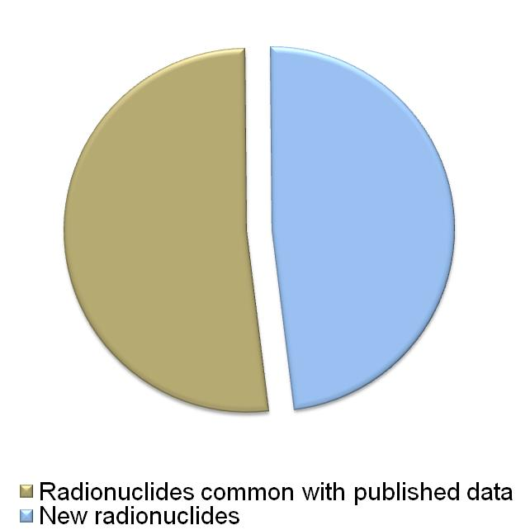
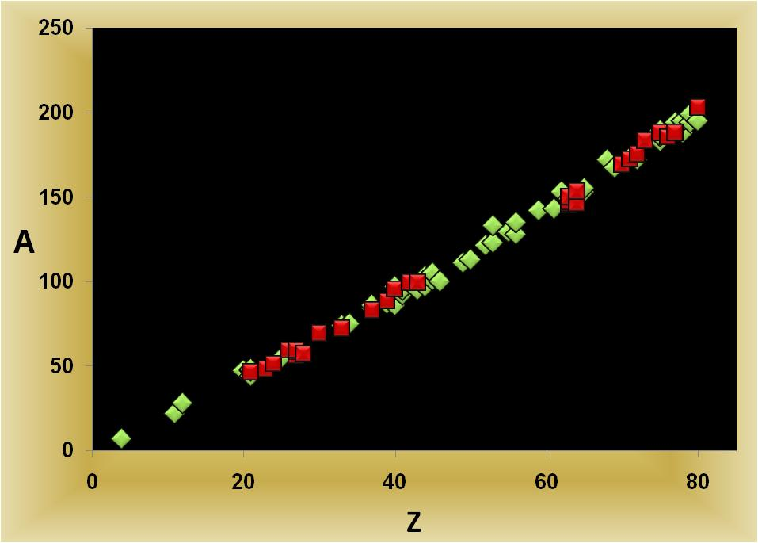
Our aim
Identification of radionuclides
Quantification of each radionuclide
Development of chemical separation techniques
Identified probable radionuclides by our group

Slide 7
Results we found
Radioisotope present | Radioisotopes to be confirmed | Radioisotopes to be confirmed
As-72 (26.0 h ) | As-74 (17.77 d) | Pr-142 (19.12 h)
Co-56 (77.27 d) | Au-194 (38.02 h) | Pt-188 (10.2 d)
Co-58 (70.86 d) | Au-199 (3.139 d) | Pt-195m (4.01 d)
Co-60 (1925.28 d) | Ba-128 (2.43 d) | Rb-84 (33.1 d)
Cr-51 (27.7025 d) | Ba-135m (28.7 h) | Rb-86 (18.642 d)
Eu-145 (5.93 d) | Be-7 (53.22 d) | Re-183 (70.0 d)
Eu-146 (4.61 d) | Ca-47 (4.536 d) | Re-186 (3.7186 d)
Eu-147 (24.1 d) | Co-57 (271.74 d) | Re-189 (24.3 h)
Eu-150m (12.8 h) | Cs-129 (32.06 h) | Rh-101 (3.3 y)
Fe-59 (44.495 d) | Er-172 (49.3 h) | Rh-101m (4.34 d)
Gd-146 (48.27 d) | Eu-148 (54.5 d) | Rh-105 (35.36 h)
Gd-153 (240.4 d) | Eu-149 (93.1 d) | Ru-103 (39.26 d)
Hf-175 (70 d) | Hf-172 (1.87 y) | Ru-97 (2.791 d)
Hg-203 (46.595 d) | Hg-195m (41.6 h) | Sc-44m (58.61 h)
Ir-188 (41.5 h) | I-123 (13.232 h) | Sc-47 (3.3492 d)
Lu-172 (6.7 d) | I-133 (20.8 h) | Sc-48 (43.67 h)
Mo-99 (2.7489 d) | In-111 (2.8047 d) | Se-75 (119.779 d)
Os-185 (93.6 d) | Ir-192 (73.827 d) | Sm-153 (46.284 h)
Rb-83 (86.2 d) | Ir-194 (19.28 h) | Sn-113 (115.09 d)
Re-188 (17.003 h) | Lu-173 (1.37 y) | Tb-153 (2.34 d)
Sc-46 (83.79 d) | Mg-28 (20.915 h) | Tb-155 (5.32 d)
Ta-183 (5.1 d) | Mn-54 (312.12 d) | Tc-95 (20.0 h)
Tc-99m (6.0058 h) | Na-22 (2.6027 y) | Te-121m (154 d)
V-48 (15.9735 d) | Nb-92m (10.15 d) | Tm-167 (9.25 d)
Y-88 (106.616 d) | Nb-95 (34.991 d) | Y-87m (13.37 h)
Yb-169 (32.018 d) | Ni-57 (35.6 h) | Zn-69m (13.76 h)
Zr-95 (64.032 d) | Pd-100 (3.63 d) | Zr-86 (16.5 h)
 | Pm-143 (265 d) | Zr-97 (16.744 h)

Slide 8
Work plan
1
C1 Irradiation and Production of radionuclides
C2/S1 Identification of γ-emitting radionuclides
S2 Chemical separation
S3 Development of sequential separation technique
of clinical radionuclides (T_{1/2} > 7d)
2
C3/S4 Identification of α-emitting radionuclides
C4/E 1 Development of chemical separation technique
for short lived (≤ 1 d) radionuclides
3
S5 Separation and detection of long-lived (T_{1/2} ~100 yr-few Myr) radionuclides
Constrains ?
Safety clearance….
Transport
Finance

Slide 9
Existing reports…
¹²C+¹⁴¹Pr (1963)

Slide 10
Theory…
PACE-II
In order to understand discrepancies in the production of ¹⁴⁹Tb from the natural praseodymium target we made an attempt to measure production cross sections in the same reaction.

Slide 11
Experiment
Pr₆O₁₁ Targets
¹²C beam
2.5-3 mg/cm²
The experiment was carried out at the BARC-TIFR pelletron facility

Slide 12
Our measurement…

Slide 13
Comparison…

Slide 14
Production of ¹⁴⁹Tb was not satisfactory
Possible reasons
^{149m}Tb shows high shielding towards the production of
¹⁴⁹Tb
The high initial angular momentum of the compound
nucleus formed in ¹²C+¹⁴¹Pr reaction likely populates
the high spin (11/2-) isomer (^{149m}Tb) which directly
decays to ¹⁴⁹Gd.
¹⁴⁹Tb (spin 1/2+) is produced only from the decay of low
spin states of the compound nucleus.

Slide 15
Why low cross section?
 |  |  | 7/2- 0
 |  |  | ¹⁴⁹Dy (4.23 min)
 |  | 11/2- 35.8 | ^{149m}Tb (4.16 min)
 | 99.978%  | 1/2+ 0 | 0.022% α
 |  | ¹⁴⁹Tb (4.1 h)
 | 83.3%  |  | 16.7% α
 | 7/2-
 | ¹⁴⁹Gd (9.28 d)

Slide 16
Outlook…
It becomes important to study indirect production route, which may offer better cross section for ¹⁴⁹Tb
For example
¹⁴¹Pr(¹⁴N, 6n) ¹⁴⁹Dy (EC) ¹⁴⁹Tb
¹⁴⁴Sm(⁹Be, 4n)¹⁴⁹Dy (EC) ¹⁴⁹Tb
^{142/143}Nd(¹²C, 5/6n)¹⁴⁹Dy(EC)¹⁴⁹Tb

