Slide 1

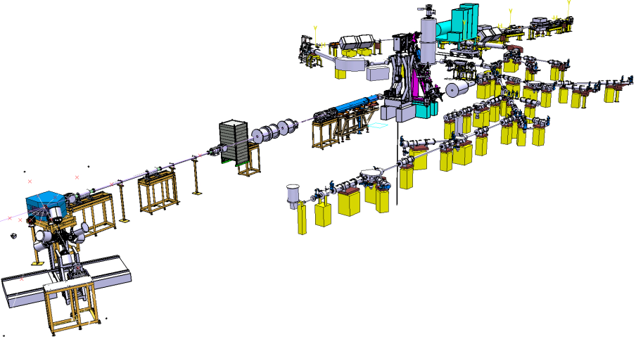
ISOLDE Technical Report
Richard Catherall EN-STI-RBS
ISCC Meeting
4th November 2010

Slide 2
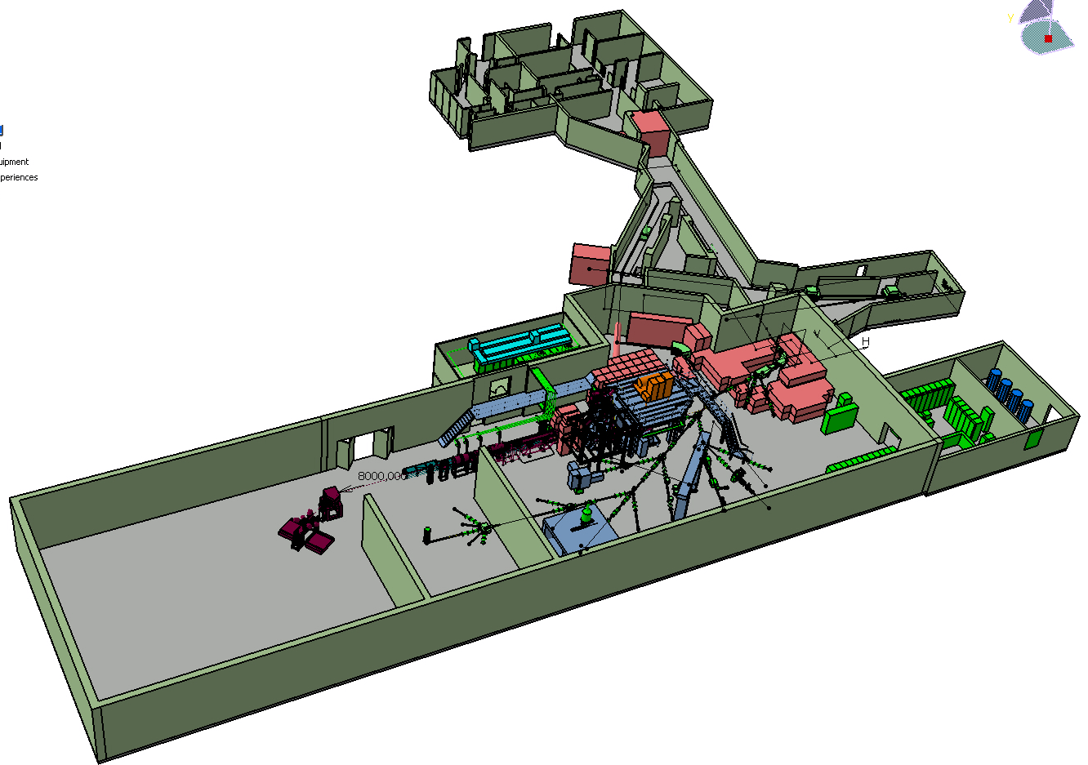
Overview
Operations
  Target Area
  Infrastructure and beam lines
REX
RILIS
Safety
Target Development
Shutdown Work 2010/2011
  Front end #7 installation
  Upgrade of vacuum controls for REX-ISOLDE
News from EN-STI
  Target Area Upgrade Project

Slide 3
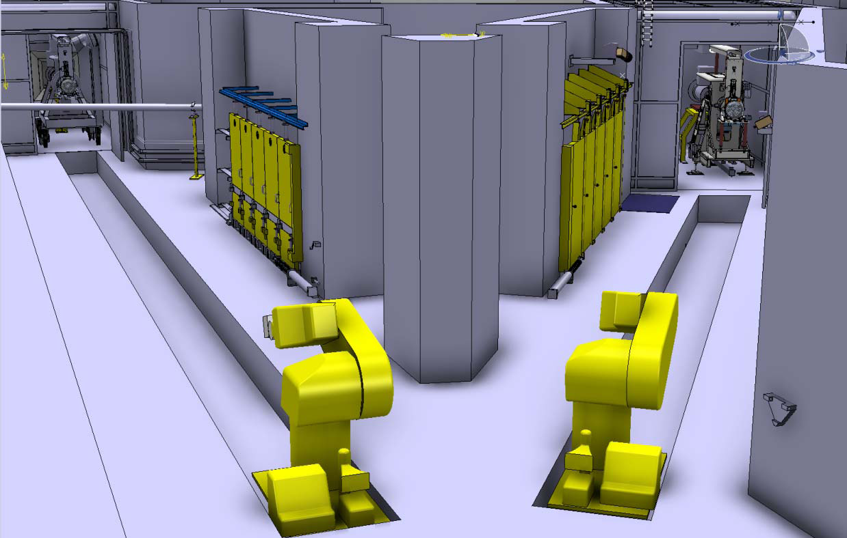
Operations
  Robots
  Robot door relay problem (24 hour delay)
  Flat batteries
  Electronic card failure
  Loss of calibration (4 hour delay)
  Closing of target valve on FE#6
    Prevents re-use of targets as re-coupling is impossible
    Intensive investigations on-going
  Ventilation
    Failure of ventilation pulsing in Class A labs caused a leak of activated air towards the labs.

Slide 4
Operations
Beam Instrumentation
  Exchange of the GPS.FC490 following reports of incomplete movement
  Prototype pico -ampere meters (PAM) running at REX all year
  Keithley system to be replaced by PAM during the shutdown period
Magnets
  Recuperation of “unused” BH15 controllers of HRS to repair GPS magnet control
  New NMR Tesla-meters have improved field regulation problems
  Failure of phase in power supply preventing operation at higher masses a GPS
Water panel
  Failure of pump
  Interruption when changing target
    Regulation of flow
Transformers and target power supplies
  Power off due to water, vacuum interlocks, plc’s
  Vacuum: Second slow vacuum gauge now providing interlock signal to transformer (HT sparks)
  Water: Revision of water panel this shutdown. Close monitoring of flow.
RFQ
  RF amplifier
    Purchase of off-the-shelf amplifier being investigated
  He gas consumption/replacement
HT
  Failure of modulator power supply causing a rise time in HT of 40ms instead of 6ms
    Manual FUG power supply put in place
    New PS to be ordered

Slide 5
Operations
Vacuum controls
New PVSS controls have been used all year, but not without a few minor problems.
  Command memory
    To be addressed in version upgrade during shutdown
  Vacuum threshold between experiment and beam line
    8 E -04 mbar. Please ensure good pumping on experimental side.
ISOLDE Controls
  New application for target start-up
    Includes vacuum sequence and water cooling
  VISTAR
    Modification of beam current averaging to smooth out peaks.
    Target operation features included in VISTAR including HT On or Off
  Logger, request for p-beam logging for experiments
    Logging device to measure all parameters

Slide 6
Overview
Operations
  Target Area
  Infrastructure and beam lines
REX
RILIS
Safety
Target Development
Shutdown Work 2010/2011
  Front end #7 installation
  Upgrade of vacuum controls for REX-ISOLDE
News from EN-STI
  Target Area Upgrade Project

Slide 7
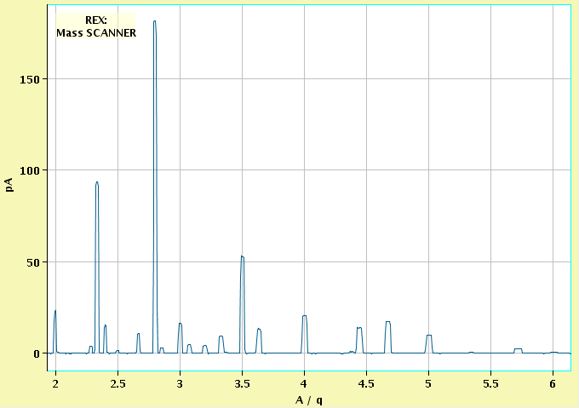
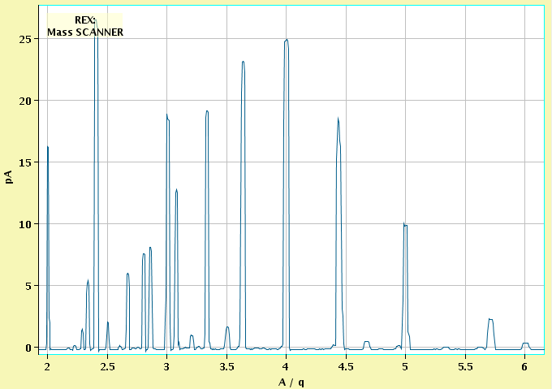
REX-ISOLDE
To improve the beam purity new
NEGs pumps installed in REXEBIS
REX scalability and reproducibility
good (in most cases)
Beams to Miniball from target #433.
15/8 A/q=4 stable EBIS
16/8 208Pb49+ stable Isolde
192Pb45+ radioactive
18/8 87Rb21+ stable Isolde
95Rb23+ radioactive
19/8 93Rb22+ radioactive
20/8 30Na7+ radioactive
99Rb23+ radioactive
23/8 A/q=4 stable EBIS
REX in standby, WITCH uses REXTRAP
30/8 A/q=4 stable EBIS
224Ra52+ radioactive
1/9 97Rb23+ radioactive
2/9 99Rb23+ radioactive
3/9 A/q=4 stable EBIS
224Ra52+ radioactive
4/9 A/q=4 stable EBIS
At least 16 beams in 15 days!
N5+
N6+
N4+
NB! Change of scale.
Ar11+
Ar10+
Ar9+
Ar12+
N3+
Ar8+
Ar13+
Ar7+
July 2008 I_{coll}=179 mA, T_{period}=20 ms, T_{breed}=18 ms
Ar10+
Clear N₂
suppression
Ar11+
Ar12+
Ar9+
Ar13+
Ar14+
Ar8+
N5+
N6+
Ar15+
Ar16+
N4+
N3+
Ar7+
July 2010 I_{coll}=202 mA, T_{period}=26 ms, T_{breed}=24.4 ms
F. Wenander & D. Voulot

Slide 8
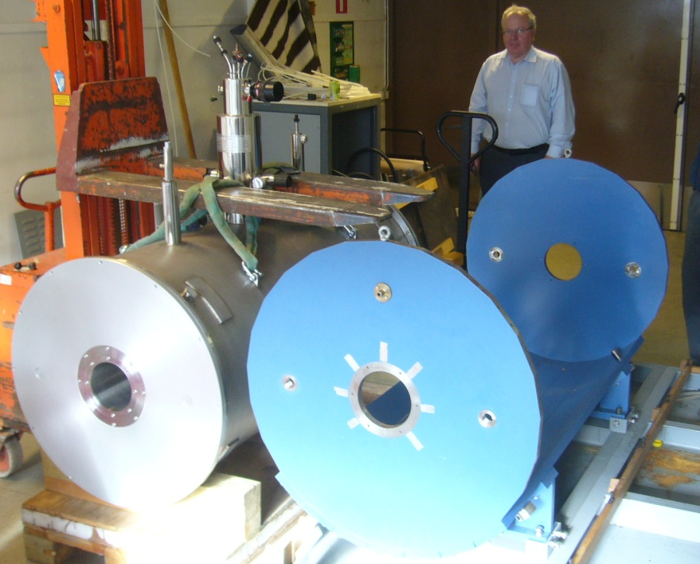
REX - Upgrade and development
1. Consolidation of REXTRAP
* New PLC
Control system
RF system
Beam diagnostics
Application
* Improved Voltage sampling
* Some new power supplies
Ready by beginning of May 2011
2. Consolidation of REX vacuum system
PVSS (remote) control of complete system
Some new gauges and pumps
Ready by beginning of May 2011
3. TwinEBIS arrival from
Manne Siegbahn Laboratory
Act as spare solenoid
test bench for cathodes and guns
Plan Installation during 2010 Q1-Q3
F. Wenander & D. Voulot

Slide 9
Evaluated consequences of long-lived
beams at REX-ISOLDE
Conclusions from meeting
1. INTC informed by RP and the technical committee about the consequences for machine maintenance and chamber openings in case long-lived radioactive beams are accepted.
2. IEFC informed of that measures will be required
3. Apply same beam rules as for the rest of ISOLDE.
4. We will be prepared for the worst-case scenario in terms of measures that need to be taken for maintenance (e.g. air lock / tents around areas to be opened), although, based on the experience from ISOLDE, such measures are very unlikely.
F. Wenander & D. Voulot

Slide 10
Overview
Operations
  Target Area
  Infrastructure and beam lines
REX
RILIS
Safety
Target Development
Shutdown Work 2010/2011
  Front end #7 installation
  Upgrade of vacuum controls for REX-ISOLDE
News from EN-STI
  Target Area Upgrade Project

Slide 11
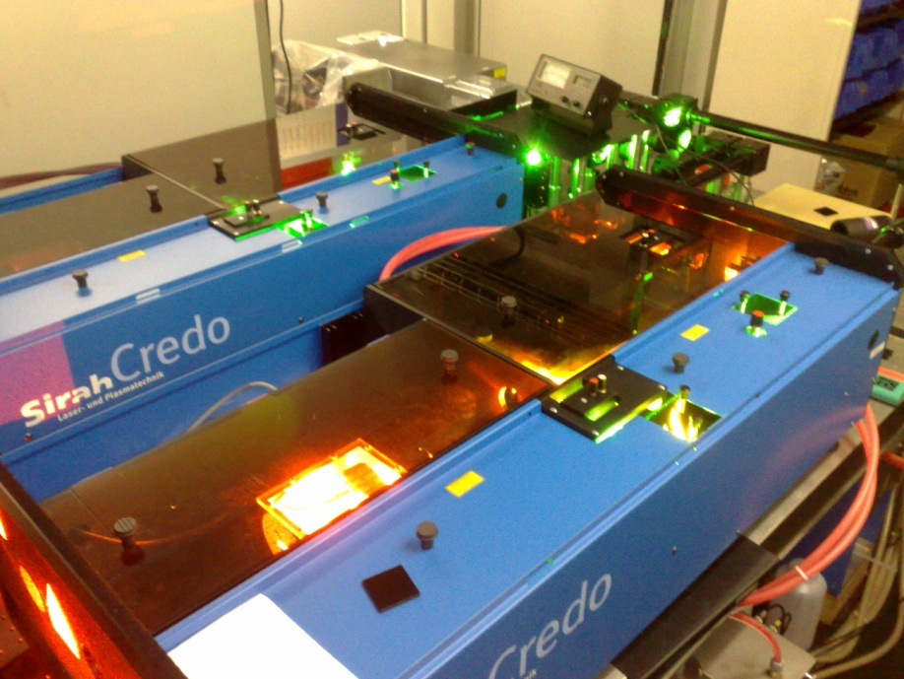
High intensity ISOLDE beams with RILIS
Beams provided by RILIS in 2010:
Mg, Cu, Ga, Tl, Be, Pb, Mn, Au, Be, Zn, Ag
Au
Be
673.9 nm
IP=9.23 eV
IP=9.32 eV
297.3 nm
306.5 nm
267.6 nm
234.9 nm
Gold isotopes
²⁰¹Au, ²⁰³Au, ²⁰⁵Au successfully produced and studied
Beryllium isotopes
Production of ¹⁰Be, ¹¹Be, ¹²Be increased x 4.
UCx target #438
measured 12.10.2010:
¹¹Be – 2x10⁷ at/μC
¹²Be – 8x10³ at/μC
V. Fedosseev

Slide 12
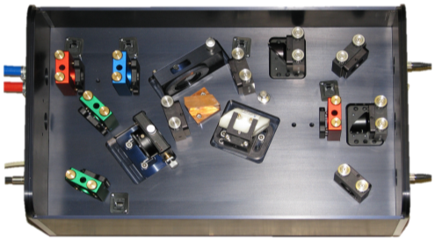
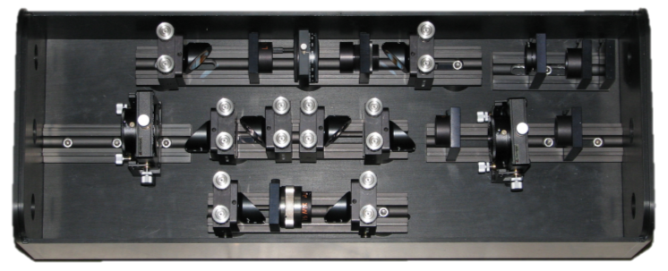
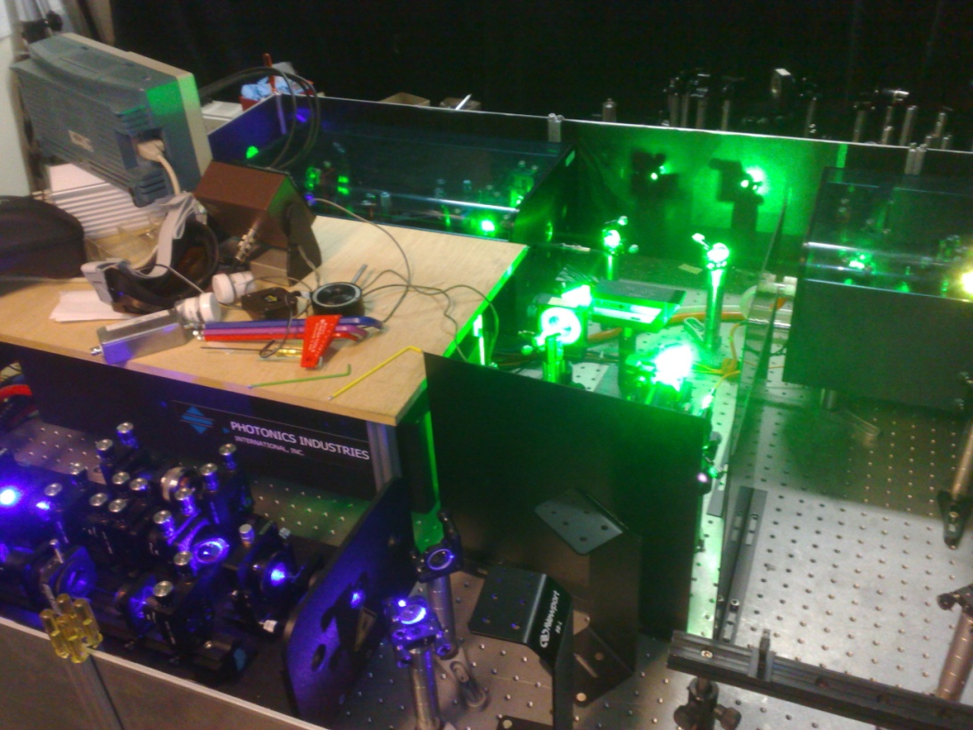
New lasers for RILIS
Three Ti:sapphire laser units were constructed and tested
(PhD student S.Rothe)
Wavelengths in the near infra-red range 690 - 940 nm are obtained
The Frequency Conversion Unit (FCU) allows generation of wavelengths in the blue and UV range
Installed at the ISOLDE off-line mass separator for testing the Laser Ion Source Trap (LIST)
To be installed at RILIS during the winter shut down
Ti:Sapphire laser
Frequency Conversion Unit
V. Fedosseev

Slide 13
Overview
Operations
  Target Area
  Infrastructure and beam lines
REX
RILIS
Safety
Target Development
Shutdown Work 2010/2011
  Front end #7 installation
  Upgrade of vacuum controls for REX-ISOLDE
News from EN-STI
  Target Area Upgrade Project

Slide 14
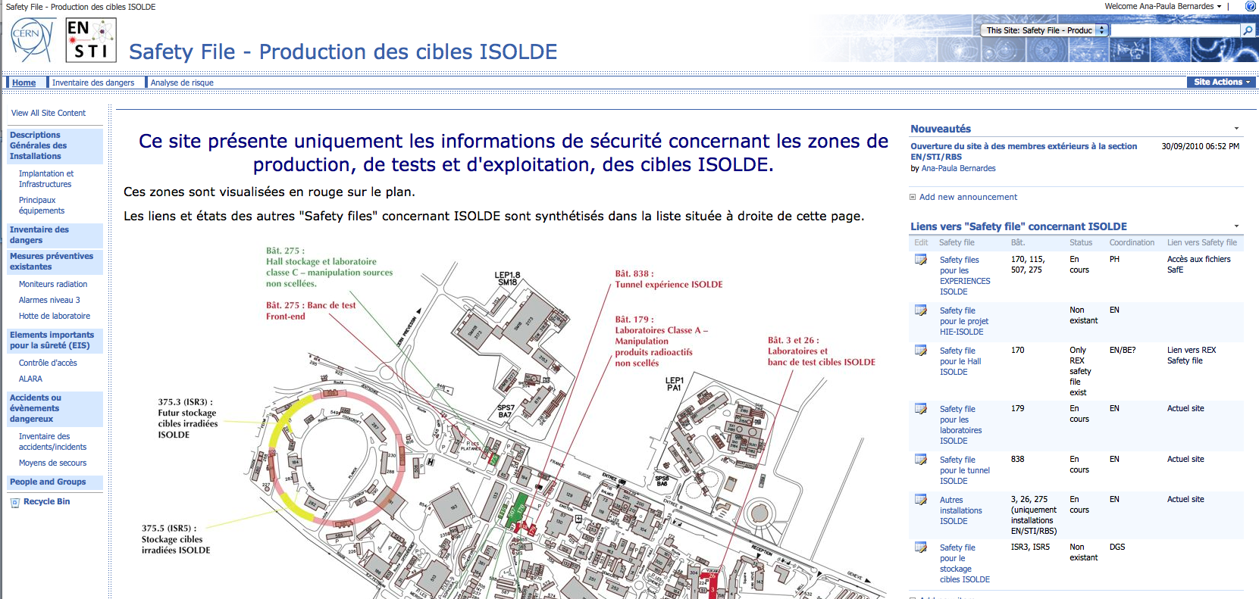
Safety at ISOLDE
SAFETY FILE for ISOLDE primary facility under development
Courtesy of A-P Bernardes

Slide 15
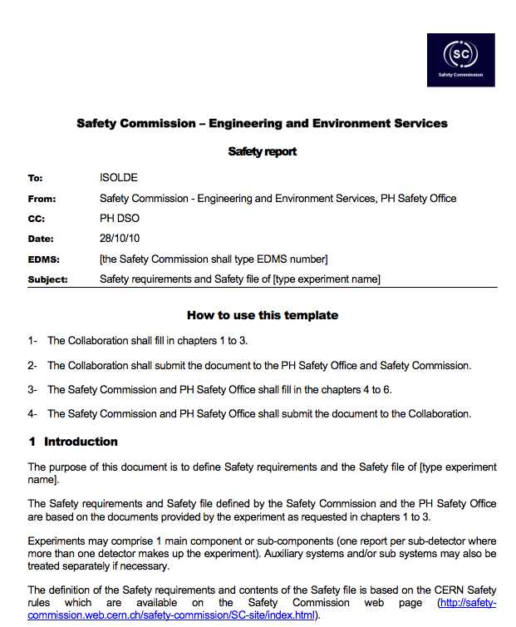
Safety at ISOLDE
SAFETY FILE for ISOLDE primary facility under development
- ISOLDE primary facility used as pilot
SAFETY FILE draft presented to BFSP (Beam Facilities Safety Panel)
- Complementary to Safety file for experiments requested by PH DSO (Departemental Safety Officer)
Courtesy of A-P Bernardes

Slide 16
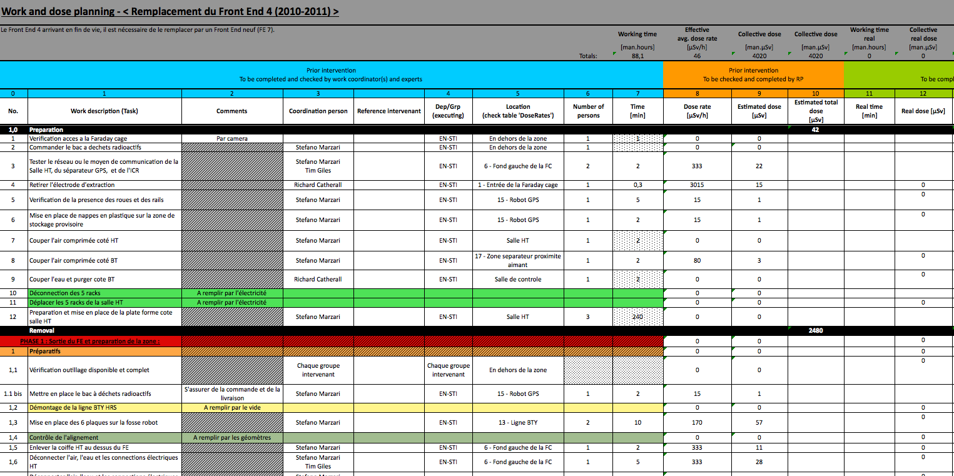
Safety at ISOLDE
ALARA procedure for Front-end 7 installation
Courtesy of A-P Bernardes

Slide 17
Overview
Operations
  Target Area
  Infrastructure and beam lines
REX
RILIS
Safety
Target Development
Shutdown Work 2010/2011
  Front end #7 installation
  Upgrade of vacuum controls for REX-ISOLDE
News from EN-STI
  Target Area Upgrade Project

Slide 18

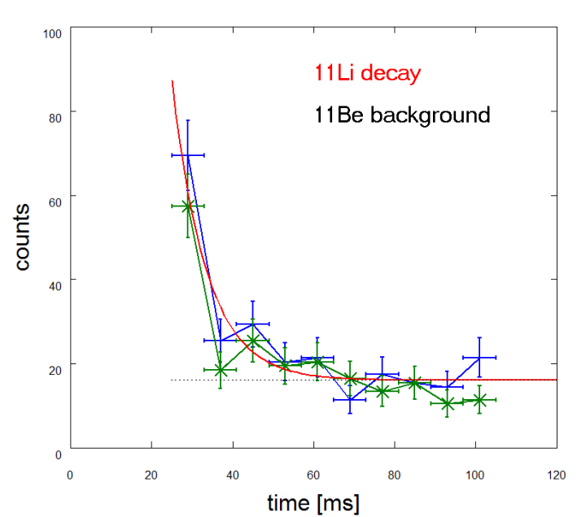
TISD – Target & Ion Source Development
Latest news :
n-rich Au beams 201, 203, 205Au delivered from UC435-W + RILIS
JRA2 – ActiLab has started within FP7
(development of UCx targets)
High density UC target UC440-W (alkalis+Ag) under investigation (collaboration IPNO, GANIL, INFN, PNPI, TRIUMF, ORNL, CERN-ISOLDE)
Further exploitation of the Fast Tape Station
  To be used as the default TS in 2011
Thierry Stora & T. Giles

Slide 19
TISD – Target & Ion Source Development
Collaborators:
Pekka Suominen (plasma ion sources)
Alex Gottberg (target materials)
Raul Luis (ITN, Lisbon) (n,X) reactions with neutron converter (PhD student)
Christoph Seiffert (effusion of molecular beams, PhD student)
Post doctoral fellowship (tbd) for UCx (FP7-ENSAR)
Thierry Stora

Slide 20
Overview
Operations
  Target Area
  Infrastructure and beam lines
REX
RILIS
Safety
Target Development
Shutdown Work 2010/2011
  Front end #7 installation
  Upgrade of vacuum controls for REX-ISOLDE
News from EN-STI
  Target Area Upgrade Project

Slide 21
FE#7 - Justification
The Front End #4 in place was installed in 2001
  Expected lifetime 5 years
  Radiation hardening of materials
The 60kV acceleration voltage can no longer be maintained
  Maximum voltage 40kV
  Change of extraction electrode tip only helped slightly
  Extraction electrode arm very dirty and cannot easily be cleaned
Breakdown of HT transfer insulator imminent
  Reinforced with Stycast epoxy for the second time in 2010
Postponement to next long term shutdown (option)
  2012 or 2013
  Operation at 30-40 kV
  Infrastructure required to test new FE#7 in situ not guaranteed until very end of shutdown.
And as from midnight this morning, the ventilator cooling of the GPS FE has stopped functioning.
  Estimated lifetime of pumps without cooling – 4 days

Slide 22
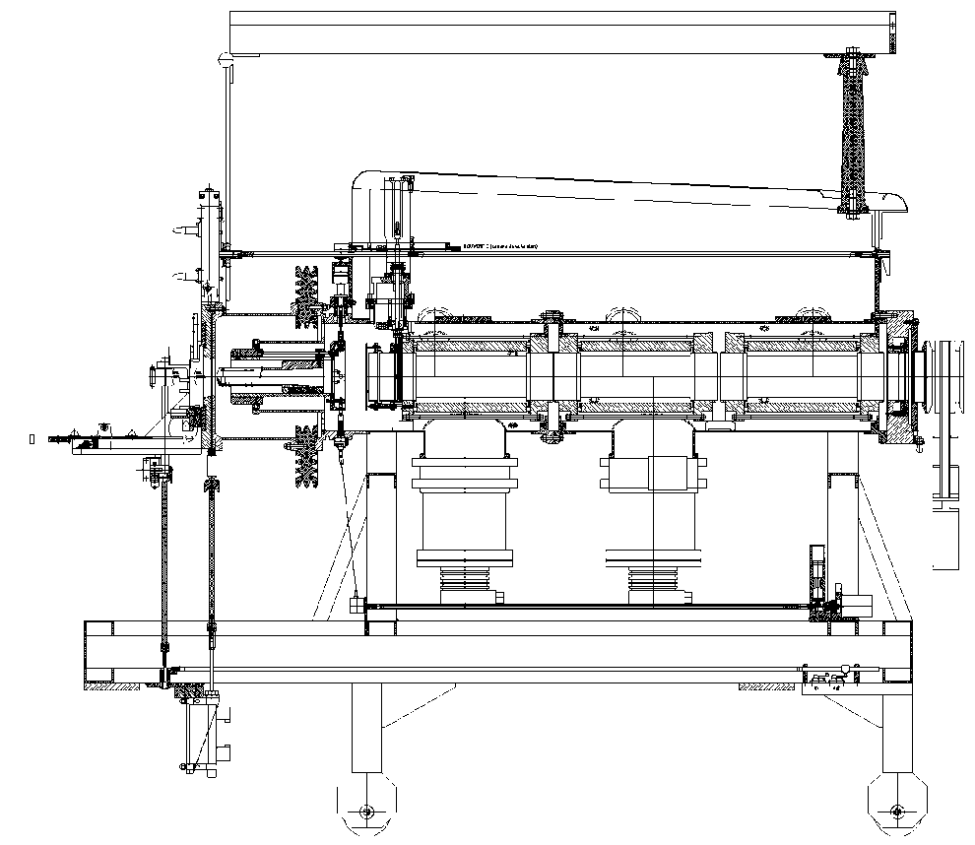
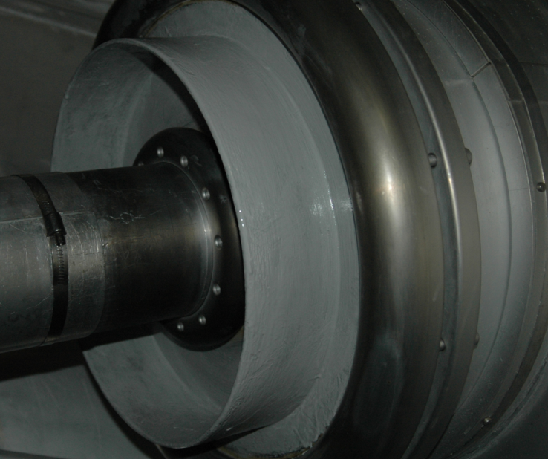
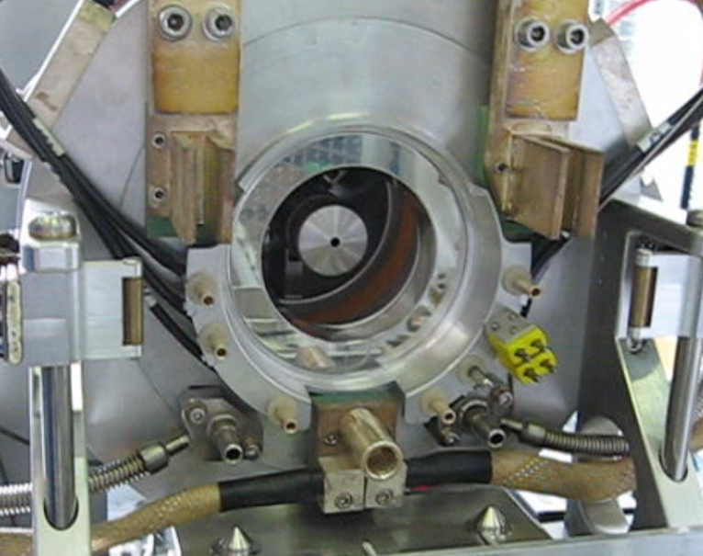
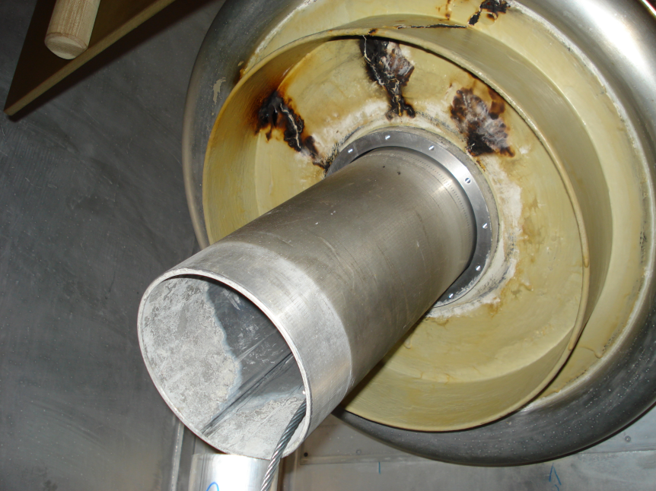
FE#7 - Justification

Slide 23
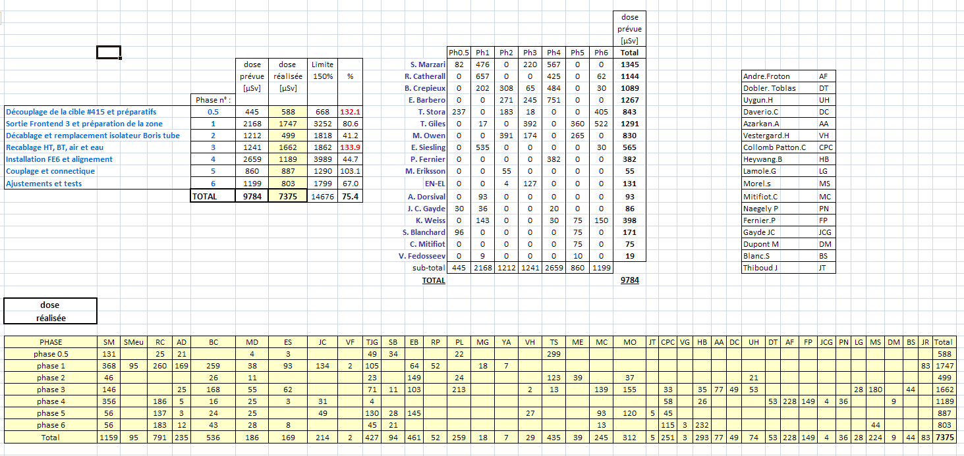
FE#7 - Experience from FE #6 Installation
Collective dose 75% of first estimate
Rigorous follow-up and documentation of all phases
  Weekly briefings
More detailed work planning
EDMS doc. 1068280
  For images
RP report EDMS 1095195
  Visualization
  Transport to ISR
Parallel preparation for FE#7
  Controls, cabling, tests
Stefano Marzari

Slide 24
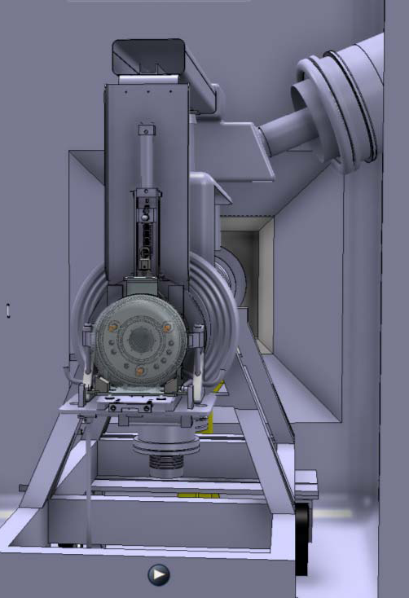
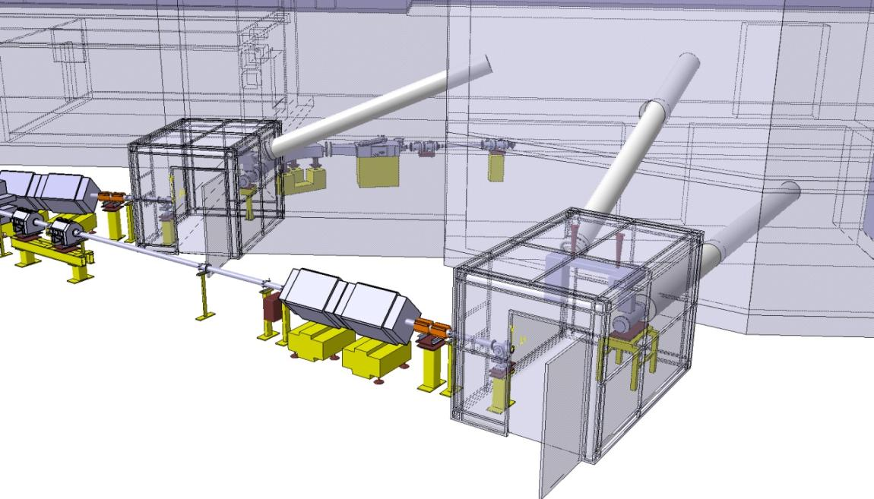
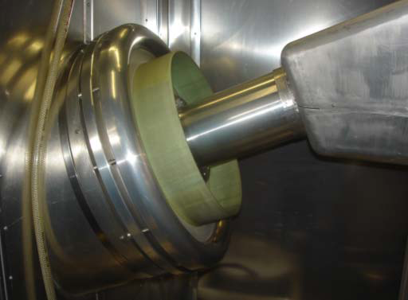
FE#7 - Differences
HT transfer tube at 90 deg and enters directly into HT racks in HT room
BTY line needs to be removed
Stefano Marzari

Slide 25
FE#7 - WDP and RWP
Work Dose Planning
  Each participating support group will be responsible for estimating its role and intervention time in the radioactive zone.
  Currently under completion, deadline today.
Radiation Work Permit
  To be completed by RP as a function of WDP.
When both are completed.
  Present documents to RP and RSO who will then present a summary to the accelerator sector head asking if an ALARA committee should be requested.

Slide 26
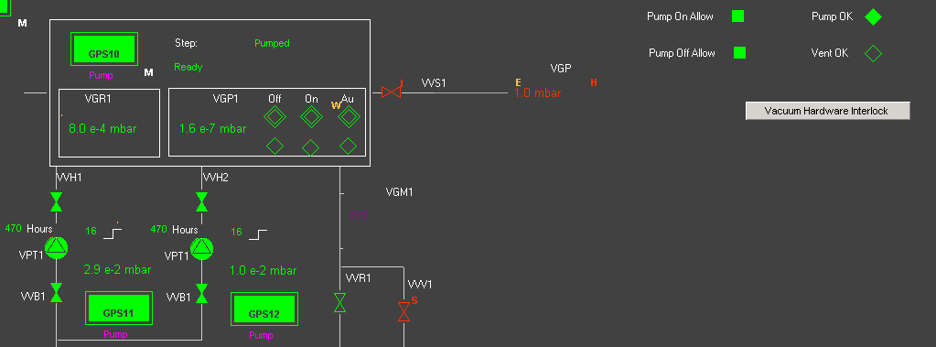
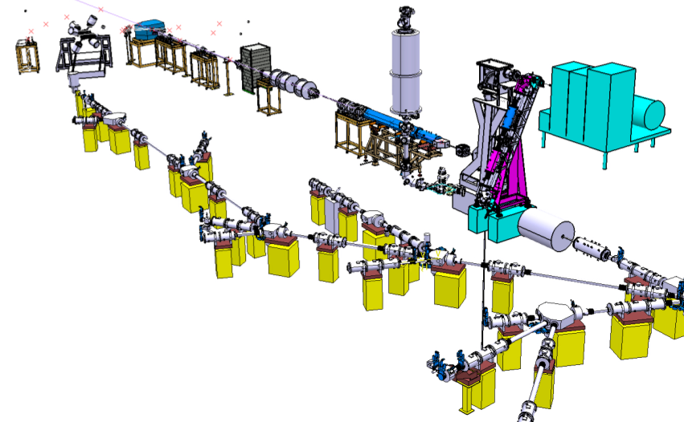
REX Vacuum Controls Upgrade
Hardware
Pumps, Instruments Layout
Cables Layout (DIC)
Crates & Racks design
Equipment procurement and assembly
Crates Assembling
HW Installation
Cable Installation (and removing)
HW commissioning
Software
Logic (Stepper + Interlocks)
Data Base
I/O and Field Objects Specs
PLC Development
SCADA Development
Software deployment
Software commissioning
Same Software system than Vacuum ISOLDE v2 with some additional processes and modes :
- New Process for Cryo pump (including temperature measurement)
- New Process for the Turbo pumps used as pre-compression stage
- New Option mode “Bakeout” for RexEbis
Sebastien Blanchard

Slide 27
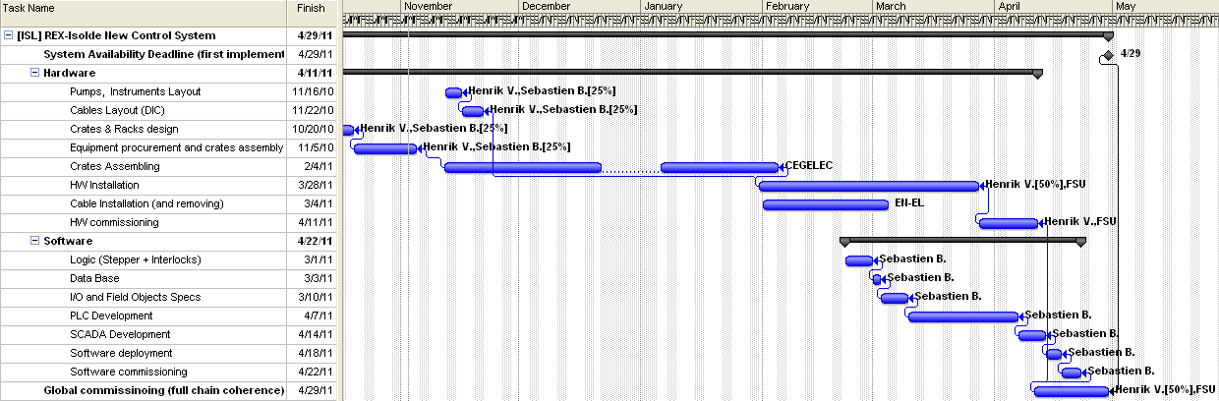
REX Vacuum Controls Upgrade
REXTRAP, BTS & SOURCE sections to be ready for end of March 2011
New system commissioned end of April 2011
Sebastien Blanchard

Slide 28
Overview
Operations
  Target Area
  Infrastructure and beam lines
REX
RILIS
Safety
Target Development
Shutdown Work 2010/2011
  Front end #7 installation
  Upgrade of vacuum controls for REX-ISOLDE
News from EN-STI
  Target Area Upgrade Project

Slide 29
News From EN
Target Area Upgrade Project
  Robots
    EN-HE
  Visualization
    EN-HE
  Hot Cell
    EN-STI
  Waste disposal pathway
    EN-STI & RP

Slide 30
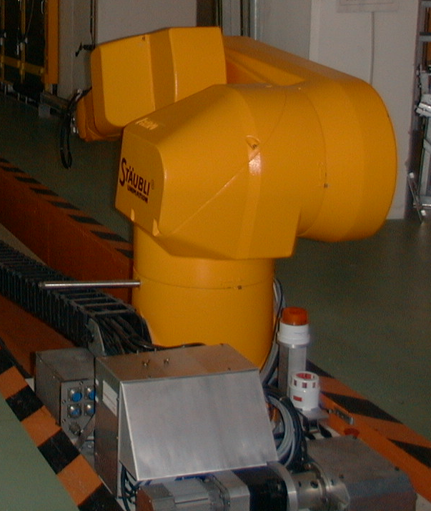
Robot replacement
Lack of contingency to recuperate situations after a failure of the robot system.
Ageing of system leading to an increase in breakdown frequency.
Modifications of current programs not possible
Spare parts are becoming sparse
Need a more reliable and flexible system
Remove robot from high dose rate in target area
  Maintenance, and rad hard issues

Slide 31
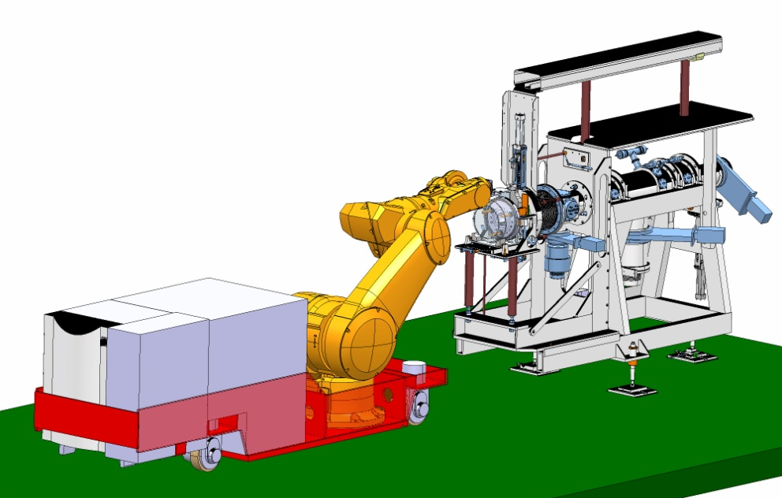
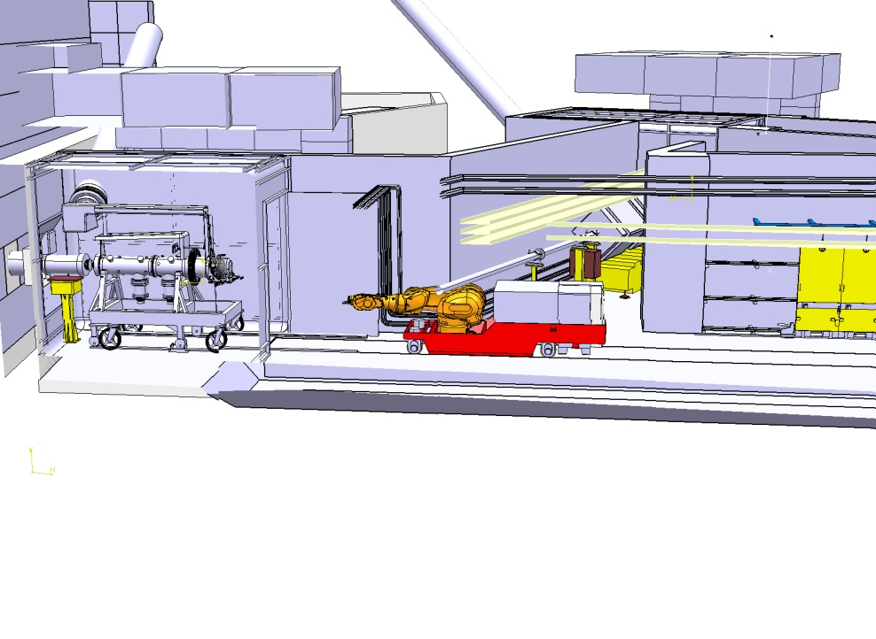
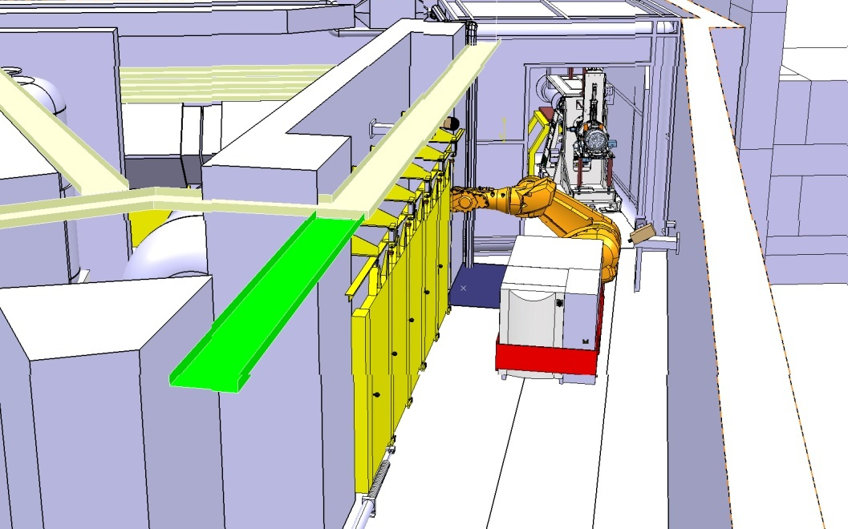
Robot - Conceptual design - robot on AGV
AGV parks outside target area during ISOLDE operation
Trenches filled-in for better front end exchange
More flexibility with AGV operation
K. Kershaw

Slide 32
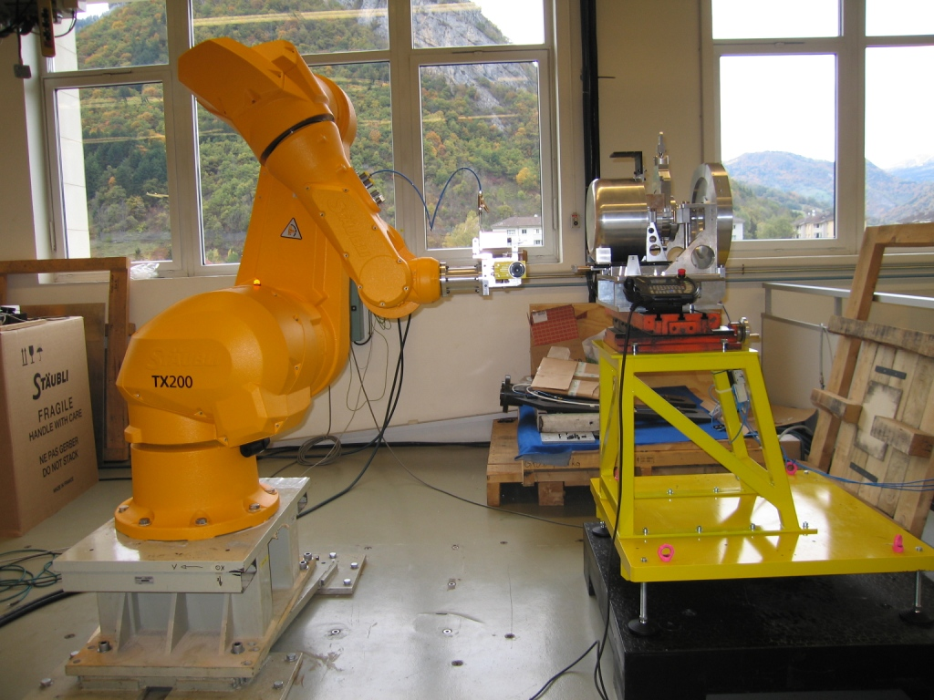
Robot- Initial Tests at Staubli
Robot-mounted camera checks position of support before placing target.
Trials demonstrated correction for support movements of over 50mm
To be used for target confinement tests in 10 days
K. Kershaw

Slide 33
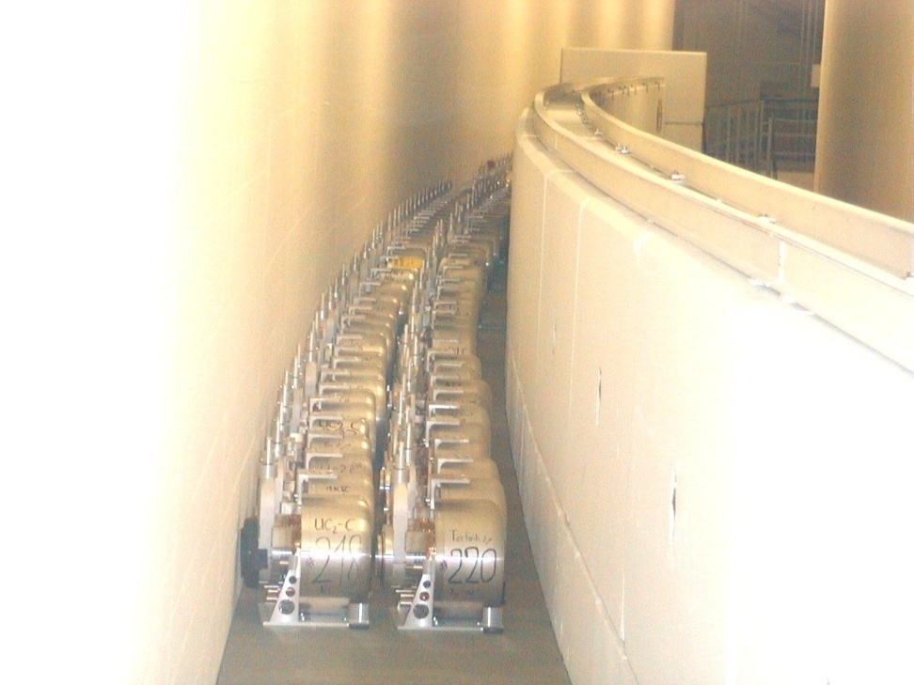
Waste elimination -Background
ISOLDE uses thick targets (about 100 different target/ion-source combinations)
ISOLDE uses about 25 targets per year – ranging from SiC to UC and ThC targets
ISOLDE user community requests about
50 – 60 % of beam time from Actinide targets (UC and ThC) => production of about 15 UC and ThC targets per year
Used targets are temporarily stored in ISR5 gallery (simple and cheap installation dating from late 90th)
-> Temporary storage saturated with about 200 targets stored on one level

Slide 34
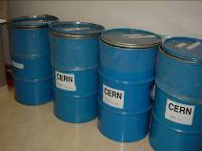
ISOLDE Target Disposal
=> PSI insists on dismantling of ISOLDE targets and separation of components according to chemical composition into 4 categories as required by NAGRA :
  aluminium, target material and ion source, other metals, organics and ceramics
2006 – 2009: 4 target dismantling campaigns of light targets (54 targets) with acceptable low dose rate had been performed
Requirements for further dismantling
  targets of a higher dose rate and actinide
  targets require a hot cell for dismantling
  actinide targets require oxidization prior to
  disposal – on request by PSI
  89 UC2 targets + 9 Th targets

Slide 35
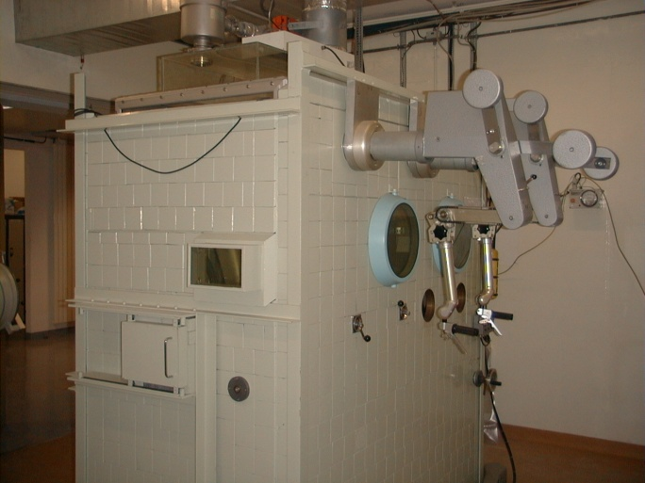
Status
Hot Cell for target dismantling
  Compatible with remote handling and waste treatment.
  Initial feasibility specs done
  Initial delay because of lack of resources
  Expected time line 3 years but start delayed due to
    Oxidation process must be part of the specs
    Need to provide buffer zone for target storage and confine target units
  One outside company replied to the possibility of out-farming
    1.17 MEuros, without transport and containers
    Hot Cell would be located in Dresden.
    Oxidation and preparation for PSI not considered
Oxidation of UC₂ to UO₂ as required by the Swiss authorities
A new “buffer” zone for target storage at ISR
  Containment of future targets
    To be compatible with future dismantling facility
  Remote handling and new shelf system

Slide 36

UC₂-Bristol University Collaboration
Extended experience in working with actinides in collaboration with AWE.
BU have the infrastructure and license to carry out experiments
4 work packages
  Characterisation of starting material
  Imaged oxidation experiments
  Gas cell water vapour oxidation experiments
  Microbalance oxidation experiments
To build a complete picture of the oxidation process…
  XRD, XPSD, FIB, EBSD, SEM, RGA, gas rigs
Process to be adopted and included in Hot Cell specs.
UC samples have finally arrived at Bristol University and work is starting.
  Delay due to time required to export pills > 3 months
Results by April next year

Slide 37
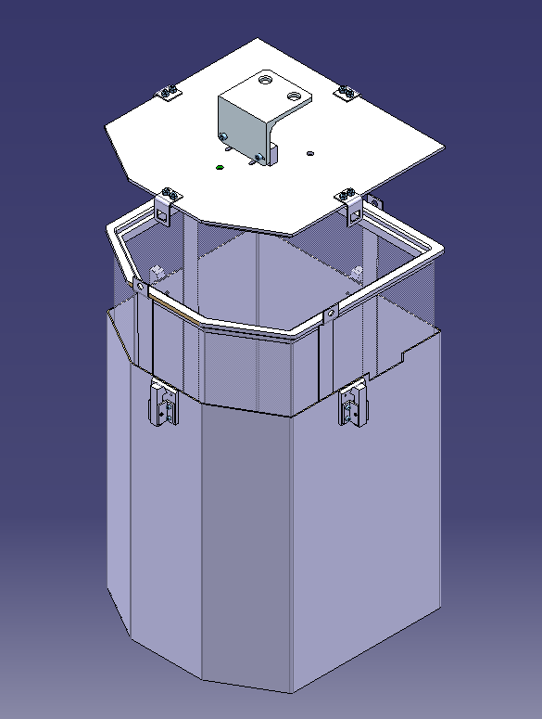
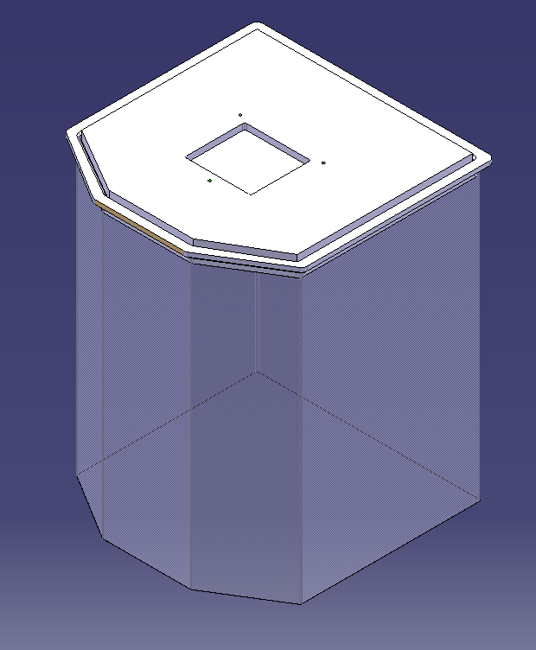
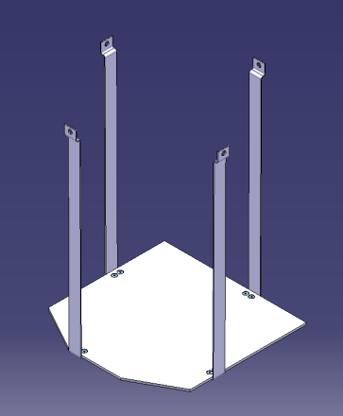
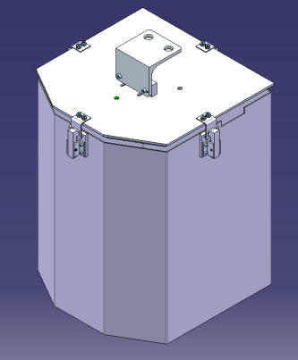
Handling in target area
Storage of used targets in sealed drums
  Addressing the problem of radon out gassing
  Compatible with new robot system, new shelf storage and new hot cell
  Prototype available this week
  To be tested with robot installation rented at Staubli, Faverges.
Metal cage to support plastic containment and allow handling
Plastic containment
(sealed with glue)
Outer aluminium drum to protect plastic bag
Alexander Stadler EN-STI

Slide 38
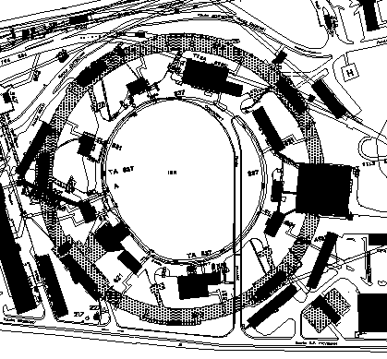
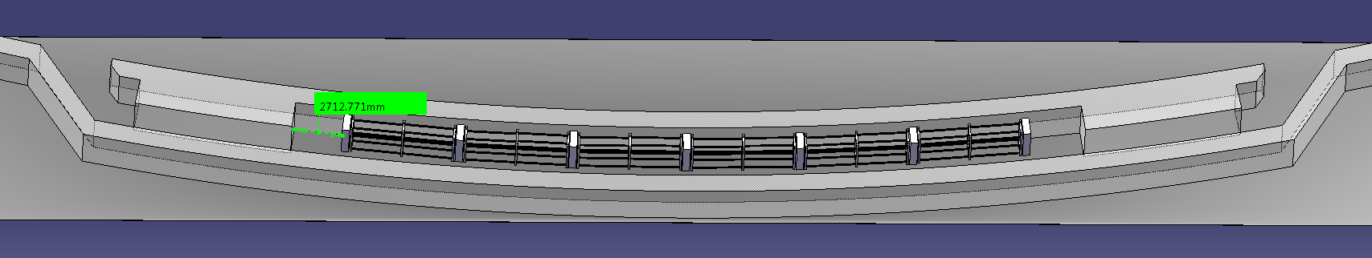
Storage in ISR3
Allows buffer time/space for the installation and commissioning of the Hot Cell
Space for 6 standard shelf units
  On each shelf unit space for 24 targets
Space for minimum 144 targets (4-5 years of ISOLDE operation)
Installed this coming shutdown
Alexander Stadler EN-STI

