Slide 1

ISOLDE Technical Report for the ISCC
Richard Catherall EN-STI
CERN, 6th July 2011

Slide 2
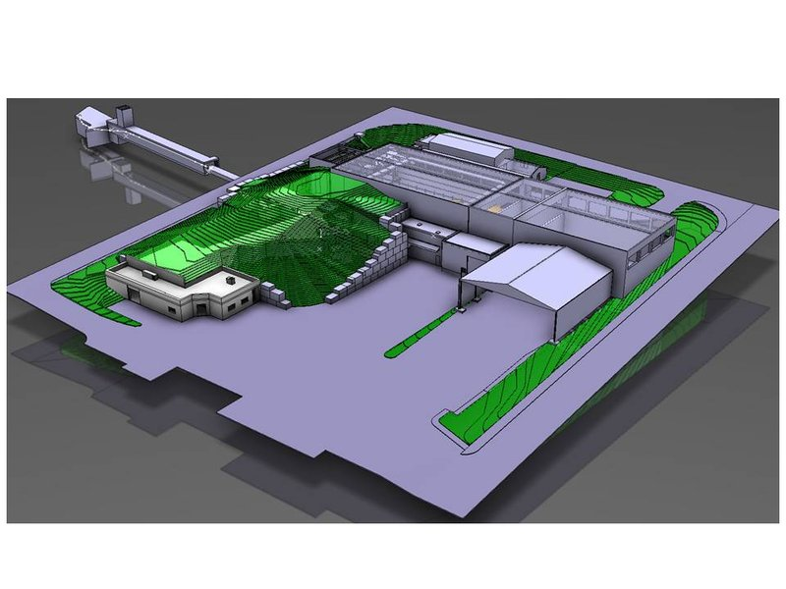
Agenda
Start Up 2011
  Front Ends
    Front End #7
    FE#6 corrections
  Targets
  REX upgrade
  RILIS upgrade
  Machine Issues
    GLM Deflectors
    Water cooling
    RFQ Cooler
    Merging switchyard
    Robots
Safety
Shutdown 2011/2012

Slide 3
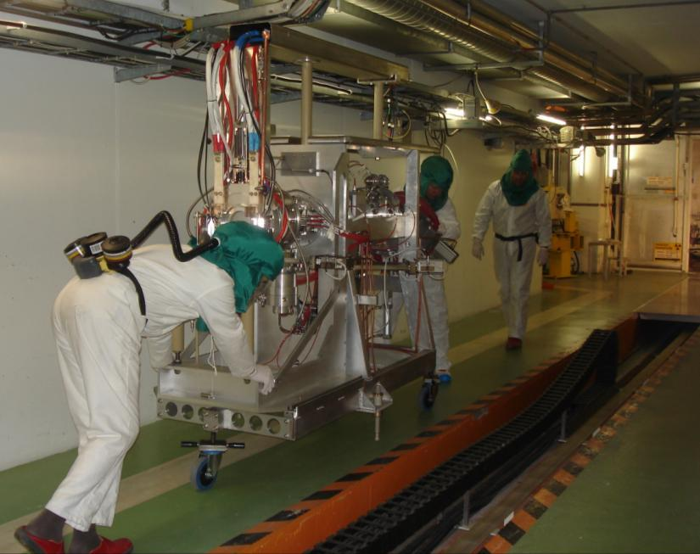
Front End #7
Successfully installed and commissioned on time.
Identical to FE#6 with the addition of an RF connector.
Excellent planning and follow up meetings
82% of expected total collective dose calculated in ALARA committee
Thank you to all participants

Slide 4
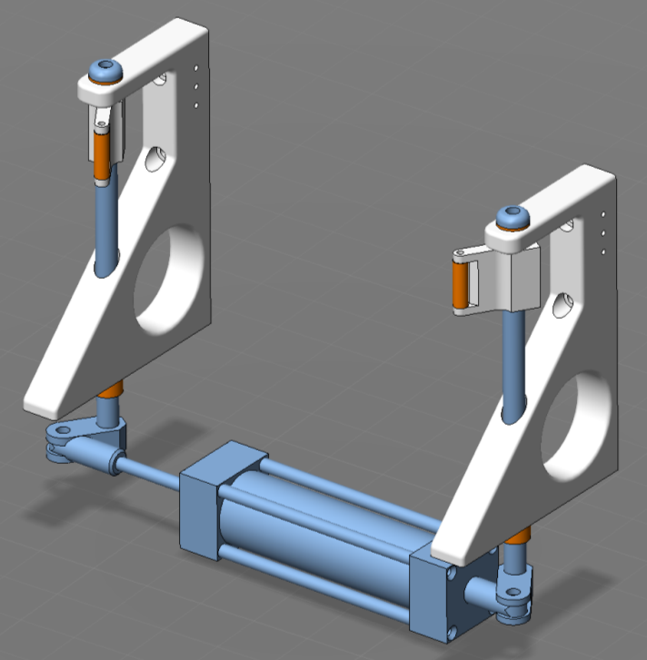
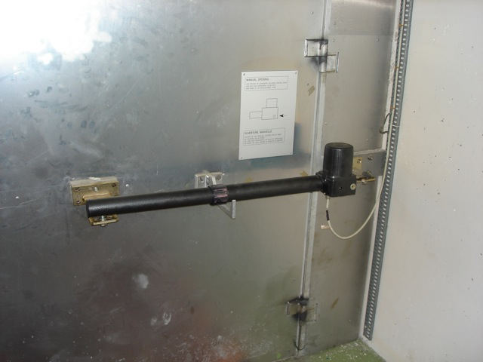
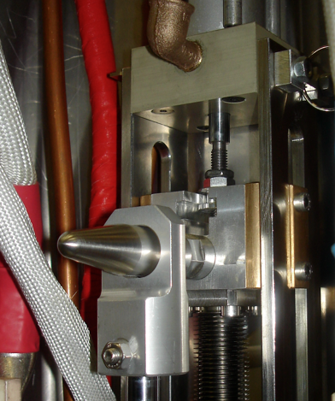
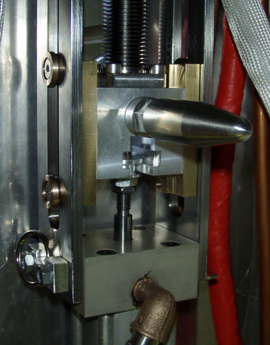
Front End #6
Corrective measures
  Angle of clamps modified
  Bronze insert for less friction on target valve
  Installation of compressor to assure valve closing
  Faraday cage door piston replaced
    Manufacturing changes.
    Prevention or repair to be evaluated
    Need 5 days without protons on HRS
Courtesy of S. Marzari

Slide 5

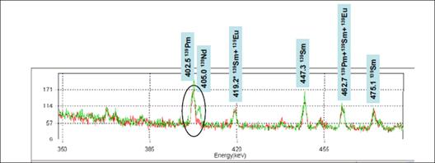
Target and Ion Source Development
NanograinedY₂O₃-VADIS unit : YO446
  CERN patent (S. Fernandes et al.)
  VADIS (L. Penescu et al.)
(New purity grade Y₂O₃, safety aspects: A.P. Bernardes)
⁶¹Cu yields: x4 gain : 5e8/μC
    Yield estimate of ⁶¹Cu from γ spectroscopy (A. Gottberg et al.)
  (confirmed gains or production on: ^{48,49}Cr, ⁵²Fe, ^{56,57}Co, ….)
Development of ¹⁴⁰Nd beams by RILIS
in low work function cavities GdB₆
Courtesy of T. Stora

Slide 6
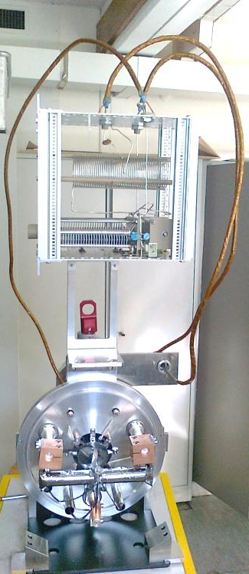
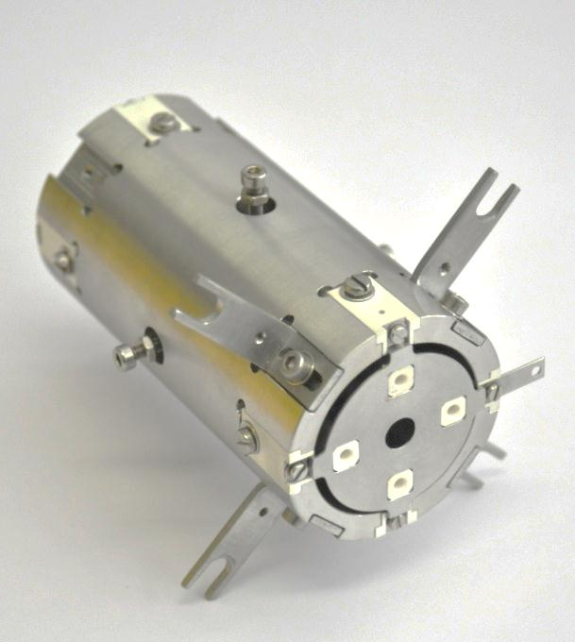
First On-Line Test of Laser Ion Source and Trap at ISOLDE
First on-line test of performance of the Laser Ion Source and Trap (LIST) at ISOLDE from 11/05/2011 untill 13/05/2011
LIST was implemented successfully at ISOLDE
LIST worked well over 2 days of proton taking
Measurement of
    suppression of isobaric contaminants
    ionization efficiency
    yields of different isotopes etc.
1 cm
Preliminary Results:
Maximum Surface Ion Suppression of ≈ 3000
No significant change of performance after two days with protons
Different time of flight structures for different LIST settings
Courtesy of T. Stora, D. Fink & RILIS team

Slide 7
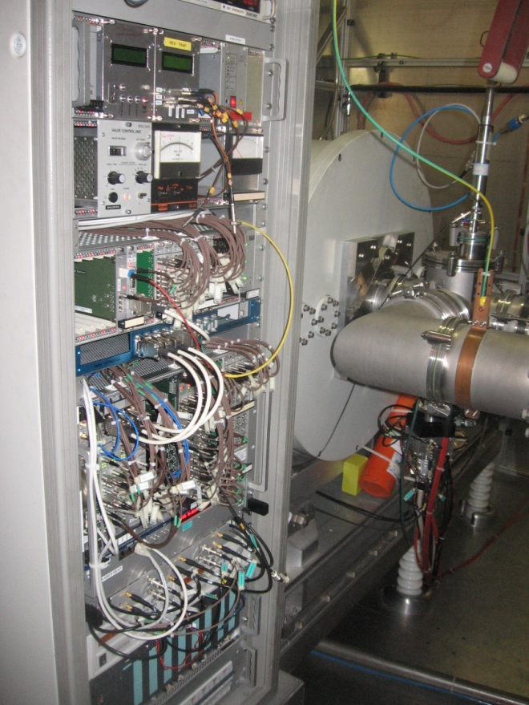
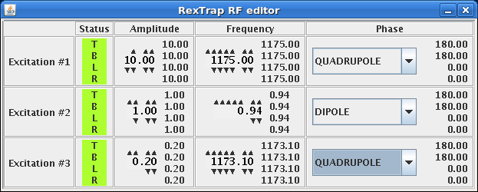
REXTRAP Renovation
Upgraded:
Control system
Beam diagnostics
RF excitation
Applications
Power supplies (partially)
Still remaining:
Some pulsed power supply functionality / readback
Some applications
Full mass resolving functionality
Backwards beam kicking
Back to VME based system
In general:
Smooth startup and now well functioning
1st REX beam time in June provided five bonus isotopes ^{186,188,190,194,196,198, 200}Pb
F. Wenander, E. Piselli & J. Sanchez et al.

Slide 8
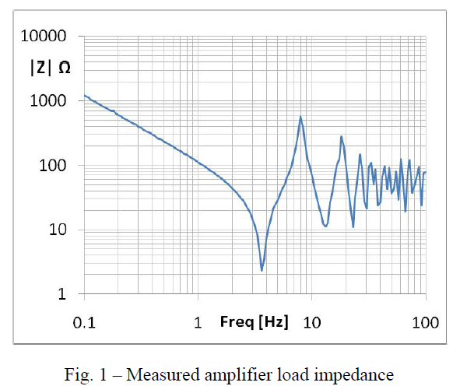
REXTRAP - what did we gain?
+ RF excitation more linear over 0 Hz to 15 MHz
no λ/4 notches as before
+ Easy setup of different RF excitation sequences
incl quadrupolar, dipolar and rotating wall excitation
+ Soon also backwards ejection (towards ISCOOL)
+ Backup from the support groups
- Less in-house knowledge for quick interventions
Freq MHz
Courtesy of M. Paoluzzi, CERN

Slide 9
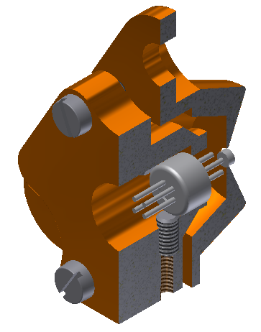
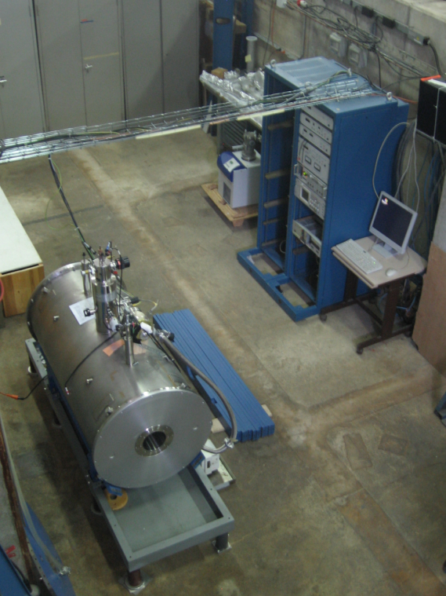
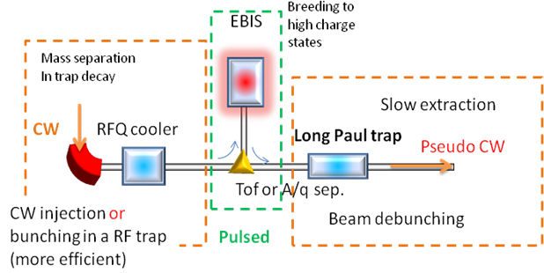
TwinEBIS Testbench
Act as:
1. Spare solenoid for REXEBIS
2. Test bench for new
REX electron
cathodes and guns
New IrCe
cathode
Modified
Wehnelt
electrode
Courtesy of T. Berg
3. Provider of highly charged ions (if possible)
for cw trap tests (EMILIE proposal by P. Delahaye)
From Manne Siegbahn Laboratory
Status Excessive LHe boil-off so the system was reopened again
Limited progress due to other obligations for external Fellow and LHe delivery problems
F. Wenander & P. Suominen

Slide 10
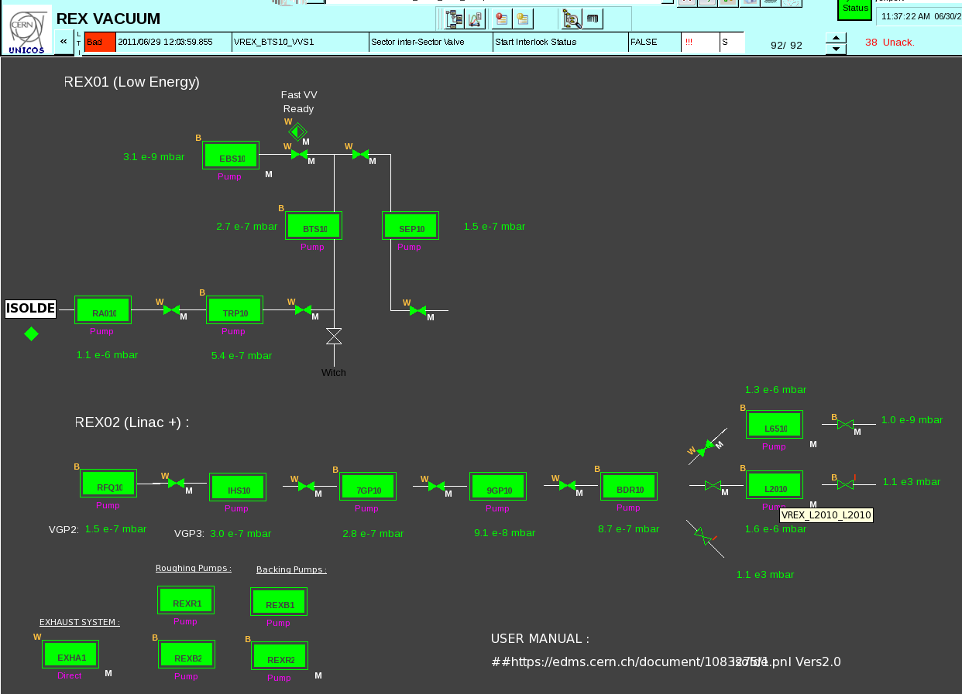
REX Vacuum Upgrade
1. REX vacuum system now fully automated - same controls as for ISOLDE
2. Increased the pumping speed in the RFQ section, lowered pressure a factor 2
(aim for better transmission of heavy ions)
S. Blanchard, G. Vandoni & C. Collomb Patton

Slide 11
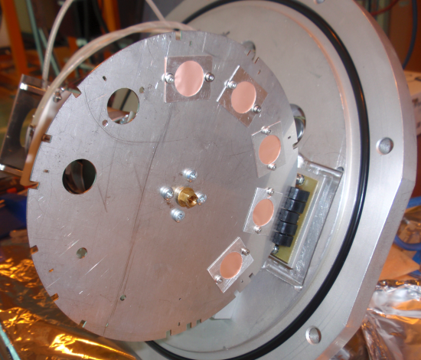
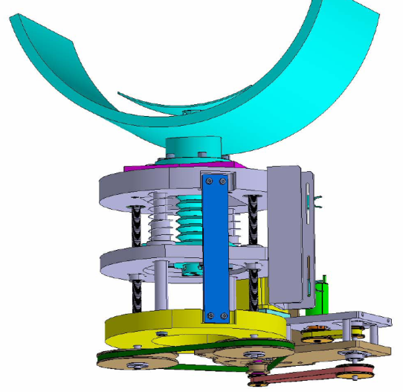
REX miscellaneous
REXEBIS electron beam cathode
* CeB₆ used instead of LaB₆
* Low electron emission but no acute poisoning effects
Attenuation foils
* Installed before and after RFQ to reduce the beam intensity for:
1. beam composition measurements in ionization chamber
2. Linac setup measurements using a Si detector
* 15 um copper foil with 50 um diameter holes
* Should reach an attenuation factor of 1E6
* No need to insert collimators along the Linac and change EBIS
settings to reduce the beam intensity
7-gap tuners
* All three cavities equipped with new tuner drives
Foils on collimator wheel
F. Wenander & D. Voulot

Slide 12
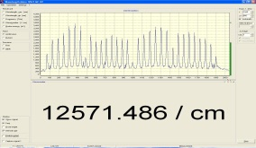
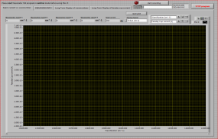
The 3 RILIS laser upgrade steps are now completed
1) Pump laser replacement
2) Dye laser replacement
3) Ti:Sa laser installation
λ – meter
Nd:YAG
Dye 2
SHG
Dye 1
THG
Master clock
RILIS Dye Laser System
GPS/HRS
Delay Generator
RILIS Ti:Sa Laser System
Target &
Ion Source
Nd:YAG
Ti:Sa 1
Ti:Sa 2
FHG
Faraday cup
SHG
λ – meter
pA – meter
Courtesy B. Marsh

Slide 13
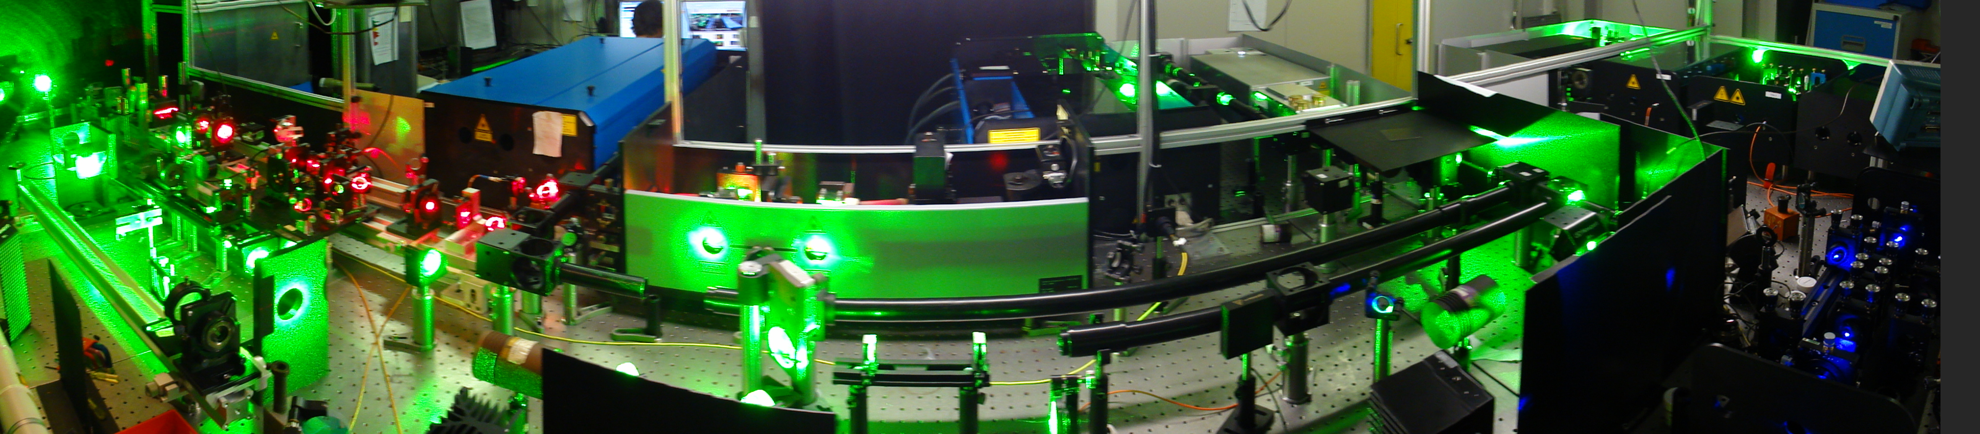
The complete RILIS Dye + Ti:Sa system
Improved HRS laser beam launch system with a 4th laser beam path for laser transport to ISCOOL
Sirah dye lasers with 2nd harmonic generation and UV pumping option
Edgewave Nd:YAG laser for dye pumping or non resonant ionization
Narrow band dye laser with computer controlled grating and etalon for high resolution spectroscopy or isomer selectivity
3 Ti:Sa lasers from Mainz university
Photonics Industries Nd:YAG pump laser for the Ti:Sa lasers
Harmonic generation unit for Ti:Sa system
Dye laser 3rd harmonic generator
RILIS cabin layout has been redesigned to accommodate the new lasers
Dye and Ti:Sa synchronization and compatibility for mixed ionization schemes has been verified online during the At run
Ti:Sa system is operating in testing/backup mode during 2011. It has so far been used for ionization of At and for Pr ionization scheme development
Optical pumping in ISCOOL should be tested during 2011 shutdown
Preparations for remote monitoring, machine protection and RILIS automation are underway. RILIS running in on-call (shift –free) mode for some elements is planned for 2012.
B. Marsh

Slide 14
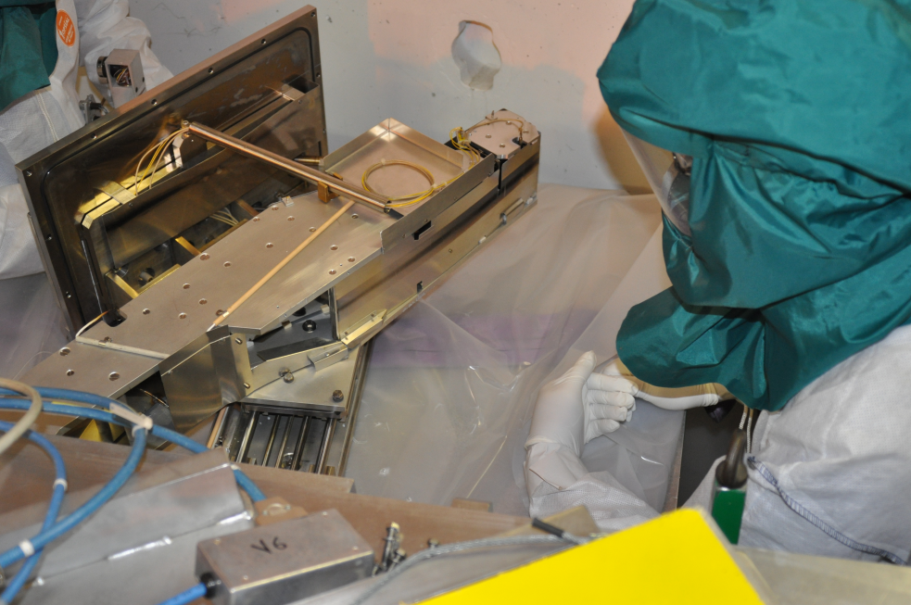
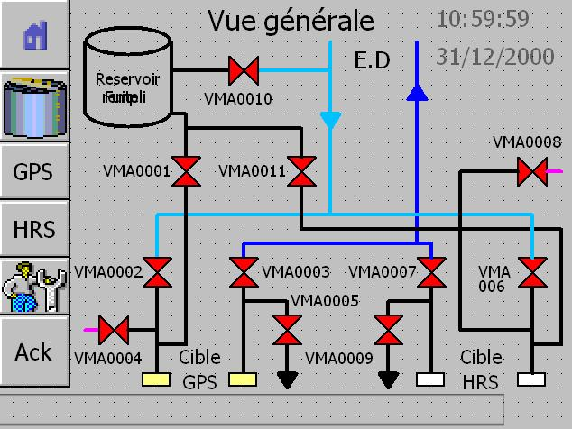
Machine Issues
GLM Deflectors
Replacement of bearings and transmission screw
Delicate operation due to contamination.
Water Cooling
Pressure reading valves across by-pass closed.
Insufficient pressure in expansion tank to re-fill reservoir
Courtesy of E. Siesling & D. Voulot

Slide 15
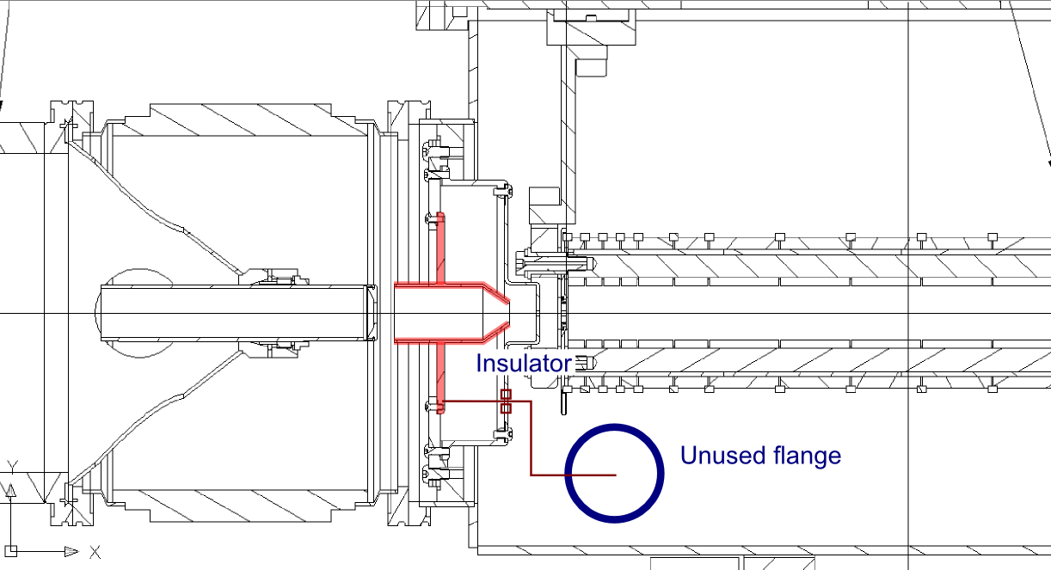
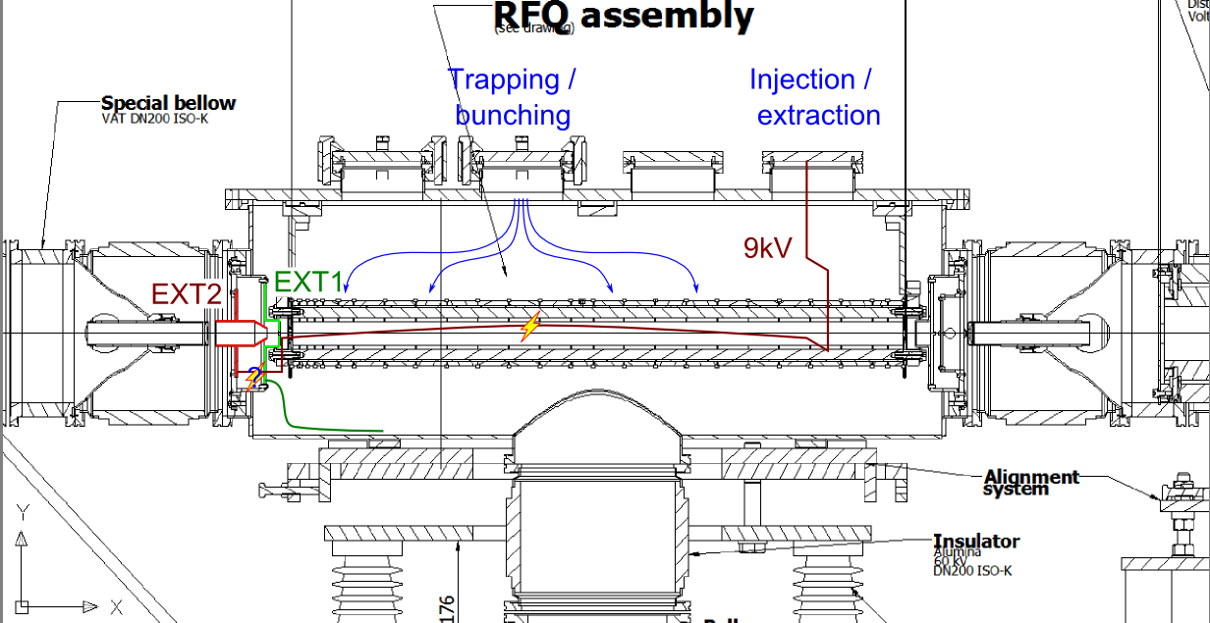
RFQ Cooler
Sparking from 9.5kV wire to both radial electrodes and EXT1
Other elements not designed to hold 9.5kV..sparking at connector
Wire replaced and re-directed to a new flange
New insulator installed
Faulty cable at FE added to the diagnostic confusion
Courtesy of T. Giles

Slide 16
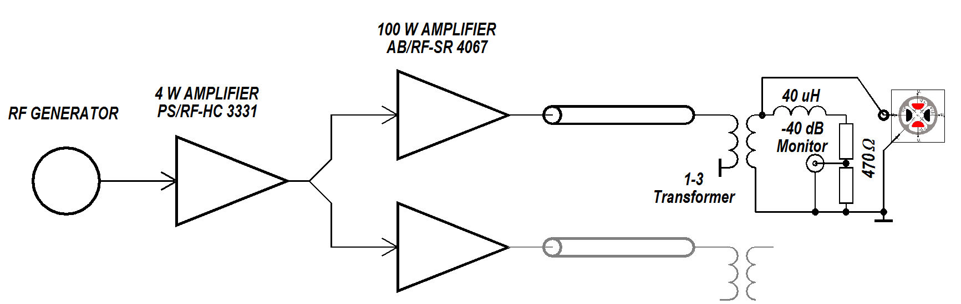
A new RF driver for ISCOOL
Use small 100 W amplifiers + 1/3 transformer
* Direct drive (no resonant circuit)
* Easier to protect from over-voltage
* Use standard equipment
* Support from RF group
Courtesy M. Paoluzzi & .D. Voulot

Slide 17
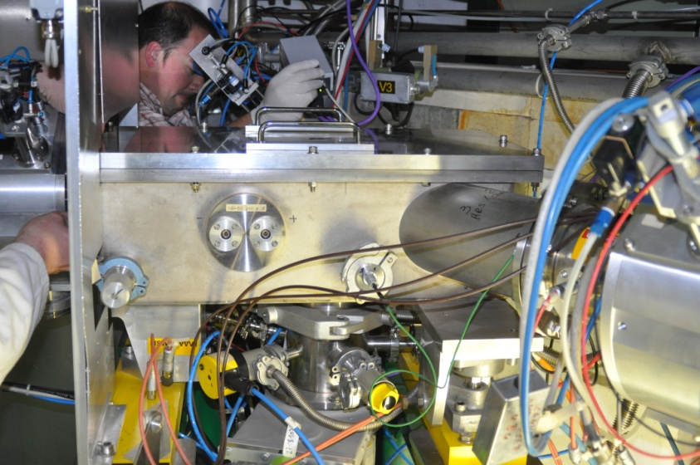
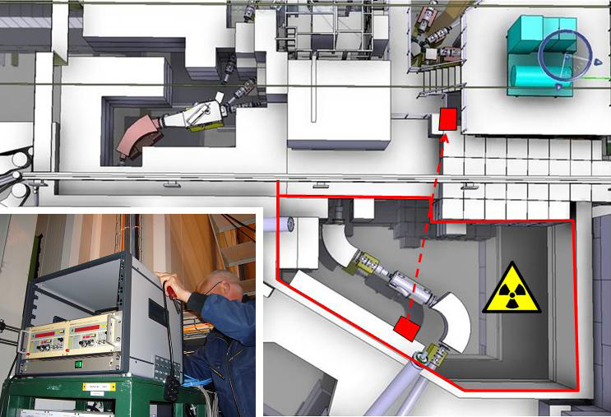
Machine Issues
Merging Switchyard 
Replacement of insulator
Cleaning with inert gas
NMR Teslameters
Moved outside of HRS secondary zone for easier access
Courtesy of M. Lozano Benito & P. Galbraith

Slide 18
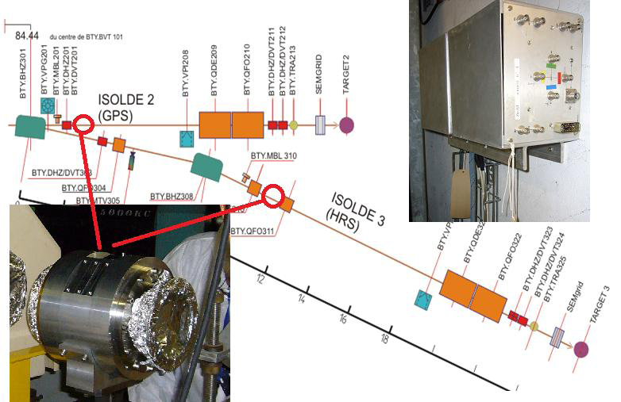
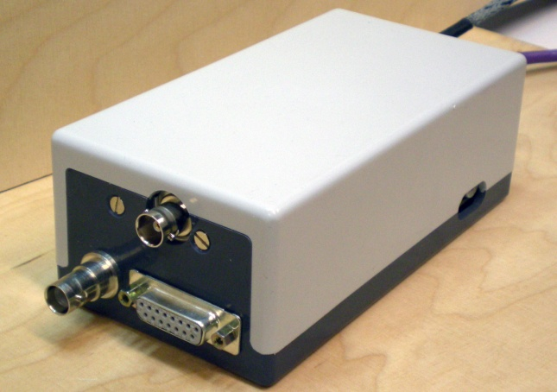
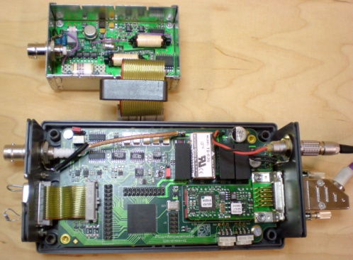
Machine Issues
BTY Pick ups 
Installation of BTY pick-ups in p-beam line
Proton intensity/ integration
Pico-ampere meters
Refresh rate 2Hz
Autorange feature
Still some troubles for REX
Electronics susceptible to Single Event Upset
  Require moving
D. Gerard, G. J. Focker & M. Duraffourg

Slide 19
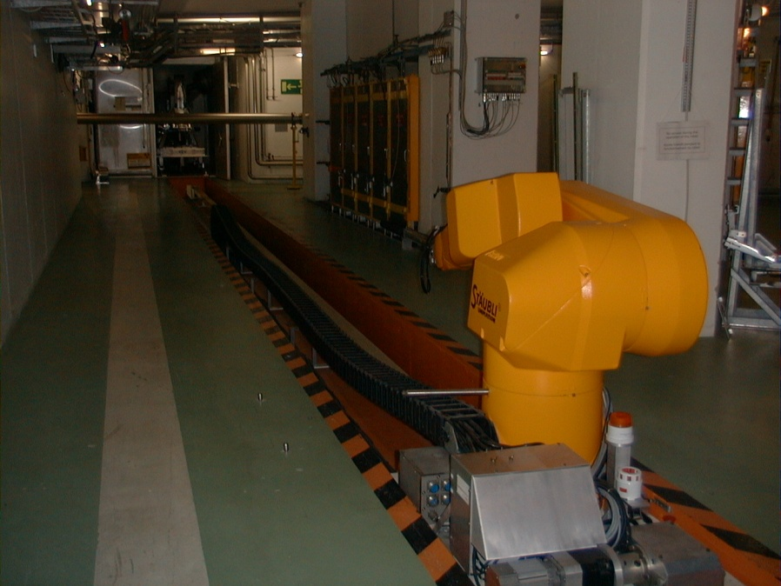
GPS Robot
Robot accidently programmed to place used target on third shelf.
Robot loses it position after placing target and collapses on itself.
Able to recover robot and shield target remotely
Error in calibration
  Solved by Staubli the following day
Damage to axis 6
  +/- 2mm play unacceptable
  Needs to be replaced and tested
3 weeks to repair instead of 6 weeks
Robot repaired, 10 positions re-taught
+ GPS FE + Exchange point

Slide 20
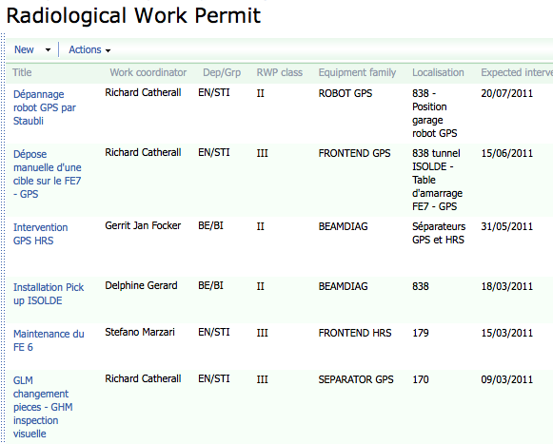
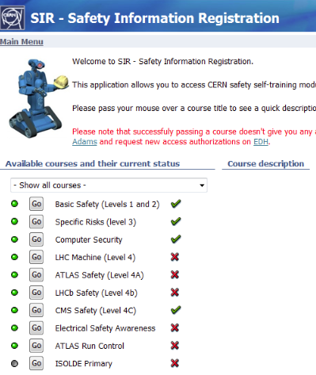
Safety
  ALARA interventions addressed since last INTC
  3 ALARA III
  3 ALARA II
  ISOLDE participation to ALARA up-date Working group
  Procedure requested from ALARA process documented on EDMS (1136056, 1113176, 1132987, 1108892)
  Specific Safety training to access ISOLDE primary area under development
A-P Bernardes, E. Macario, A. Dorsival

Slide 21
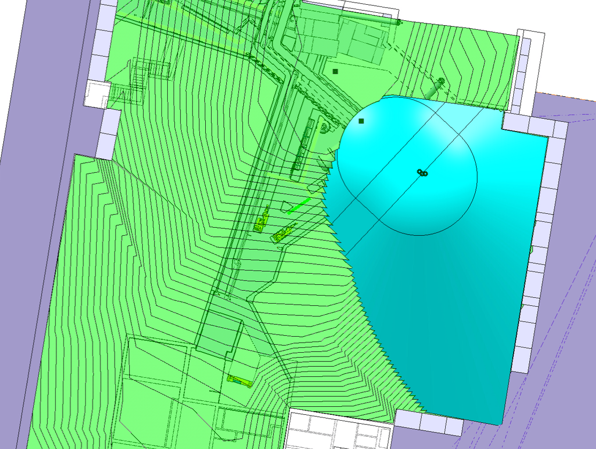
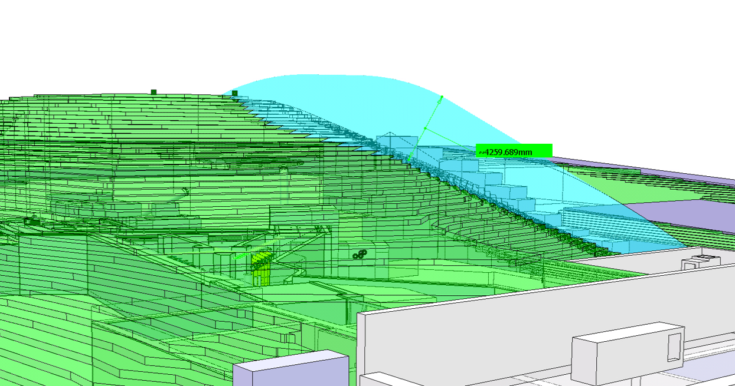
Safety
  Primary area shielding assessment for ISOLDE and HIE-ISOLDE
  Shielding weakness above HRS dump identified
  Due to structure limitation, additional earth layout on the top of HRS dump is not possible
  The hill above primary area will be fenced off in future
Thanks to V.Barozier
A-P Bernardes, A. Dorsival, J.Vollaire, Y.Romanets

Slide 22
Shutdown 2011/2012
Currently evaluating the possibility of reducing the shutdown period with a possible start up in March 2012 (almost) in line with availability of protons for LHC.
Main projects identified so far:
  Tape station move to CA0 beam line
  Move of solid state lab from 275 to 115
Call for possible « showstoppers » sent out to all those who contribute to the shutdown work.
  Awaiting replies.
Comments welcome!

