Slide 1

ISOLDE Technical Report for the ISCC
Richard Catherall EN-STI
CERN, 3rd November 2011

Slide 2
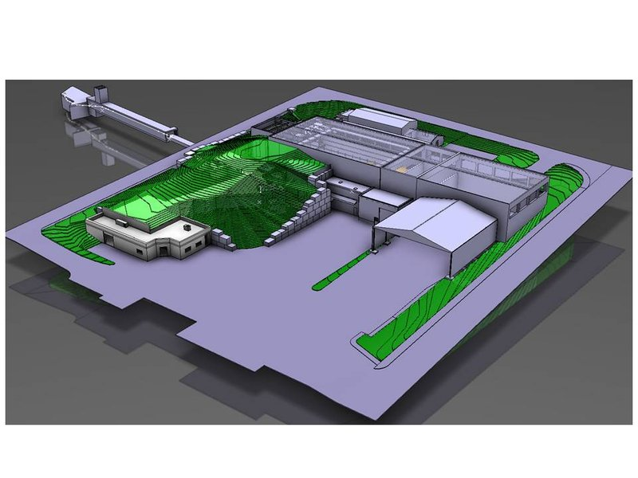
Agenda
Operation 2011
  Targets
    Drawings
  REX
  RILIS
  Machine Issues
    GLM Deflectors, Water cooling
    Faraday cage, pico-ampere meters
    Tape station
    RFQ Cooler
    Robots
    Robot Upgrade
Shutdown 2011/2012
  Winter physics
Safety
HIE-ISOLDE construction work
News from EN-STI

Slide 3
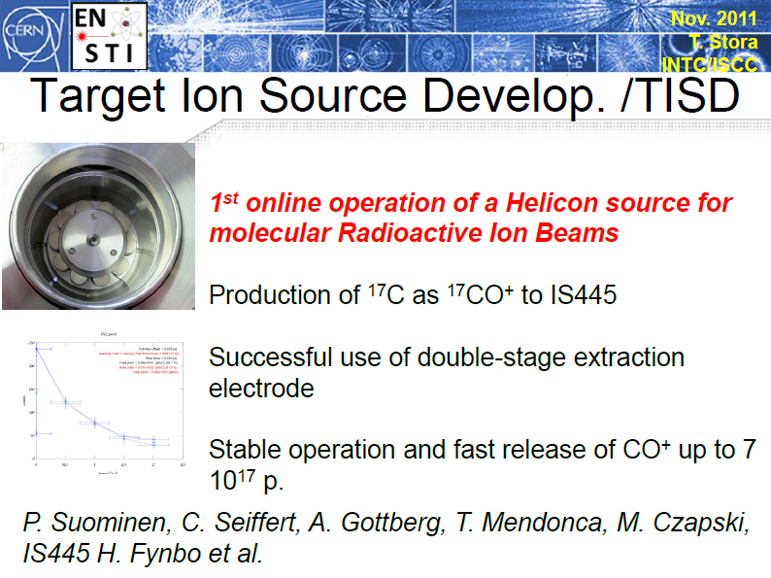

Slide 4
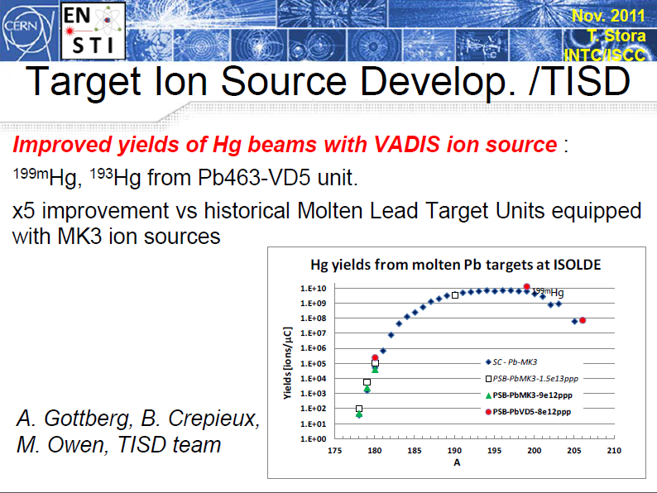

Slide 5
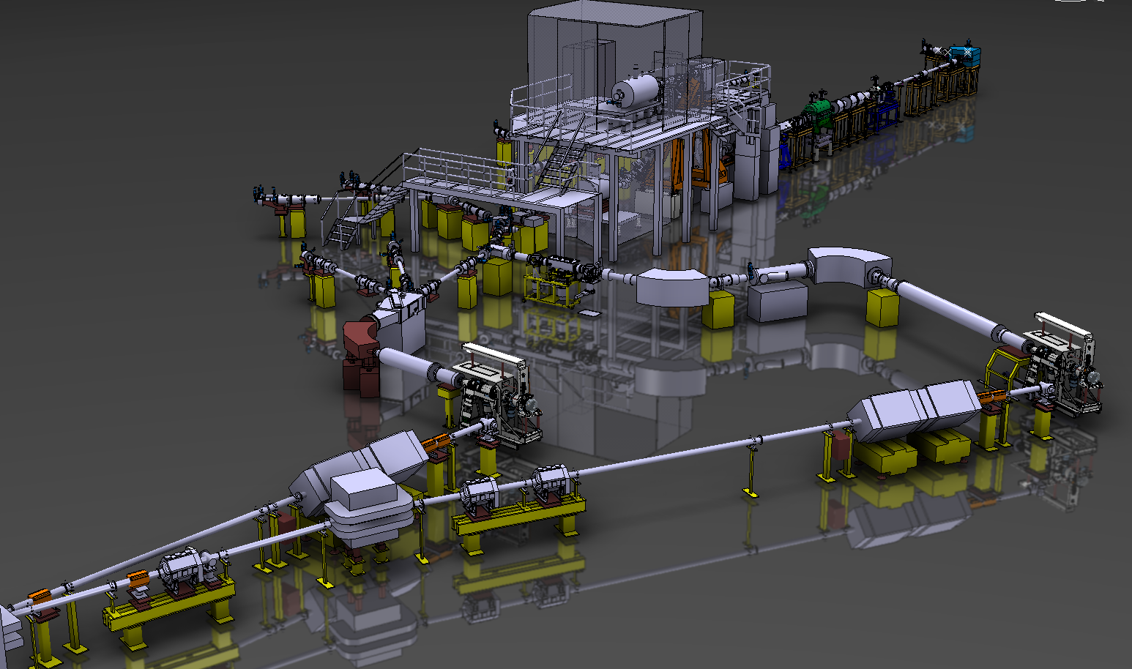
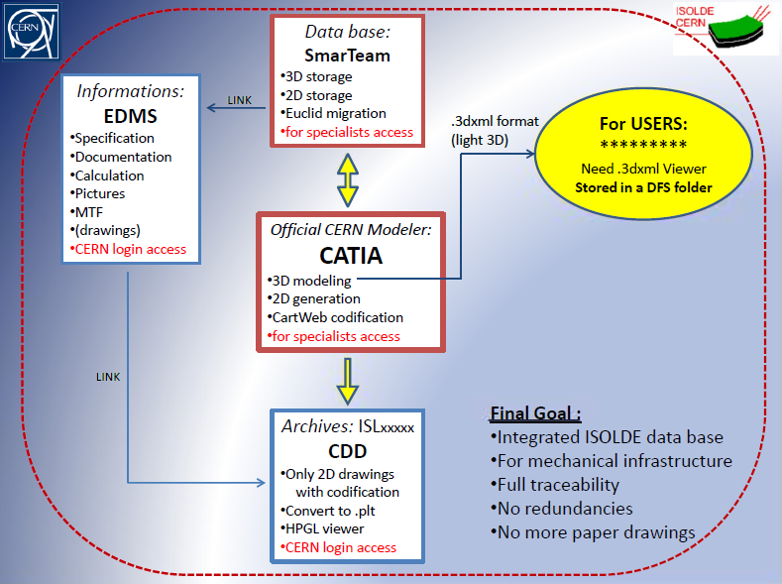
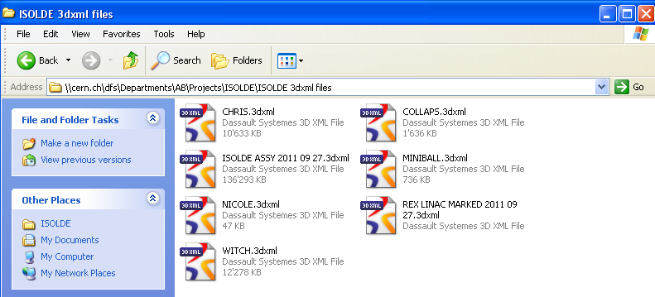
Drawings
S. Marzari, V. Barozier

Slide 6
REX campaign 2011
IS494 186-200Pb
7 isotopes delivered!
(2) IS496 140Nd
(3) IS485 96Kr
(4) IS506/IS475 208, 220Rn
(5) 224Ra
(6) IS477 126,128Cd
(7) IS478 72Kr (RF amplifier problems)
(8) IS482 26Na (30Na too low yield ISOLDE)
(9) IS451 98Sr
(10) IS504 66Ni
(11) IS510 72Zn
2-neutron transfer reactions + Coulomb excitation
(12) IS483 72 or 74 Zn
(scheduled for end of November)
In addition
+ 2 beta-NMR runs with 27Na (8Li failed TRAP/EBIS)
+ 2 WITCH runs: IS433 35Ar
+ 1 WITCH run scheduled for next week
12 REX-ISOLDE runs scheduled for 14 experiments with 190.5 RIB shifts (43 %) (160 in 2010)
  10 runs done
  1 to be done
  1 postponed by user (IS512)
heavy
beams
* Ambitious programme
* Record number of delivered REX shifts
* Some hick-ups (RF problems, cathode failure) but mostly successful year
D. Voulot & F. Wenander

Slide 7
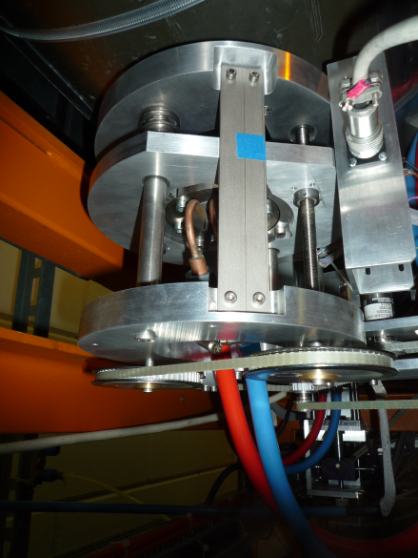
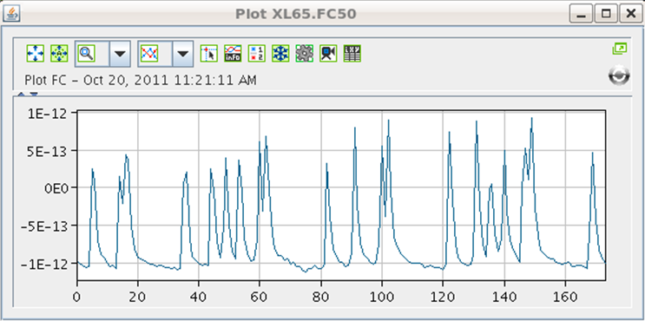
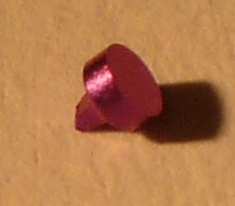
Technical issues I
7-gap tuners consolidation
  -> installation finished
  -> working smoothly, no more RF interruption due to 7-gap tuner failure
Pico-amperemeter for Faraday cups
  -> 2 Hz: real time feeling
  -> very low noise (can detect 20 fA beams!)
  -> clear improvement for REX set-up
PVSS vacuum control for REX
  -> fully automated (on paper)
  -> same as ISOLDE
EBIS cathode problems
  -> ‘poisoning problem’ understood? tbc
  -> limited lifetime and e⁻ emission problem remains
D. Voulot & F. Wenander

Slide 8
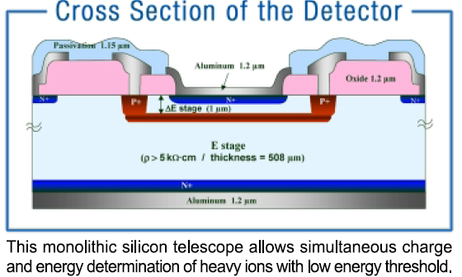
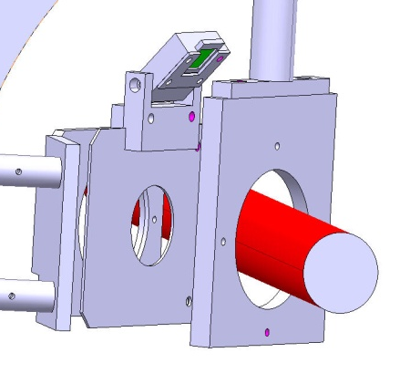
Technical issues II
Δ E-E for beam composition examination
  -> first test of monolithic Si detectors
  -> preliminary results = need to improve ΔE signal
  -> collaboration with the Madrid group
Detector for slow extraction optimization
  -> installed a Si pin diode before Miniball
  -> first tests positive; improved amplifier setup to follow
  -> collaboration with J. Pakarinen + BI group
β-NMR setup mechanically operational
  -> 27Na beam taken and data under analysis
  -> see talk by H. Tornqvist at ISOLDE workshop
pin
diode
beam
Coming–up next year:
  * 2 ms RF pulse length for slow extraction (with reduced duty cycle)
  * Improved vacuum in RFQ section for highly charged beams
D. Voulot & F. Wenander

Slide 9
RILIS operation
Combined dye and Ti:Sapphire laser system is in regular operation
Ion beams of 16 elements are produced since beginning of the running period: 2310 hours lasers ON
Study of ionization of laser-ablated atoms in the LARIS lab
Laser time per beam for the operation year 2011 (as of today)
Beam | Sm | Ga | Mg | At | Pb | Dy | Nd | Pr | Ag | Tl | Cd | Mn | Ni | Dy &Yb | Zn
Plan | 80 | 104 | 64 | 160 | 184 | 64 | 136 | - | 112 | 208 | 288 | 120 | 272 | - | 256
Real | 89 | 101 | 64 | 216 | 221 | 35 | 110 | 4 | 92 | 231 | 241 | 206 | 348 | 73 | 279
Courtesy of V. Fedosseev & B. Marsh

Slide 10
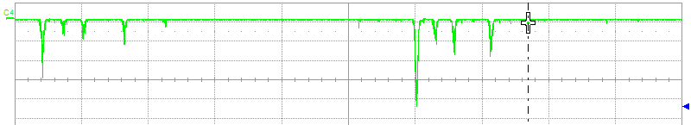
The LARIS laboratory
Ionization scheme development for refractory elements
Problem: refractory elements are not released at ISOLDE
Suggested solution: produce volatile molecules of refractory elements, break the molecule with UV light/low energy electron beam and resonantly ionize the atom of interest.
Status: Zr anf ZrF ions have been produced in the ablation source at LARIS.
Resonance ionization spectroscopy will be performed for Zr ionization scheme development and this scheme can be used during the investigation of the molecular breakup process.
Time-of-Flight mass spectrum from the LARIS ablation source with CF₄ gas injected
CF₄ gas flow
T_{gas}=730 μs
T_{ion}=1500 μs
^{90,91,92,94,96}Zr
^{90,91,92,94,96}ZrF
Courtesy of V. Fedosseev & B. Marsh

Slide 11
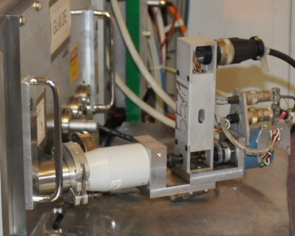
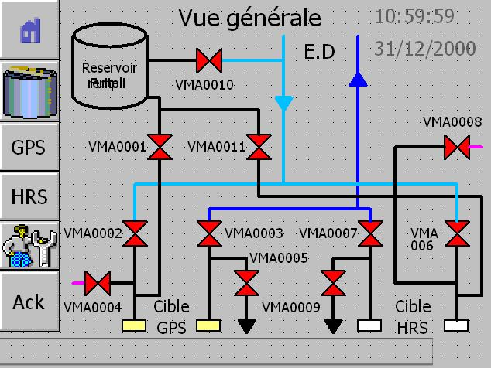
Machine Issues
GLM Deflector Part 2
Coupling between motor and transmission had slipped (vibration?).
Repaired and reinforced
Water Cooling
new circuit for reservoir filling
modification of the reservoir drain
modification of the condensation water recuperation to avoid collision with the crane
independent pressure regulation on both target circuits

Slide 12
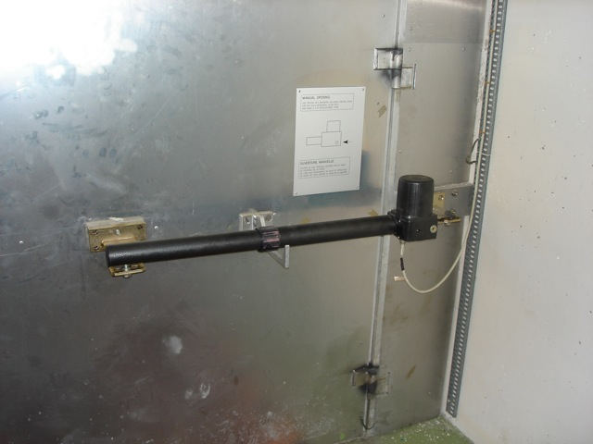
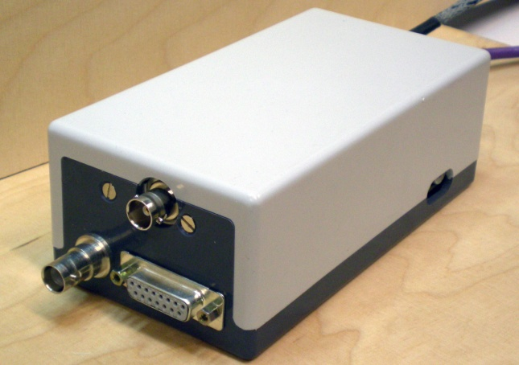
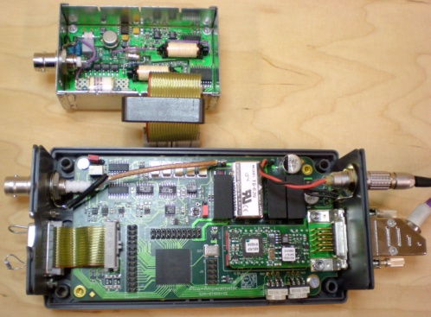
Machine Issues
Faraday cage piston 
Failed (as expected) in September 2011
Replaced with spare
To be replaced with a « nuclearized » version during shutdown
GPS to be replaced as a preventive measure.
Pico-ampere meters
Operating well, except for those located in HRS separator area.
To be moved out during shutdown

Slide 13
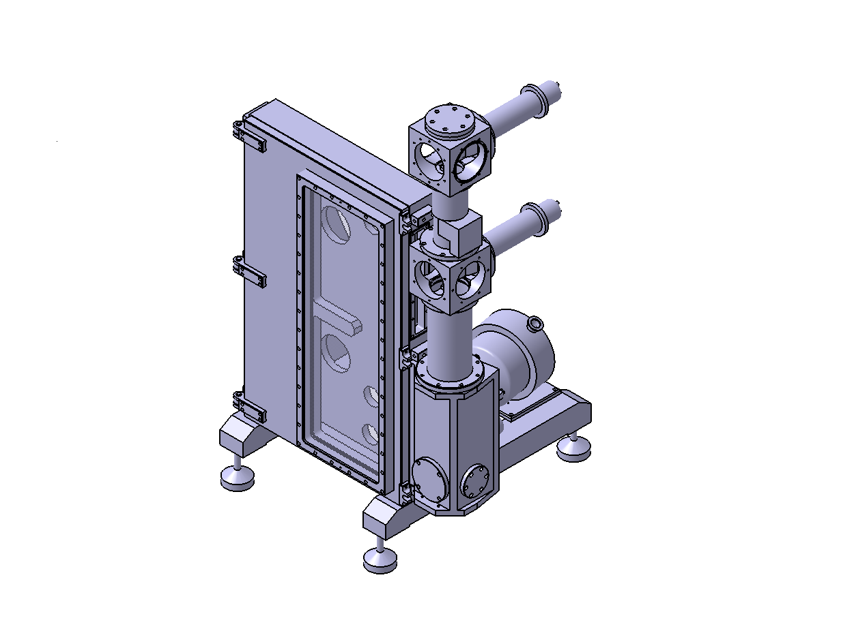
Machine Issues
Tape station
2 major issues making it unreliable
  Vacuum leak across motor feed-throughs.
    Strasbourg have been contacted for drawings and seal replacements
  Tape breaks even when not in operation (once every ~3 months)
    Controls, software?
  Too unreliable to insert into central beam line

Slide 14
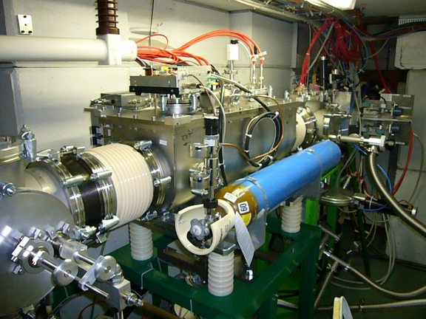
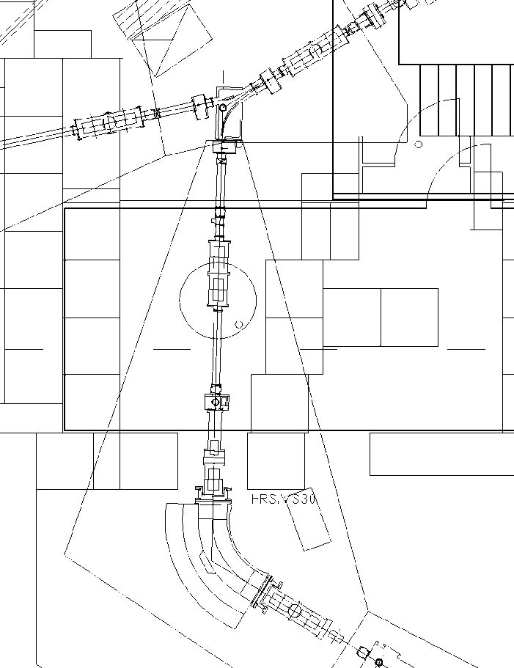
Machine Issues
RFQ Cooler
The beam is transported through the RFQ Cooler however, the RILIS beam is at the limit of transmission
Alignment tests to be done using both laser and beam.
  Survey to record points
Followed by optical pumping tests for COLLAPS
  Week 48
Delay in the supply of an RF amplifier for ISCOOL.

Slide 15
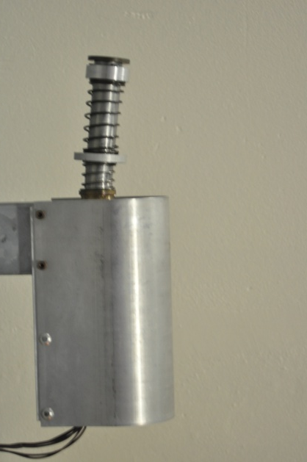
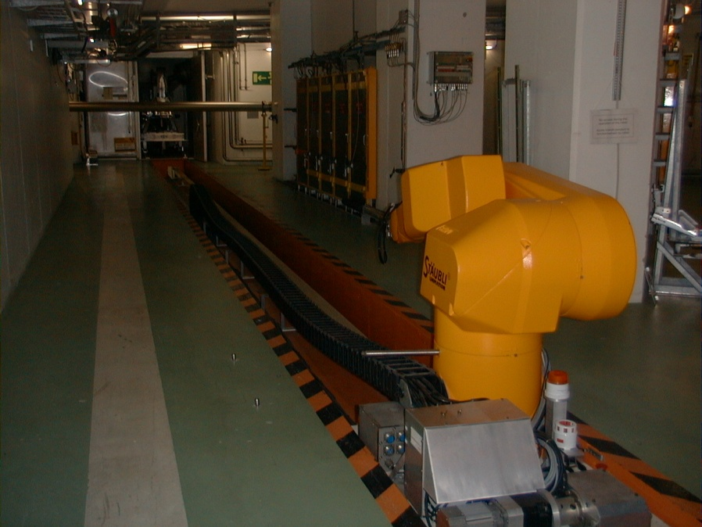
HRS Robot
The robot got stuck at calibration point
  October 2011
During recovery, the calibration point was damaged
The calibration point serves as a reference prior to the operation of either robot
  Both robots theoretically inoperable
The complicated calibration point was removed, repaired and re-installed.
Re-positioned using the GPS robot as reference
Collective dose: 162µSv (3 persons)
Cause of HRS robot failure unknown

Slide 16
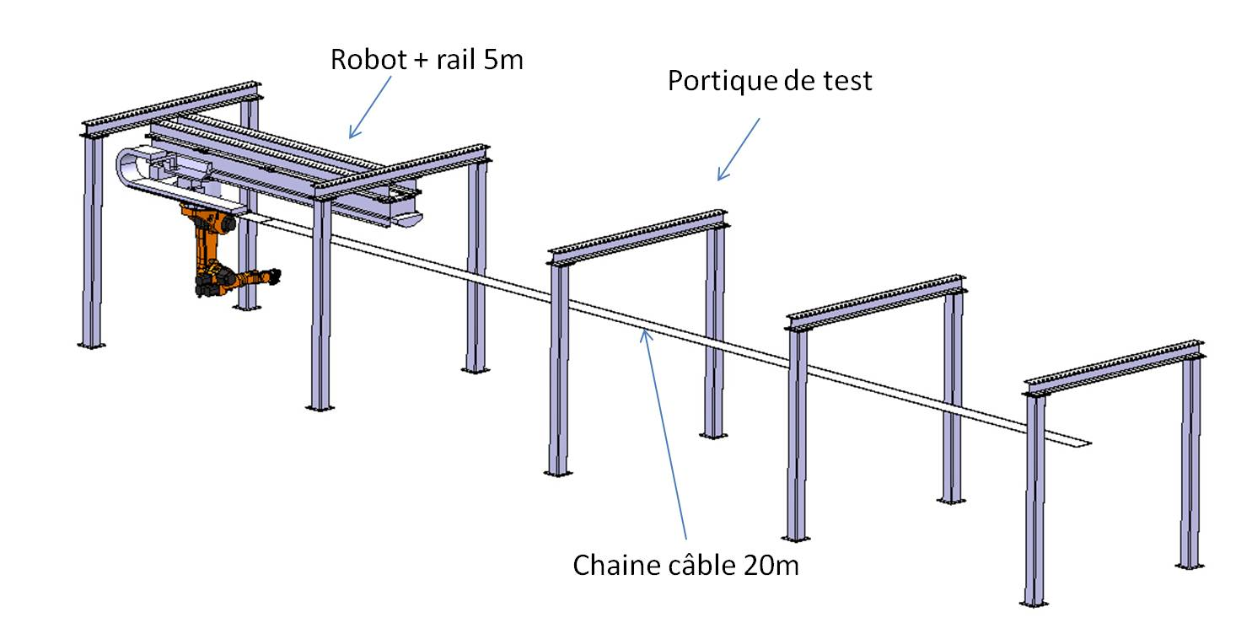
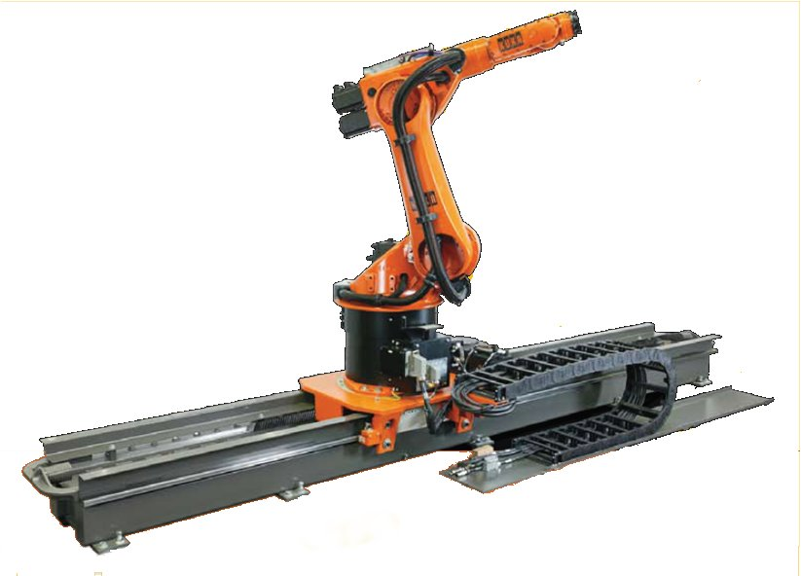
Robot Upgrade
Technical Specifications and price enquiry sent out in August 2011.
Kuka only robot company to reply (and comply)
Order sent out for 1 robot + 5m of rail. Option for 2nd robot + rail foreseen.
Delivery of 1 robot + expected in April 2012
To be installed and tested in dedicated hall.
Nuclearization issues to be addressed

Slide 17
Winter Physics
Start Isolde shutdown dec 2012
2011
2012
2013
2014
2015
2016
Q1
Q2
Q3
Q4
Q1
Q2
Q3
Q4
Q1
Q2
Q3
Q4
Q1
Q2
Q3
Q4
Q1
Q2
Q3
Q4
Q1
Q2
Q3
Q4
Beam Transfer Line
Civil
Cryo
Main services
Ventilation
CM 1&2
CM 3&4
CM 5&6
Demi water
5.5MeV/u
Electrical syst.s
10MeV/u
Timeline:
Winter physics Jan-March 2013 ?
sd
sd
LS1
CM1&2
sd
Dec 2012 - Apr 2014
Isolde & REX Ops
Main services (CV, EL)
Cryo Module 1 & 2 install
shutdown
(dismantling + installation works )
(REX perturbations)
E. Siesling

Slide 18
Shutdown 2011/2012
November
December
January
February
March
20 /11- 26/04 P-beam stop
20 /11 – 2/12 Off-line run & separator course
5/12 machine stop
5 /12 - 24/2 water stop
23 /11 - 09/12 ventilation stop target area
2/12 – 9/12 ventilation stop exp. hall
12/03 – 23/03 cold check out
26/03 – 02/04 P-beam to ISOLDE
https://edms.cern.ch/nav/P:CERN-0000000088:V0/P:CERN-0000079673:V0/TAB3
02/04 ISOLDE physics

Slide 19
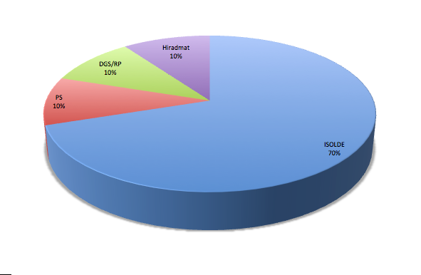
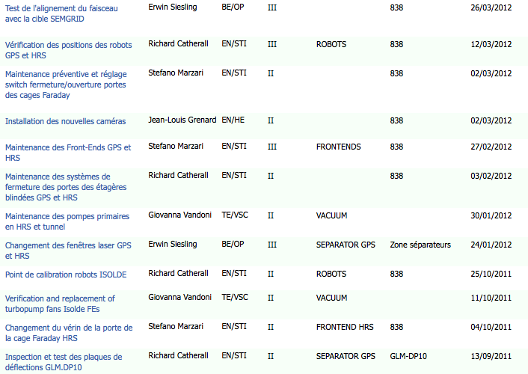
Safety
Safety
  ALARA interventions addressed since last INTC
  3 ALARA II
  Procedure requested from ALARA follow-up on EDMS (1155152, 1150899)
  ALARA interventions to be addressed for 2012 ISOLDE shut-down
    12 ALARA III (5 for contamination reasons)
    6 ALARA II
  ISOLDE participation to ALARA up-date Working group
ALARA III repartition for CERN
For 2010 and 2011
A-P Bernardes, E. Macario, A. Dorsival

Slide 20
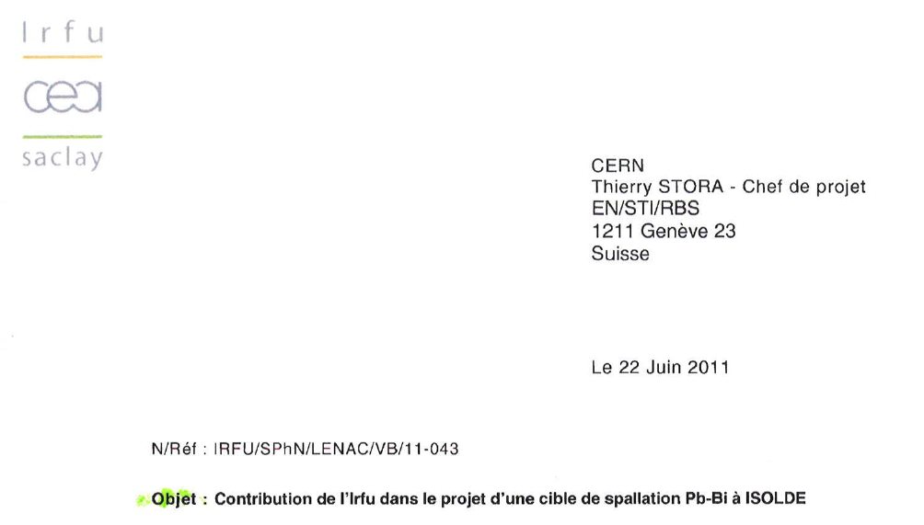
Safety
Safety
  Safety collaboration signed between CERN and CEA/IRFU for Pb-Bi ISOLDE target development (2012 -2013)
A-P Bernardes, T.Stora, J.Vollaire, V.Blideanus/CEA

Slide 21

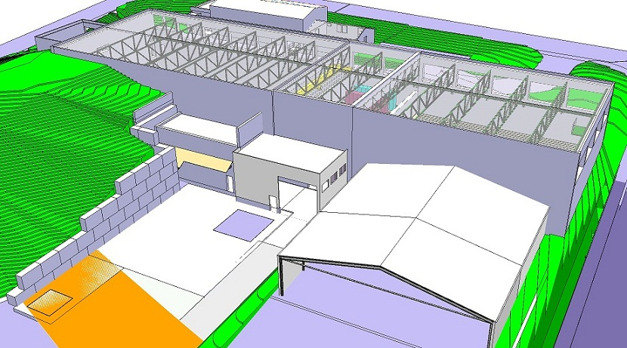
Civil Engineering
Construction starting date: July ->Aug 2011
E. Siesling

Slide 22
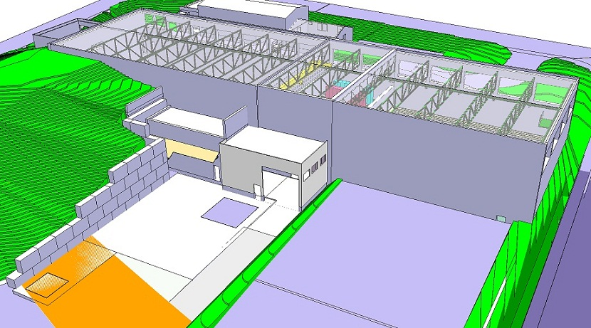
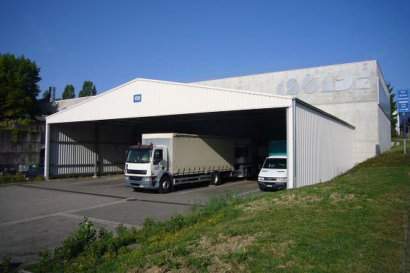
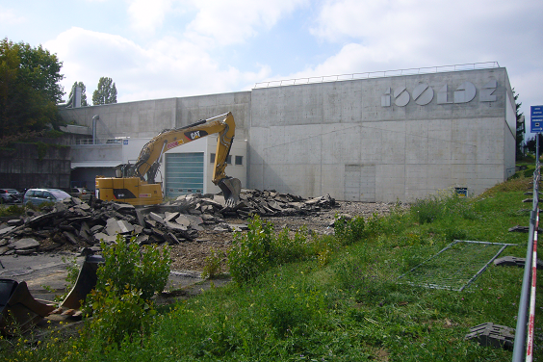
Civil Engineering
Removal of the transport hangar
September 2011
E. Siesling

Slide 23
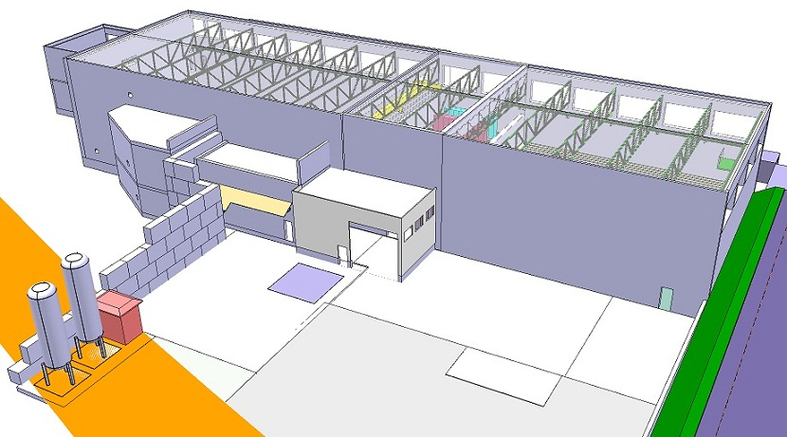
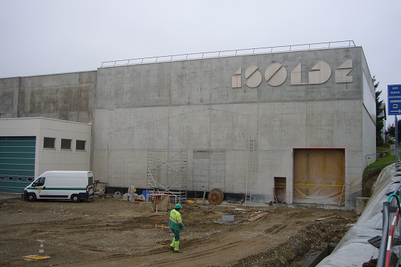
Civil Engineering
Cutting the Hall 170 wall & Terrain flattening
October 2011
E. Siesling

Slide 24
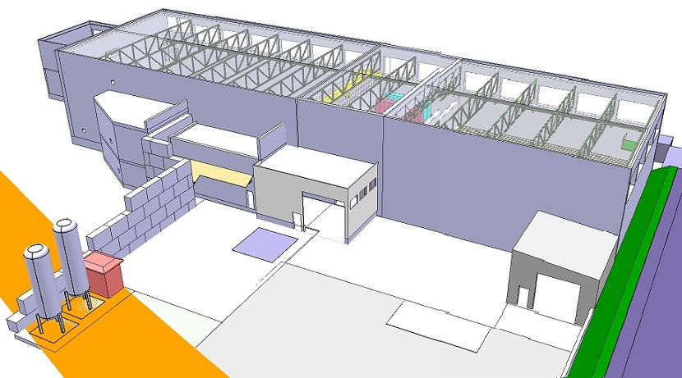
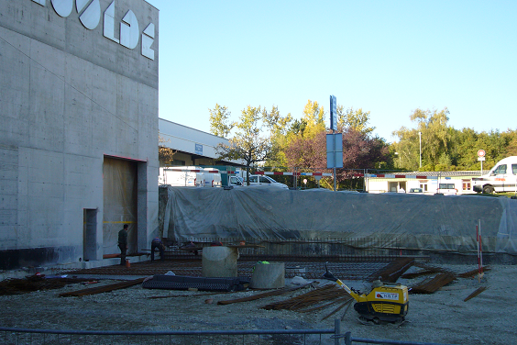
Civil Engineering
New SAS
November 2011
E. Siesling

Slide 25
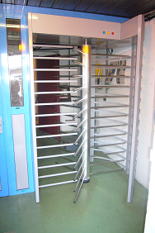
Civil Engineering
Move of the controlled access
Shutdown, December 2011
E. Siesling

Slide 26
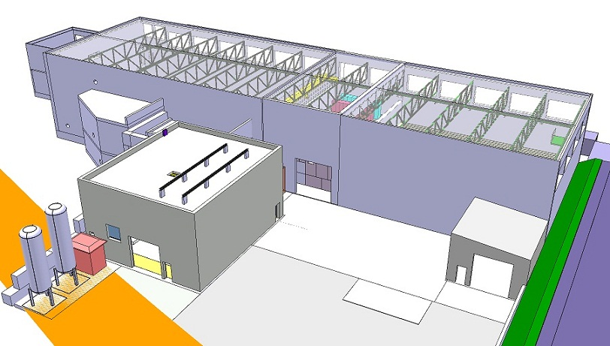
Civil Engineering
Compressor Building B.198
Start December 2011
E. Siesling

Slide 27
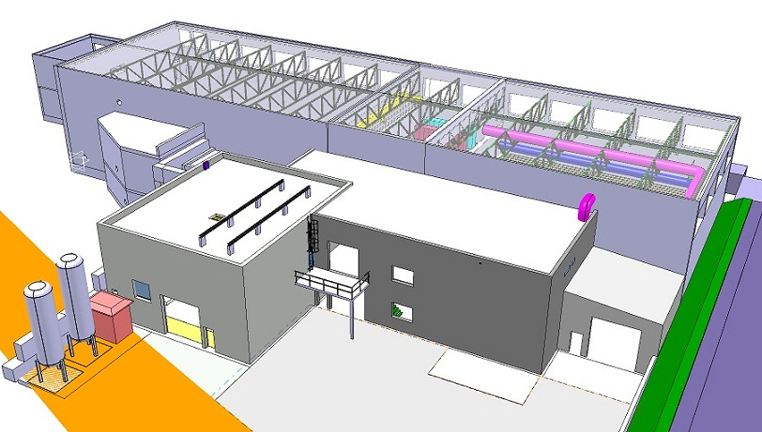
Civil Engineering
Cold Box Building B.199
Civil Engineering finished July 2012
E. Siesling

Slide 28
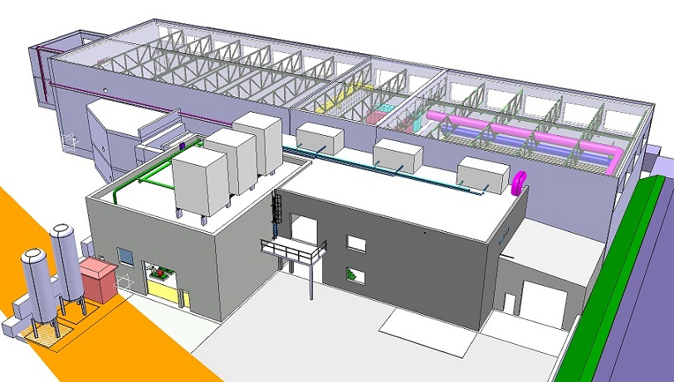
Main Services
Electrical systems, Cooling & Ventilation
Start June/July 2012
E. Siesling

Slide 29
News from EN-STI-RBS
BERNARDES Ana-Paula Staff
GILES Timothy John Staff
CATHERALL Richard Staff
STORA Thierry Staff
MARZARI Stefano Staff
OWEN Michael Staff
CREPIEUX Bernard Staff
BARBERO Ermanno Staff
GOTTBERG Alexander
  Project associate
FERNANDES RAMOS Joao Pedro
  Project associate
DE MELO MENDONCA Tania Manuela
  Project associate
MACARIO Elodie Audrey Fellow
SPANG Andrea Technical student
AUGUSTIN Mathieu Marie Curie
VUONG Nhat-Tan Technical Student
STADLER Alexander Fellow
SEIFFERT Christoph Post Doc
BABCOCK Carla Marie Curie
MONTANO Jacobo Marie Curie
KRONBERGER Matthias Associate (1st Dec)
CIMMINO Serena Marie Curie (1st Dec)
CZAPSKI Michal Adam Marie Curie
Total of 22 + 2

