Slide 1


ISOLDE Technical Report for the ISCC
Richard Catherall EN-STI
CERN, 31st January 2012

Slide 2
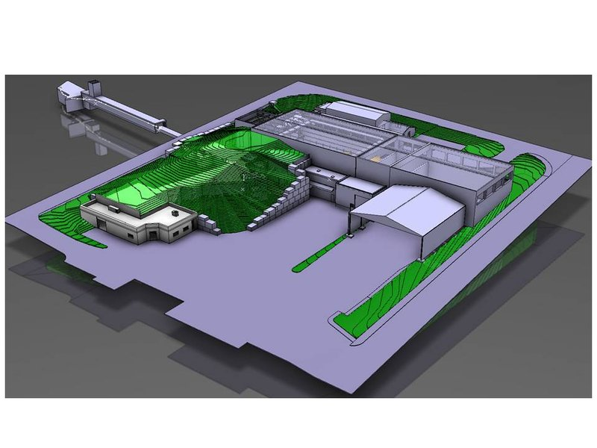
Agenda
Targets
REX
RILIS
Shutdown work 2011/2012
  Water cooling
  Access
  INCA
  Timing
Safety
News from EN

Slide 3
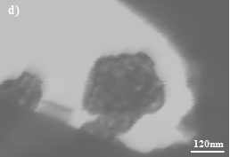

Targets
A third target nanomaterial (SiC, Y₂O₃, CaO) for ISOLDE
³⁵Ar from CaO469-VD7 for
Proprietary CERN technology
J. Nucl. Mat. 416, 99 (2011)
Ions per second | ³¹Ar (15.1ms) | ³²Ar (98ms) | ³³Ar (174.1ms) | ³⁴Ar (844ms) | ³⁵Ar (1.78s)
ISOLDE | 6.3E+01 | 3.6E+03 | 2.0E+05 | 2.6E+06 | 3.0E+08
TRIUMF | - | - | 7.0E+02 | 2.9E+04 | 6.5E+06
Yields on ^{31,32}Ar measured by ISOLDE experiment IS476 – H. Fynbo and B. Blank.
Turrion, M.; Urszula, H.-I. ISOLDE Yield Database. https://oraweb.cern.ch/pls/isolde/query_tgt (accessed December 1st, 2011)
TRIUMF. ISAC Yield Measurement. http://www.triumf.info/facility/research_fac/yield.php (accessed December 5th, 2011)
GANIL. SPIRAL Beams. http://pro.ganil-spiral2.eu/users-guide/accelerators/spiral-beams (accessed December 5th, 2011)
T. Stora

Slide 4
REX improvements
1. Addition of FC readout channels
Avoid having to move cables between XL65 and XL20 line
when reading out Miniball and beta-NMR FCs
- XEBS.FC20: new FC installed at the same location as EBIS.BO10
- XL65.FC100: new PAM for the Miniball FC
- XL20. FC100: new PAM for the beta-NMR FC
2. REX controls upgrade
Discussion about an upgrade of a number REX controls items have started.
Four work packages identified.
WP1: PLC/RS422 Controlled Power-supplies
WP2: REX magnetic field regulation
WP3: REX Linac RF Controls
    WP4: REX EBIS pulsed power-converters
Work to be carried out between now and end of LS1
3. Increased performance of the new REXTRAP RF excitation
(e.g. reduced loading time)
F. Wenander

Slide 5
REX consolidation and improvements
Linac cooling water
  Several trips during 2011
  Flow can be reduced on the BTY line magnets -> Install flow regulators (gain ~7 m3/h)
Vacuum upgrade in RFQ section (high losses with highly charged ions)
  New Hi-pace pump installed in front of RFQ
  Renovation of DB2 (this shutdown)
Enable 2 ms RF pulse length on all amplifiers for slow extraction (this shutdown)
  Max rep rate: 50 Hz without 9-gap / 15-20 Hz with 9-gap
  Need reduced power for the 9-gap -> lower max energy
D. Voulot

Slide 6
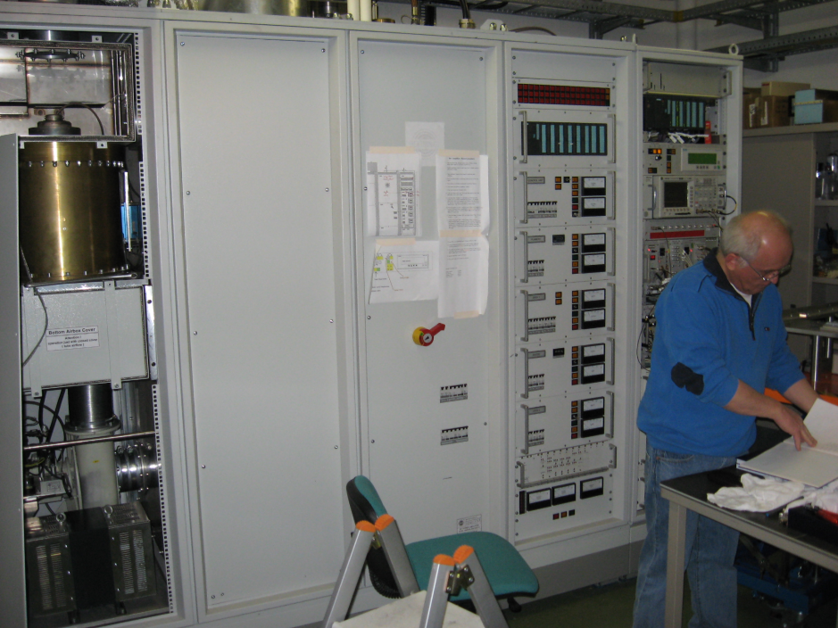
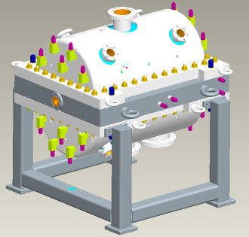
9-gap amplifier upgrade
Upgrade of 9-gap amplifier to ensure stable operation during the 2014-2018 period
Replace final stage tube, 130 kW, 2 ms pulse length
Estimated cost 300 k€
Commissioning early 2014
D. Voulot, H. Broere

Slide 7
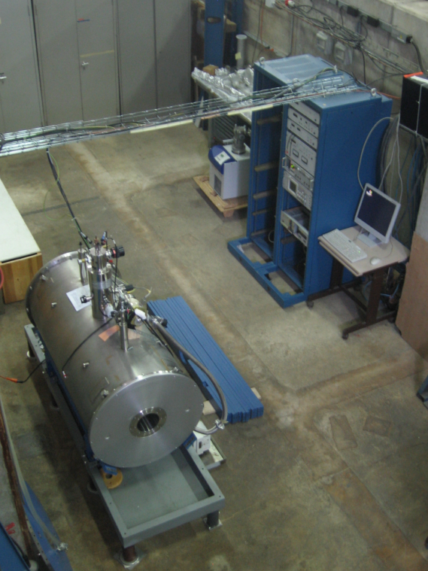
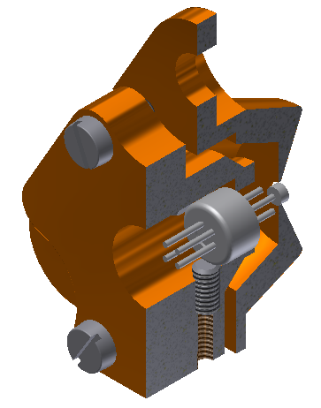
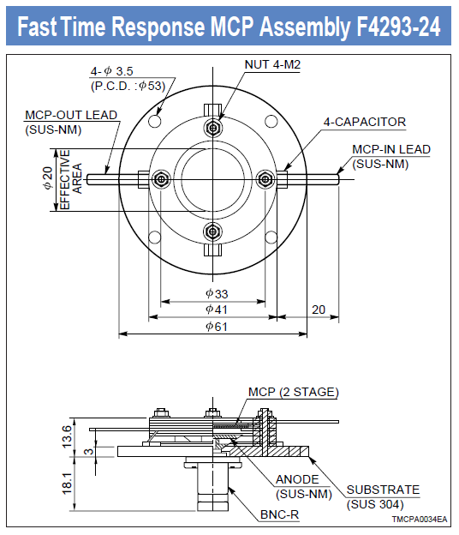
Call for support by external students
Project 1. Setup the TwinEBIS testbench
a. Finalize design and installation of mechanical parts, 6 months
b. Re-commission superconducting solenoid
c. Produce a control system for power supplies, current readouts,
vacuum control system, interlocks. Labview experience, 6-9 months
d. Commission the source, test alternative cathode and gun types,
increase electron beam current and energy. Electron beam
simulations. >12 months
Experienced student(s)
Contact person: F. Wenander
New IrCe
cathode
Modified
Wehnelt
electrode
TwinEBIS testbench
Courtesy of T. Berg
Project 2. Detect low-intensity stable beam
contamination using an MCP
* Install the equipment (2 dedicated MCPs and vacuum chamber)
* Set up electronics for particle counting of low-energetic (30-60 keV) ions
* Evaluate the setup, i.e. test efficiencies, counting rates etc
* Estimated time 3 months
  Contact persons: F. Wenander, M. Kowalska and B. Marsh

Slide 8
RILIS operation
Ion beams of 15 elements were produced
Laser ON time
in 2011:
2756 h – Total
2527 h – On-line
> 50 % of the
Total running time of ISOLDE facility
Beam | Sm | Ga | Mg | At | Pb | Dy | Nd | Pr | Ag | Tl | Cd | Mn | Ni | Yb | Zn
Planned | 80 | 104 | 256 | 160 | 184 | 64 | 136 | - | 112 | 208 | 288 | 120 | 272 | - | 376
Real | 89 | 101 | 146 | 269 | 221 | 35 | 110 | 4 | 92 | 231 | 242 | 390 | 348 | 73 | 407
V. Fedosseev, B. Marsh

Slide 9
ISOLDE RILIS development
New ion beam - Astatine
May 2011 (b, c) :
6 ionization schemes were compared
up to 150 pA of ²⁰⁵At was obtained
August 2011(d) :
A series of Rydberg states observed
At ionization potential measured precisely
Dye laser scan,
At-205 ion current measured with a Faraday cap

Slide 10
Shutdown Work
Beam instrumentation
  Exchange of double scanner unit in HRS separator zone
  Displacement of PAM’s externally to HRS separator zone.
  Migration of PLC software for PAM’s Grids and FNBS to IEPLC standard
General maintenance
  Electricity, ventilation, robots, water, vacuum, laser window exchange….etc
Controls applications
  Upgrade of various applications
  TIMBER traceability on-going
Front End maintenance
  Faraday cage pistons to be replaced with “nuclearized” pistons & new cabling
  New HT cable to be pulled through HT transfer tube
Target ramping cards
  Installation of controlled current reduction cards (ramping cards) for GPS & HRS target & EBIS cathode power supplies

Slide 11
Water cooling system
Modifications of the existing target cooling system
  Refilling of reservoir with “clean” demineralized water from another circuit.
    Previous filled from target station closed circuit
  Diversion of water drainage
  Modification of controls to implement a delay before switching to reservoir
  Independent pressure regulation of GPS and HRS water circuits
Tests on cavity cooling using 27C water cooling
  New HIE-ISOLDE specs for cooling tower.
  May need a water cooling sub-station?

Slide 12
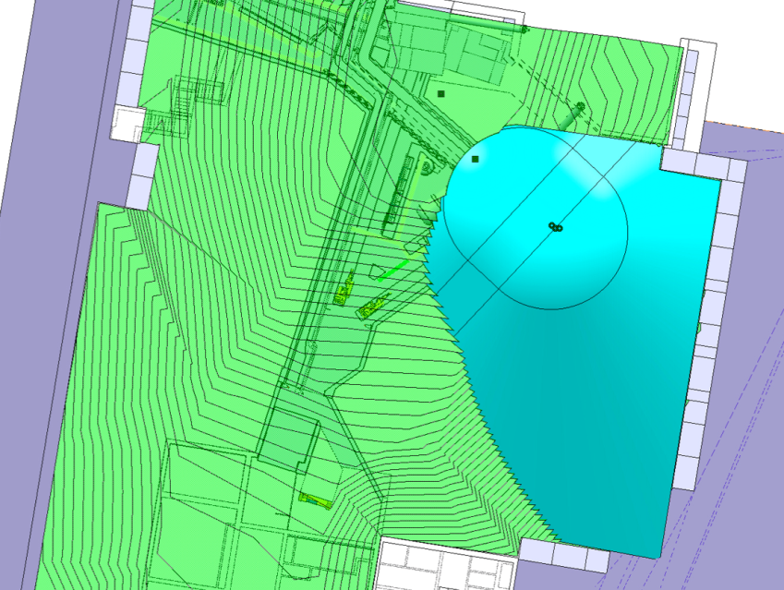
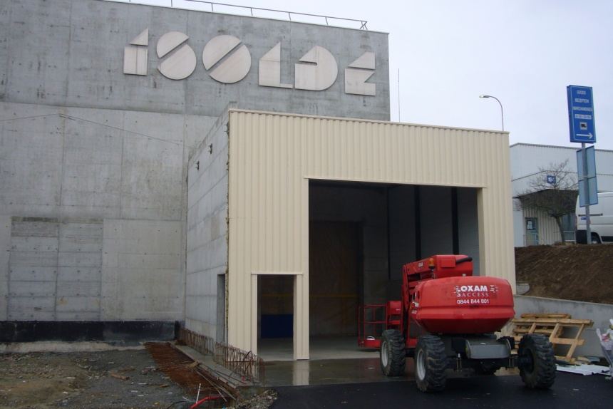
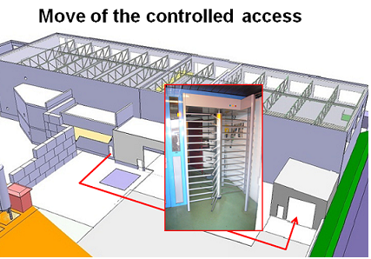
Access to ISOLDE
Following report by RP on the evaluation of the shielding at ISOLDE
  EDMS 1142606
Fencing to be put up before start up.
Turnstile will be moved to new sas in
E. Siesling

Slide 13



INjector Control Architecture @
Advantages:
Better performance thanks to centralised computing
Settings history logged in DB
Better scalability
Better security
Control room workstation
Working set
Knob
Specific applications
3-tier Architecture
based protocol
INCA deployments status:
PSB & LINAC 2
PS
LEIR & LINAC 3
SPS
ISOLDE
System INCA
Application server
CMW (middleware)
2012
Why at Isolde?
Control system uniformity within the accelerators complex
More flexibility and customization capabilities
FEC (Front End Computer)
FESA server
Real Time tasks
E.Piselli (BE-OP-PSB)

Slide 14
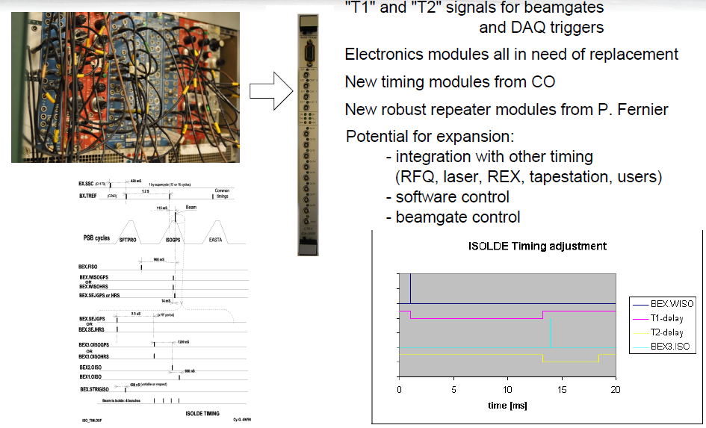
Timing Signals Renovation
T. Giles, P. Fernier

Slide 15
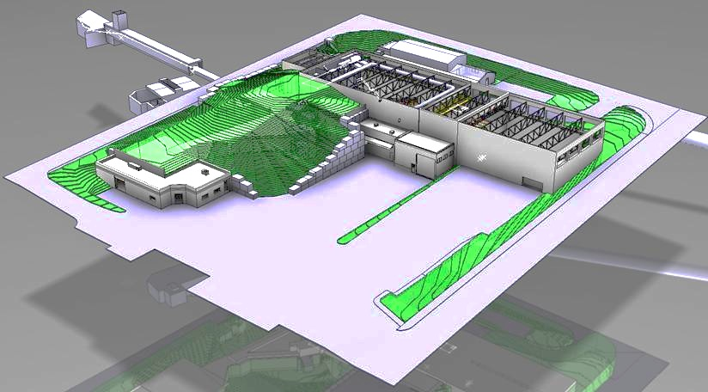
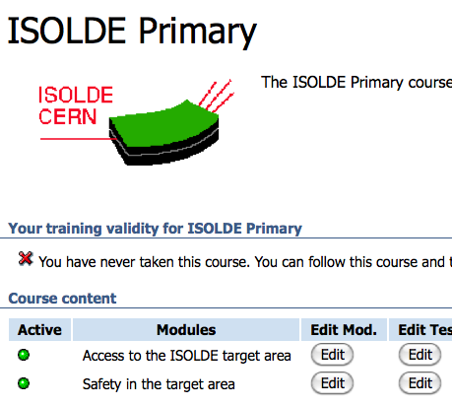
General Safety
ISOLDE Primary area inspection by the French and Swiss authorities → Few minor remarks
Web based safety course will be requested to get the access rights of the primary area
A-P Bernardes

Slide 16
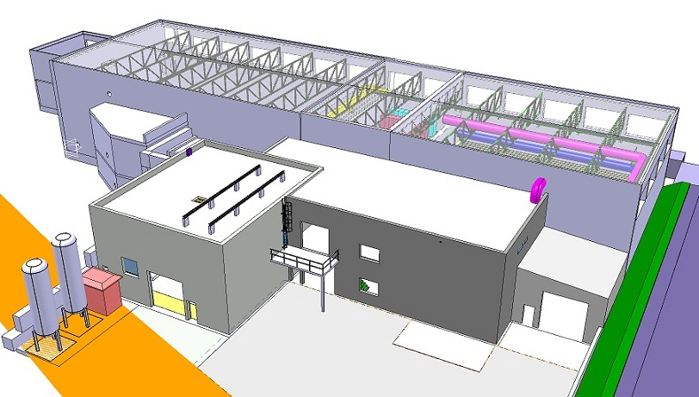
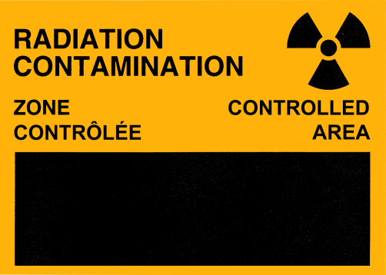
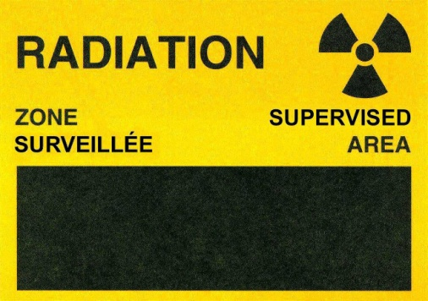
Safety
Existing Building 170
Controlled area
Supervised area
Date to be discuss with RP
(D < 6mSv/year)
Supervised area → Controlled area:
No more VCT (Short term visitor)
Medical certificate mandatory to get the dosimeter
No visitor allowed (only technical visits)
A-P Bernardes

Slide 17
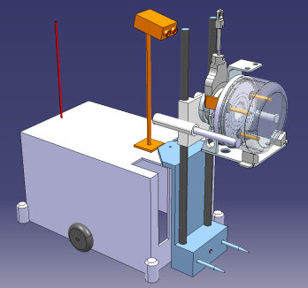
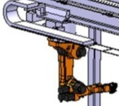
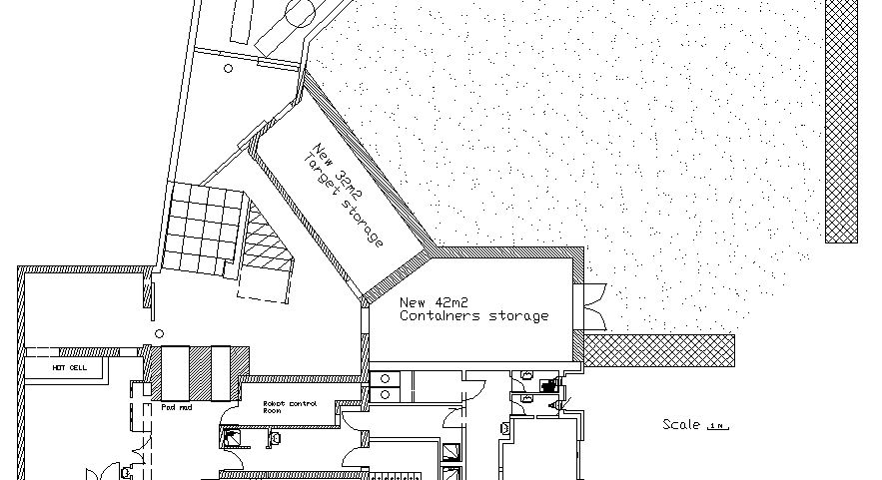
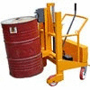

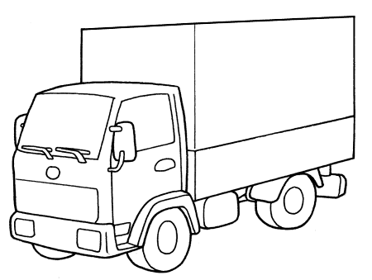


Target life cycle and Handling
Handling with
1 remote controlled
vehicle
2 new Kuka linear Robots
In Isolde Target Area
(2013)
Deliver the new target to the exchange point for the Kuka robots
Remove hot target and place on the shelf (during shut down)
Move the 3 years decayed target from shelf to hot cell
Move waste containers (with “standard” trans-pallet)
New hot
Cell (2013)
New
Target
To PSI
S. Marzari

Slide 18
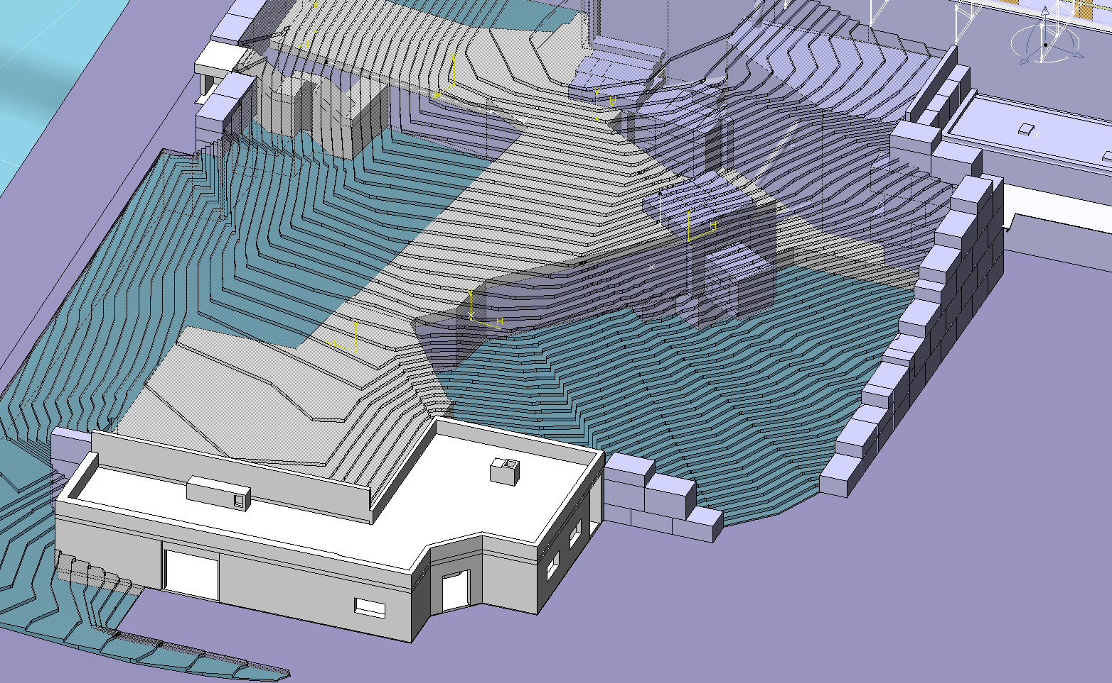
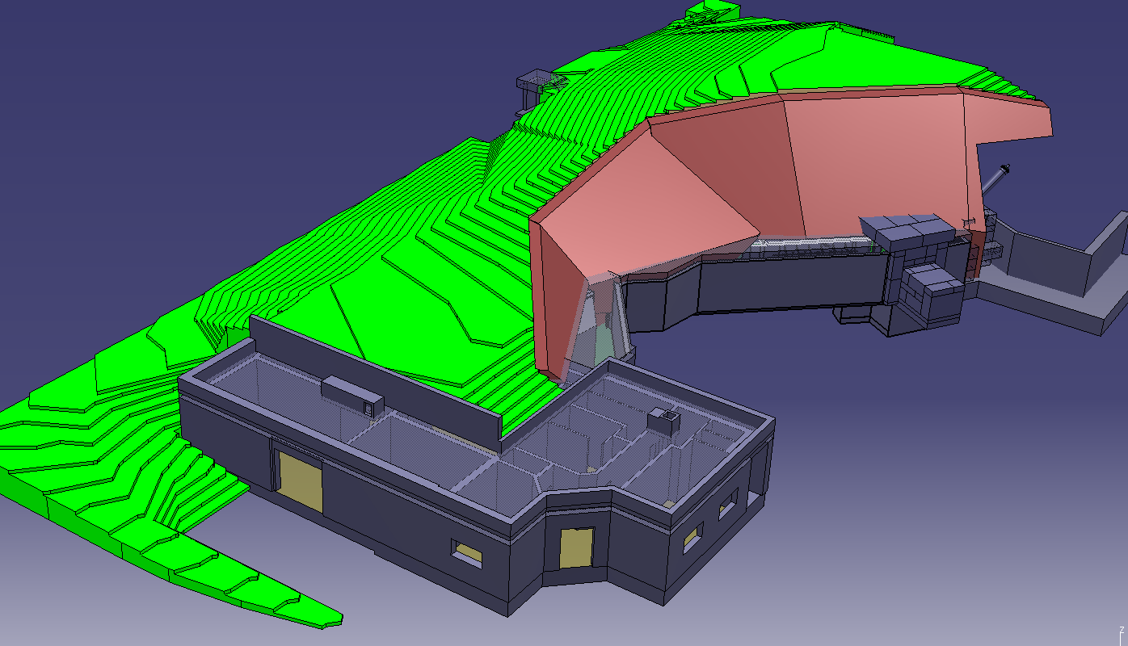
HRS Shielding improvement
New storage
~5000 m3 earth removal
~200m2 for nuclear medicine
S. Marzari, T. Stora

Slide 19
Civil engineering overview
Building 115
Class C lab
Building 507
Light building
Target area extension
TSR extension
Medical Isotope
Facility
Building 199
cold box
Building 198
Compressor room

Slide 20
Thank You
To the ISOLDE team and all the supporting groups
…and for your attention

