Slide 1

Status of The HIE-ISOLDE Design Study
Richard Catherall EN-STI
ISCC Meeting
30th October 2012
CERN

Slide 2

Outline
Intensity Upgrade
  Target Studies………………………………….…WP5.1
    Materials
    Thermo-mechanical properties
  Target & Frontend Upgrades……………….WP5.2
  Target Area Upgrades
  Ventilation…………………………………………..WP 6.2
  Fluka simulations…………………………..…….WP 5.1
Beam Quality
  Off line separator/HRS magnet……………WP 7.1
  RFQ Cooler………………………………………….WP7.2
  Controls………………………………………………WP 6.8
  Vacuum……………………………………………….WP6.2
  REXEBIS upgrade………………………………….WP 7.4

Slide 3

CATHI Mid-Term Review
Held on the 26th September 2012
All CATHI Fellows (and supervisors) gave excellent presentations on both the CATHI Project and their work for HIE-ISOLDE.
Highly commended by the EC representative
  “one of the better, if not the best, organized ITN programs at present..”
Strongly encouraged to submit another ITN proposal

Slide 4
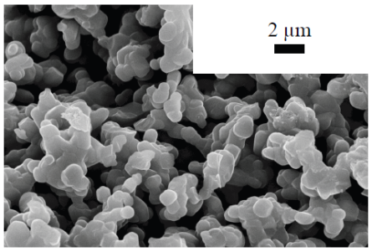
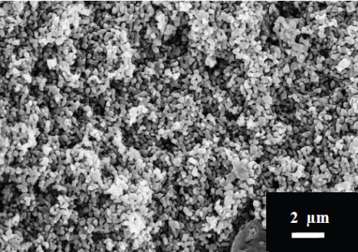
Target Materials WP6
Intensity
Upgrade
Carry out simulations of proton beam interactions with existing and potential target materials using FEM structural codes
Establish experimental programme to validate the simulations and verify the production rates and diffusion constants for different material prototypes.
Post analysis of samples
Silicon Carbide and Alumina prepared with ice-templating method in collaboration with St. Gobain
Irradiation of SiC samples already done
More samples to be irradiated using the HIRADMAT facility
Targets
Solid metals
Carbides
SiC
Oxides
Alumina
Molten metals
Michal Czapski

Slide 5
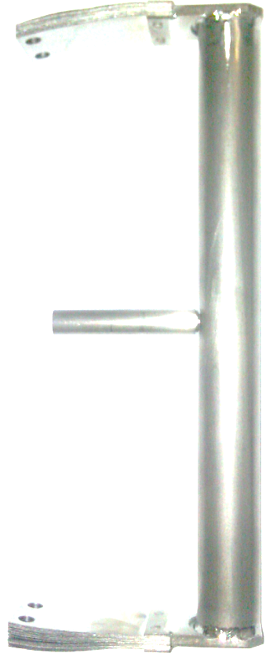
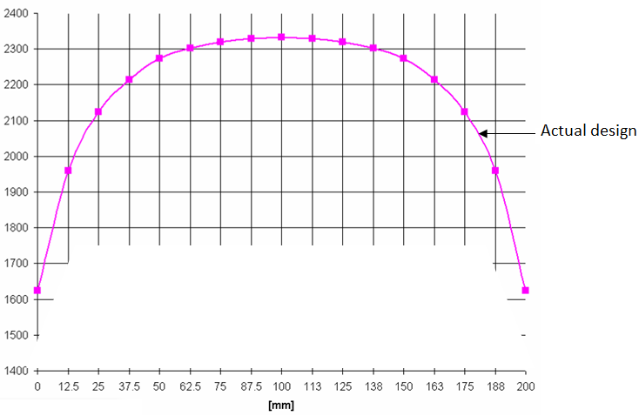
Thermo-mechanical properties WP5
Intensity
Upgrade
Obtain a uniform temperature distribution in the container.
  Maximize the isotopes production rate on the cold edges;
  Avoid re-condensation of isotopes on the edges.
Investigate the use of heat pipes as a solution to removing water from the target unit
  Safety issue
[°C ]
  Development of a script in the code Mathematica to foresee analytically the temperature of the Containers in the hypothesis of Grey Body.
  Measurements and calibration of different containers to obtain base line and to validate code
Serena Cimmino

Slide 6
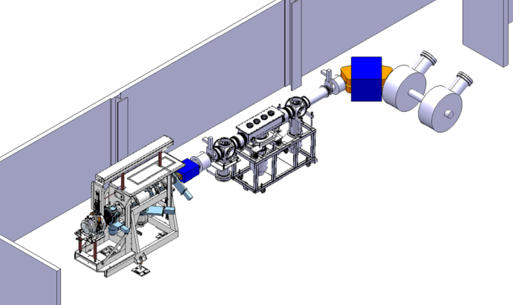
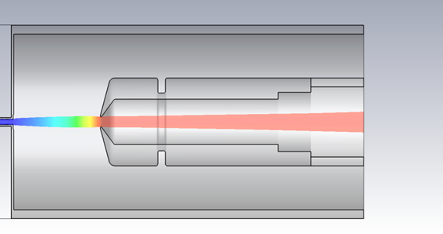
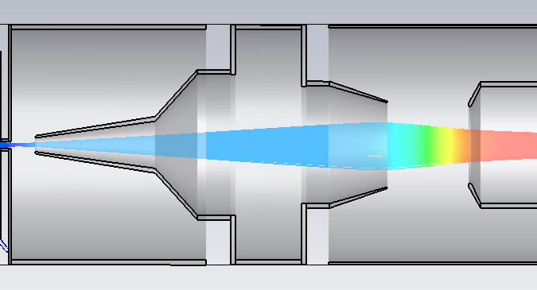
  Target & FE Upgrades WP6
  Beam extraction optics
  Conceptual and functional upgrade of the Front End design
Intensity
Upgrade
Off-line mass separator layout
Tests of breakdown in radiation
Redesign of ion extraction system
Jacobo Montano Carrizales

Slide 7
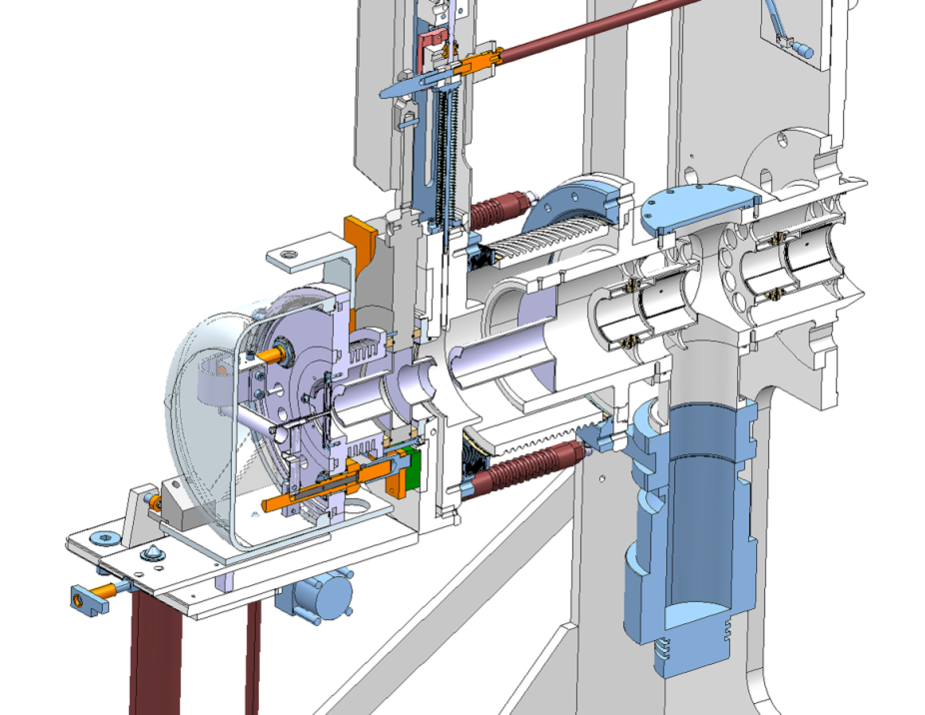
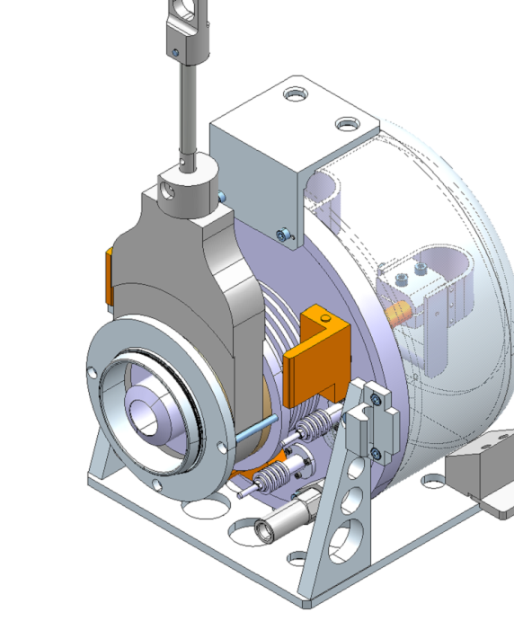
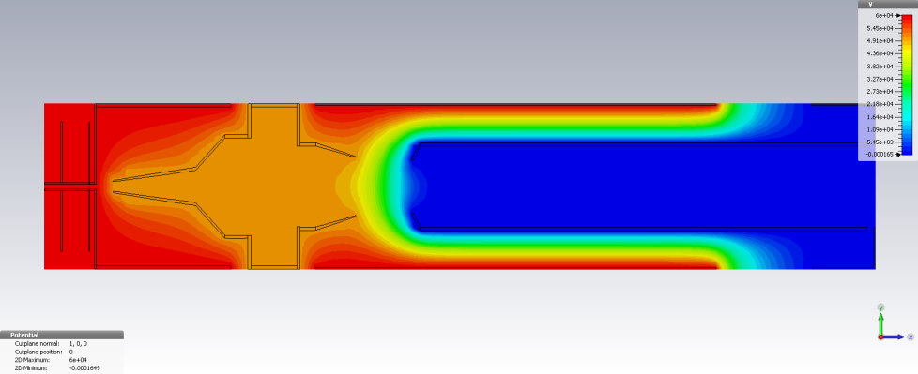
Redesign of Extraction System
Intensity
Upgrade
Fixed electrodes, larger apertures, simpler and more compact frame
Jacobo Montano Carrizales

Slide 8
HT Breakdown tests in ionizing environment
Intensity
Upgrade
Important parameter for the FE upgrade
Little information available
ISOLDE is an ideal place to study this phenomenon
  Before LS1
Next October 8th a new target unit will have a small setup for testing the HT breakdown during p-beam impact
Cancelled due to GPS frontend failure
  But BE-ABT to do tests before end of year
Jacobo Montano Carrizales

Slide 9

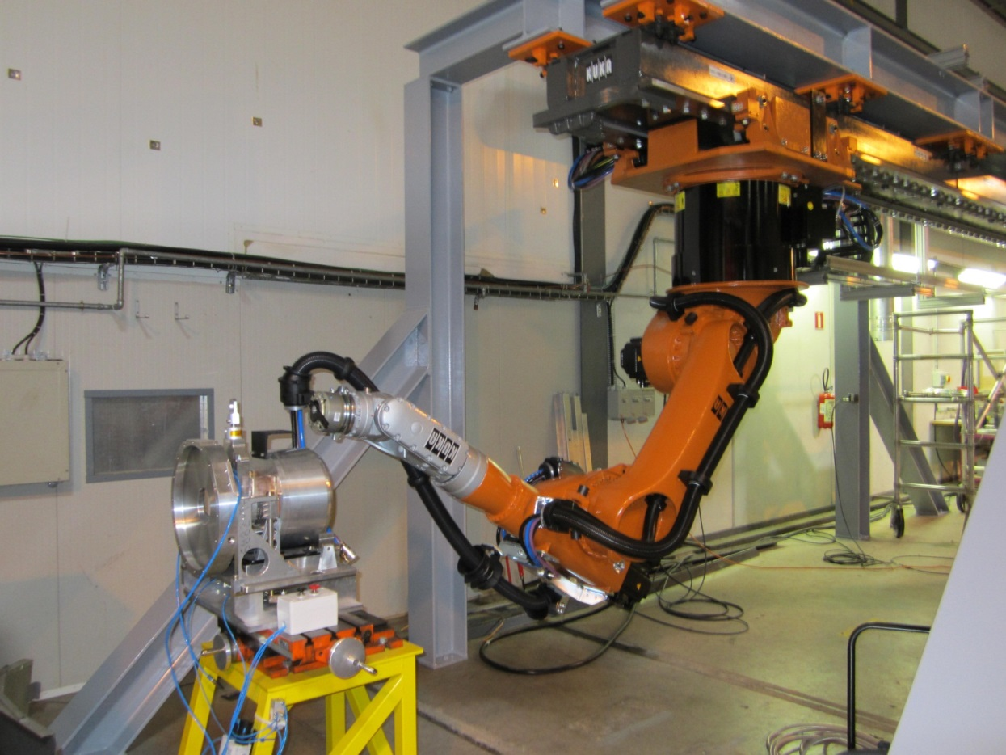
Robots
Target Area
Upgrades
1st Robot procured and under going tests
Integration under way
Installation autumn 2013
Modification of ventilation system

Slide 10
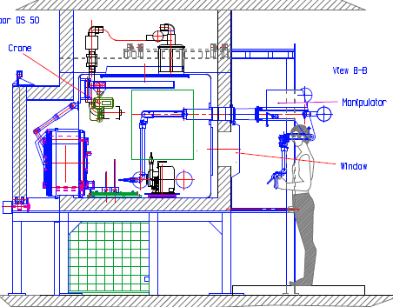
Hot Cell
Target Area
Upgrades
Invitation to tender gone out
Installation planned for January 2014
Target handling, storage and access to be considered
Connected to ventilation system

Slide 11
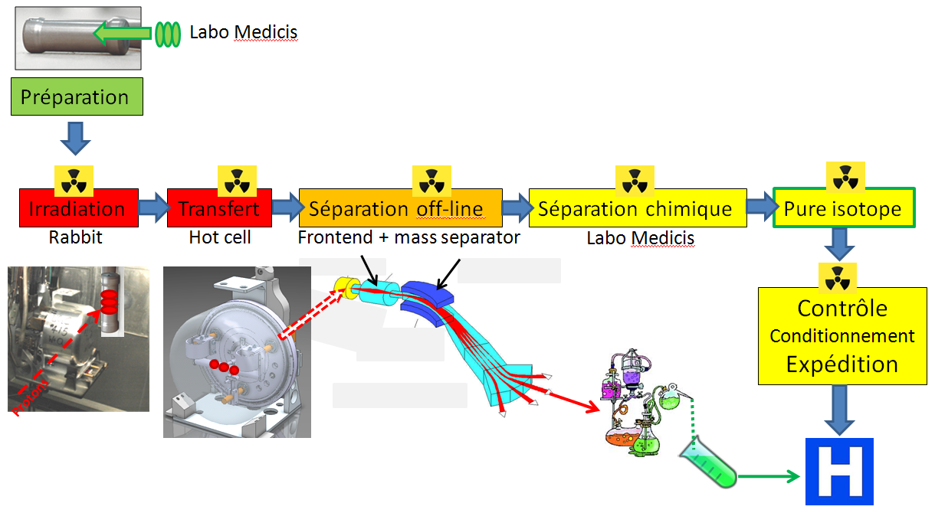

MEDICIS
Target Area
Upgrades
MEDICIS principle
Freely available
KT Fund

Slide 12
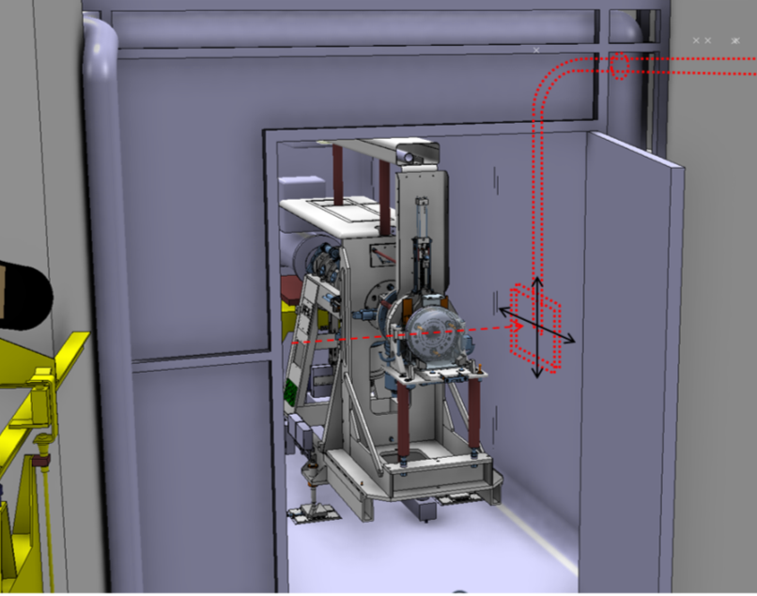
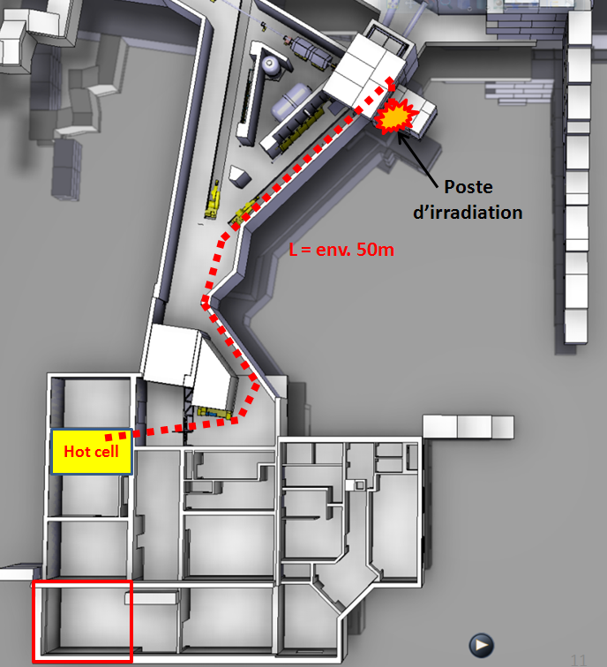
MEDICIS
Target Area
Upgrades
Project has now been approved by the DG
Initial finance for construction work has also been approved.
Project Leader: T. Stora
Irradiation transport system to be implemented during the LS1

Slide 13
PAD-MAD Access
Target Area
Upgrades
Installation planned for the end of 2013
Version with new target storage being investigated
Robot barrier will be integrated
MAD can be removed for Front End passage
PAD
MMAD
CLEFS
CHECK POINT RP
EDMS no.1145495

Slide 14
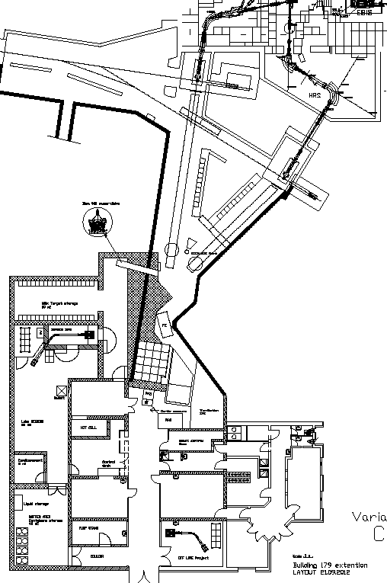
Building 179 extension
Target Area
Upgrades
New storage
  Eliminate the need to transport irradiated targets on the CERN site
  Easier handling for access to new hot cell
  Compatible with new CERN access system (PAD/MAD)
  Compatible with new robots
  Buffer zone/dispatch
Medicis laboratory
  New off-line separator connected to RABIT system
  Preparation laboratory
All these upgrades overlap with Design Study

Slide 15
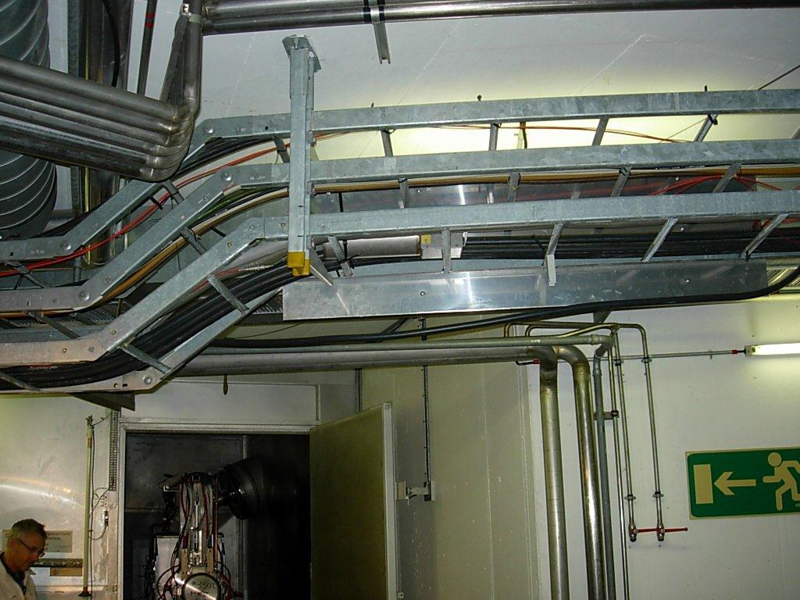

Ventilation WP6.2
Intensity
Upgrade
Delays due to the decision on other upgrades
  Now “fixed”
But…
  Experience gained in the modification of the vacuum system for the robots
  Coupling of hot cell to ventilation system
Now
  Functional specs of air tight lock to separate target area from Class A labs
  Can now start on ventilation separation specs

Slide 16
Ventilation
Intensity
Upgrade
Courtesy of V. Barozier

Slide 17
Fluka Simulations WP 5.1
Intensity
Upgrade
Training of Leonel Hernandez
  Simulations for the neighboring compressor room prior to construction
  Fluka simulations to validate dose rates associated with the proposed modifications of building 179
  Now ready to simulate possible scenarios depending on beam parameters and shielding
Leonel Morejon Hernandez

Slide 18
Fluka Simulations
Intensity
Upgrade
ISOLDE beam dumps
Brought to our attention following the upgrade of the Booster beam dumps for the 2GeV upgrade
WP not identified in design study
  But will be included
  Initial Fluka simulations done
  Thermal calculations on-going within EN-STI
Leonel Morejon Hernandez

Slide 19
Beam quality Upgrade
Beam
Quality
Courtesy of T. Giles

Slide 20
Off-line 2 Mass Separator Layout
A test bench for validation
Beam
Quality
FE
FE + RFQ
FE + RFQ + 90° magnet
FE + WF + RFQ + 90° magnet

Slide 21
Off-line Separator WP7.1
Beam
Quality
Proposal of a mechanical layout for the off-line test
Beam optics simulations
performed
Off-line Separator Specifications”: layout proposed, beamline items are being gathered, finite element design software simulations to be carried out;
Assembly and commissioning of off-line separator”: magnet test certifications to be performed within the coming weeks ;
Beam optics simulation codes” : numerical simulations completed for off-separator, ongoing activity for HRS magnet
Definition of magnet controls requirements
in progress
(with M. Colciago, STI-ECE section)
Contact with IVM group for vacuum requirements
Courtesy of T. Giles
Matthieu Augustin

Slide 22
RFQ Cooler WP7.2
Beam
Quality
Approach
  Alignment
    Adjustable alignment of the electrodes
  Pressure gradient
    Reduce pressure at injection and extraction electrodes by adding more holes to the plates
  CST Particle Studio used:
      To simulate particle trajectories
      To provide acceptances on parts of the machine
      To diagnose electrical charge build up
      Shapes, voltages and distances can be simulated
Carla Babcock

Slide 23
RFQ Cooler & Pre-mass separator WP7.2
Beam
Quality
RFQ Cooler will be part of the test stand
Drawings done and procurement started
RFQ Cooler design report done
Options for the pre-mass separator under investigation
  Wein filter, bending magnet etc
Carla Babcock

Slide 24




Magnet Controls WP6.8
Beam
Quality
New control under development using LabVIEW Real Time
Control loop
  Use an industrial control: Proportional-integral-derivative control (PID) with anti-windup scheme
  Develop a Hysteresis model to support the NMR during blind time
  Matlab-Simulink is used as simulation software
$$B_{ref}$$
-
error
$$I_{ref}$$
$$B$$
PID
Power supply
MAGNET
$$B_{measured}$$
Switch
NMR
$$B_{simulated}$$
Hysteresis
Martino Colciago

Slide 25
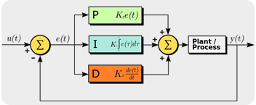
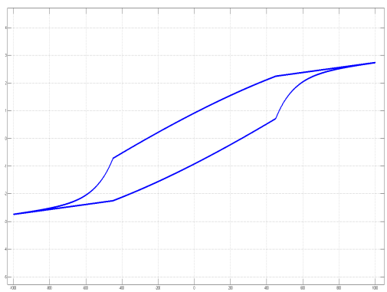
Magnet Controls WP6.8
Beam
Quality
PID control
$$K_{p}e\left(t\right)+K_{i}\int{e\left(t\right)dt}+K_{d}\frac{de(t)}{dt}$$
$$K_{p}=proportional gain;$$
$$K_{i}=integral gain;$$
$$K_{d}=differential gain.$$
$${u\left(t\right)=B}_{ref} and y\left(t\right)=B_{measured} by NMR$$
These gains have to be tuned on the magnet to optimize the behaviour of the control system
Hysteresis model
B
H
$$Ḃ=C_{α}\left|Ḣ\right|[f\left(H\right)−B]+Ḣg(H)$$
  Differential model: Coleman-Hodgdon
  The model has 5 parameters which need to be tuned on real data
Simulated hysteresis
Controls for off-line separator
Martino Colciago

Slide 26
Vacuum WP6.2
Initial phase
o Calculation of pumpdown time of a cryomodule
o Measurement of outgassing rates of different materials to ensure vacuum compatibility
o Support of drafting of workpackage description
o Establish inventory of outgassing elements in cryomodule
o Measure pumping speed of dry pump
o Simulation of pressure propagation in beam transfer line in case of accidental vacuum rupture
o Study sealing and flanging methods for intertank connection
o Study vacuum layouts
Design study activities
o Study upgrade of current gas recuperation system
o Design, build up and run a test setup for dry pump studies
o Collaboration with software developer of the monte carlo test particle code MOLFLOW+ in order to improve its ergonomics and calculation abilities
o Simulation of vacuum profiles at existing and future Radio-frequency quadrupole cooler and buncher ISCOOL
o Study alternative sealing and pumping methods for the new Front-End
o Support collaborators in terms of consulting regarding vacuum technology
Beam
Quality
A
B
C
Mario Hermann
Notes:
As you can see, my research activities are broad including theoretical and practical aspects
I like it to do hands-on work after a certain time in front of the PC doing simulations or other things
In the following I want to give you a slightly deeper insight into our work. For this purpose I chose to focus on 3 activities of importance for our project

Slide 28
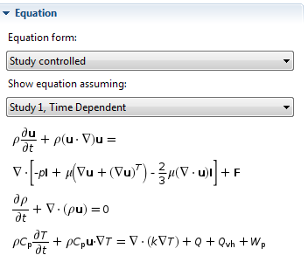
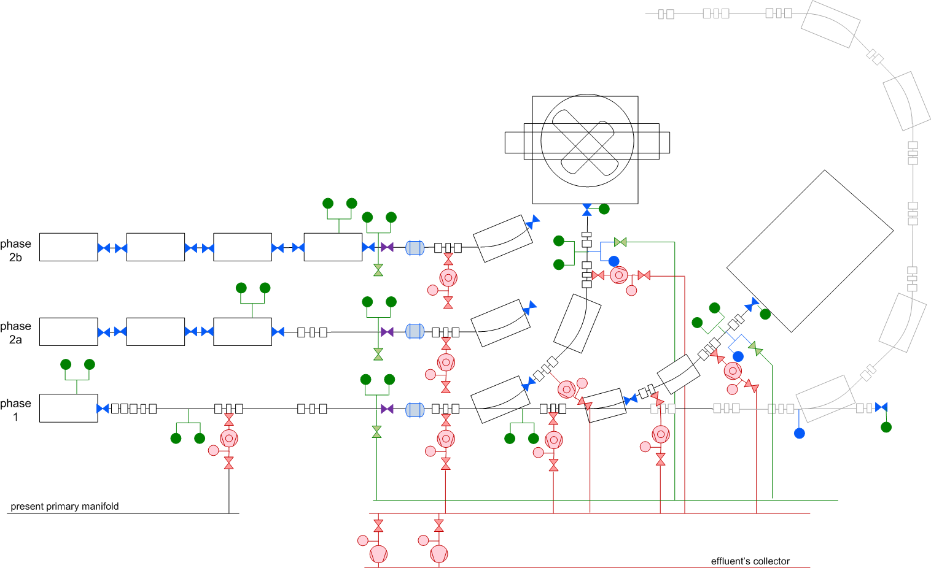
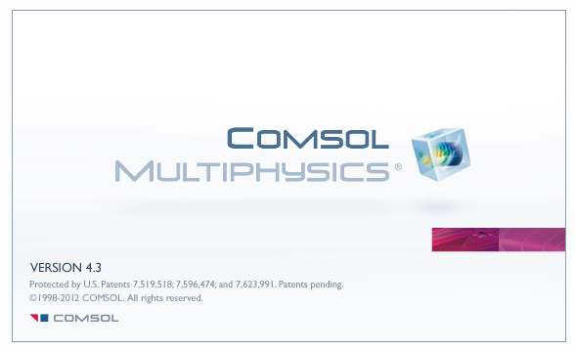
Vacuum Example B
Beam
Quality
Simulation of pressure propagation in beam transfer line
Avoid contamination of cavities in case of vacuum rupture at experiments
Mario Hermann
Notes:
Second example is the simulation of pressure propagation in beam transfer lines. Explain why and how we do it

Slide 29
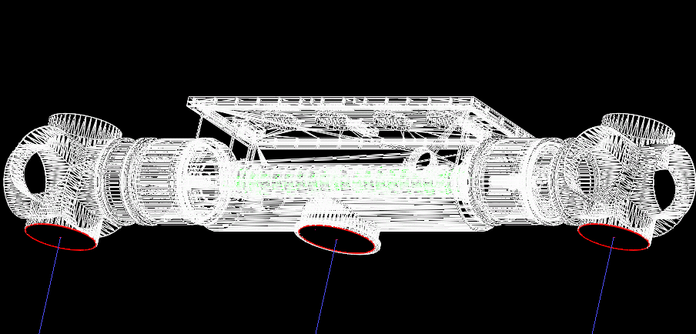
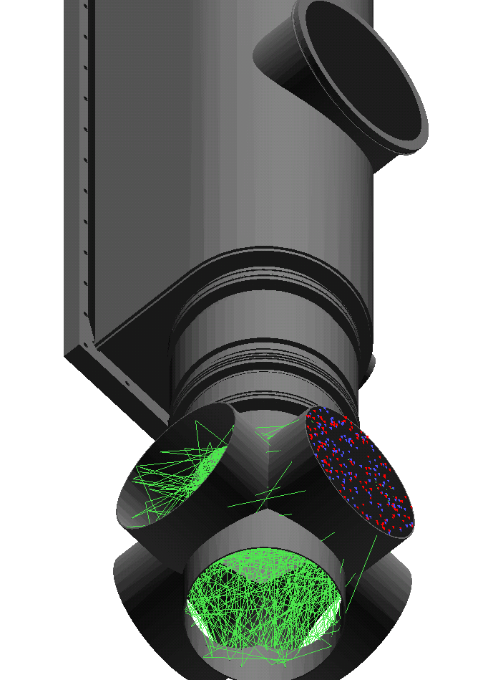
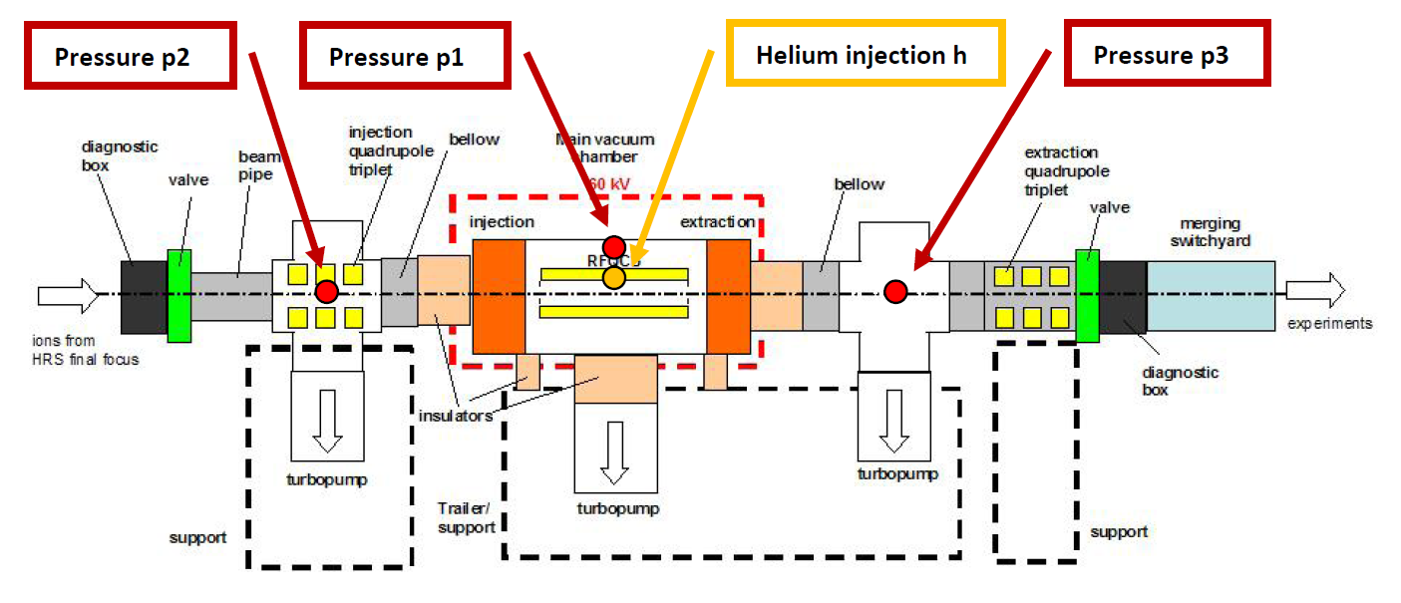
Vacuum Example C
Beam
Quality
Simulation of vacuum profiles at ISCOOL
Optimization of beam quality at future Radio-frequency quadrupole cooler and buncher
Mario Hermann
Notes:
Third example is the simulation of vacuum profiles at ISCOOL. Explain why and how we do it

Slide 30
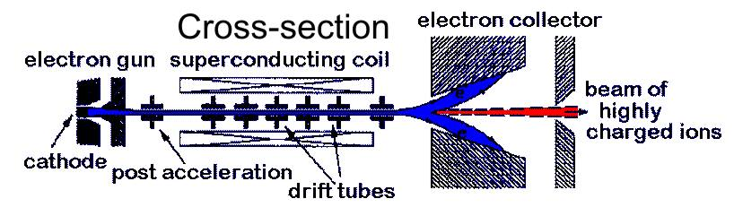
WP7.4: Radioactive Ion Beam Quality Charge breeder design study
Beam
Quality
Simulations of high current space charge limited electron beam for HIE-EBIS;
Simulation based design of High Energy Current and Compression (HEC²) electron gun, drift tubes, High Power Collector (HPC) and spec for the magnetic system;
General design concept of the HIE-EBIS;
Andrey Shornikov

Slide 31




Project status and achievements after 3 months
Beam
Quality
Active knowledge transfer:
Visited best performing relevant EBIT/S groups at MPIK, BNL, MSU/NSCL.
Preliminary agreement on collaborative construction of the HEC² gun with BNL, getting approval at CERN. If approved and funded the gun can be built and tested within the 2 years WP*.
HIE-EBIS wide board workshop** with attendance of 28 on 16-17.10 to discuss the options and get feedback from CERN and external experts
* Goes beyond WP **CATHI sponsored
Andrey Shornikov

Slide 32
Conclusions
Thanks to the CATHI project we have a dynamic and enthusiastic team of young researchers working on the HIE-DS
High Intensity Upgrade
  Compatibility with the Target Area Upgrade has now been established, opening the door for the Fluka and ventilation WPs
  Work is progressing well on target and FE WPs
Beam Quality Upgrade
  In a good position to validate concepts for RFQ Cooler and FE
Test stand is an important milestone
Excellent progress on REXEBIS upgrade thanks to the collaboration with BNL

