Slide 1
INTC matters
.
Magdalena Kowalska

Slide 2
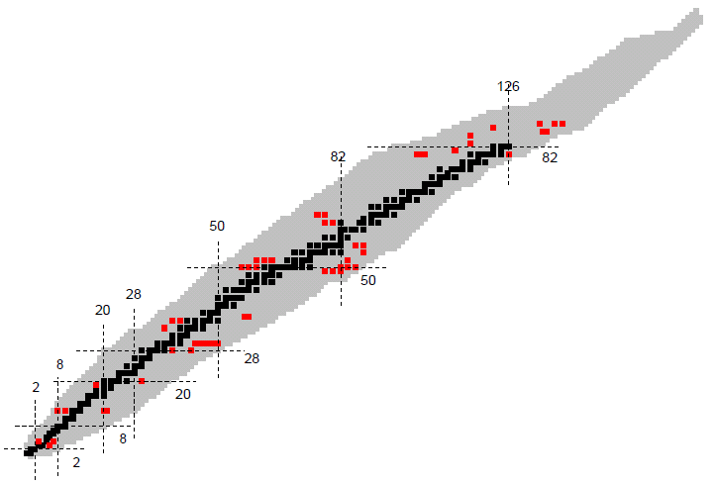
Oct 2012 meeting
Request for > 800 HIE-ISOLDE shifts
30 proposals
MINIBALL + CD-only, + T-REX, + SPEDE (15)
HELIOS (5)
Scattering experiments (3)
Active target (2)
Si+ SAND (1)
429 shifts accepted (about 200 REX schedule per year)
Most other proposals asked for clarification letters (so they’ll probably come back)

Slide 3
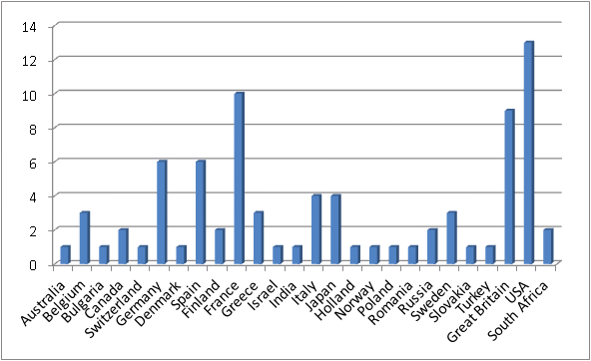
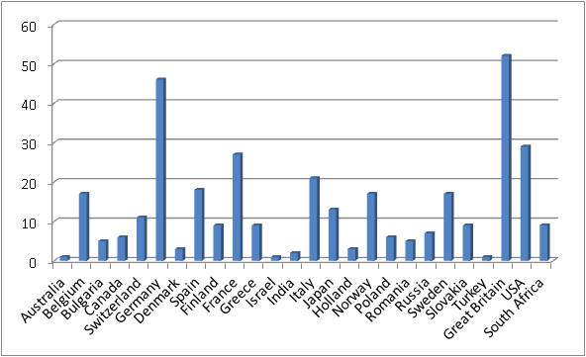
Statistics – Oct 2012
number of institutes per country
81
344
number of physicists per country of their institute

Slide 4
Shift status
Low-energy IS experiments (including WITCH): 364.5 shifts
Post-accelerated REX experiments: 216.5 shifts
HIE-ISOLDE shifts: 429 shifts

Slide 5
Strategy
Ask low-energy collaborations for status reports (SR) and addenda (ADD):
1 SR per collaboration, e.g. COLLAPS, CRIS, SSP, …
ADD for each IS experiment if more shifts needed than available
If no SR -> experiment closed, shifts at 0
Ask REX experiments for status reports (SR) or addenda:
1 SR or ADD per IS experiment
If no SR -> -> experiment closed, shifts at 0
Timing:
June and October 2013 – INTC open to low-energy and HIE-ISOLDE proposals, LOIs, SR, addenda
January/February 2014 – only low-energy SR and ADD

