Slide 1
Safety Issues
Ana-Paula Bernardes EN-STI-RBS
ISCC
Tuesday 03rd of July 2012

Slide 2
Outline
Radioprotection
REX post-accelerator radiation shielding
Access
General Safety
Oxygen deficiency hazard and access to the HIE-REX accelerator
Pressure hazard
Seismic hazard
Conclusion

Slide 3
Outline
Radioprotection
REX post-accelerator radiation shielding
Access HIE-ISOLDE experimental area
General Safety
Oxygen deficiency hazard and access to the HIE-REX accelerator
Pressure hazard
Seismic hazard
Conclusion

Slide 4
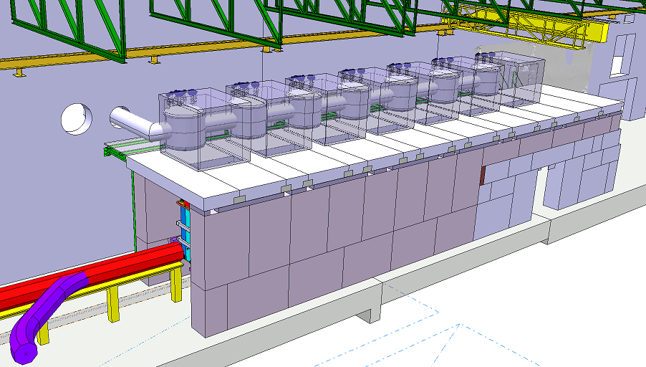
Radioprotection
Shielding
Only X-rays drive the shielding:
Dose rate from X-Rays : several mSv/h at 1 meter from cryomodules
Dose rate from neutrons : Maximum of 200 μSv/h at 1 meter from the interaction point
Acknowledgement S.Maridor

Slide 5
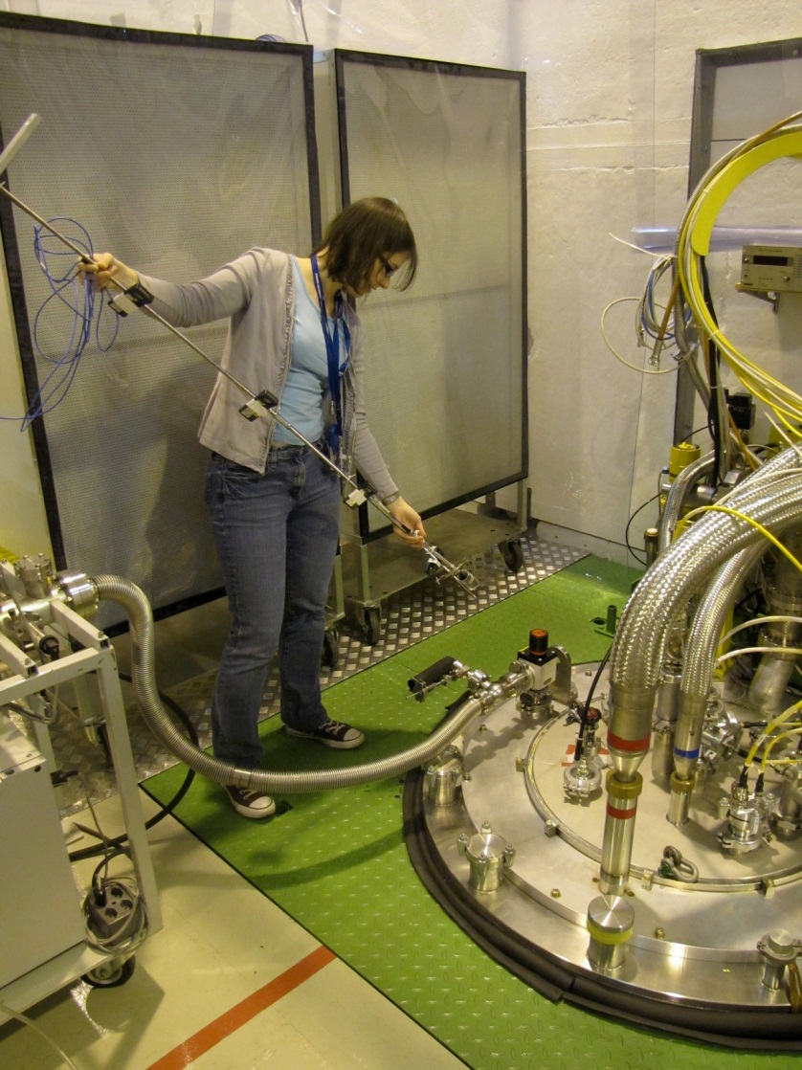
Radioprotection
Shielding studies: (Acknowledgement J.Vollaire and S.Giron):
Measurements campaign by DGS-RP in agreement with cryomodule test schedule (conditioning and during nominal conditions)
Shielding sizing based on LNL data (7 mSv/h inner side of shielding – distance of 3 meters) as envelop scenario for the shielding in order to go ahead with tunnel integration
Started by DGS/RP

Slide 6
Radioprotection
Strategy for experimental Hall for HIE-ISOLDE Collaboration J.Vollaire, F.Wenander, D.Voulot
Normal operation - Data used for defining access to the experimental area
< 1μSv/h at 1m
< 4μSv/h at 1m
< 200μSv/h at 1m
Exceptional procedure used for example during commissionning
→ Specific safety measures will be put in place and beam permit will be requested
Acknowledgement D.Voulot – Data extract from EDMS 1224228 “Specification of the sources of radiation and maximum beam intensities and energies of the HIE-ISOLDE Linac”

Slide 7
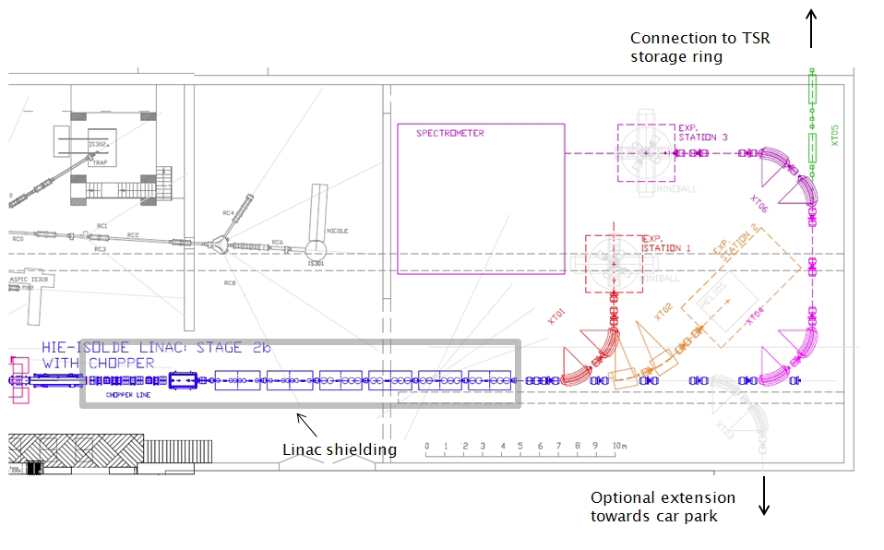
Radioprotection
Access system with key (interlocked with RF power)
No Access Control for the experimental

Slide 8
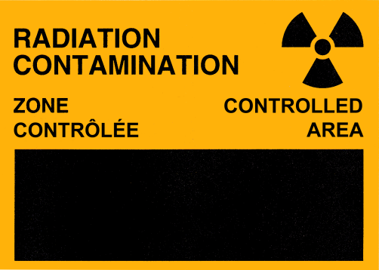
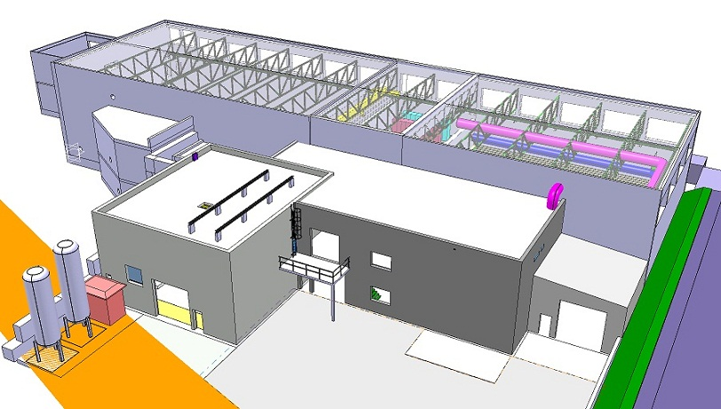
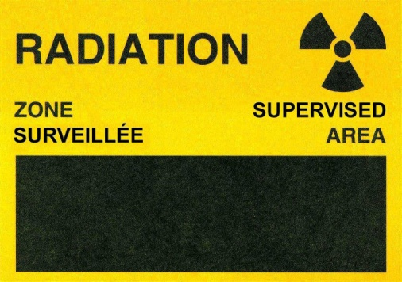
Radioprotection
Area classification change due to presence of contamination
Existing Building 170
Controlled area
Supervised area
In near future on request of RP
(D < 6mSv/year)
Supervised area → Controlled area:
No more VCT (Short term visitor)
Medical certificate mandatory to get the dosimeter
No visitor allowed (only technical visits)
Picture from V.Barozier

Slide 9
Outline
Radioprotection
REX post-accelerator radiation shielding
Access HIE-ISOLDE experimental area
General Safety
Oxygen deficiency hazard and access to the HIE-REX accelerator
Pressure hazard
Seismic hazard
Conclusion

Slide 10
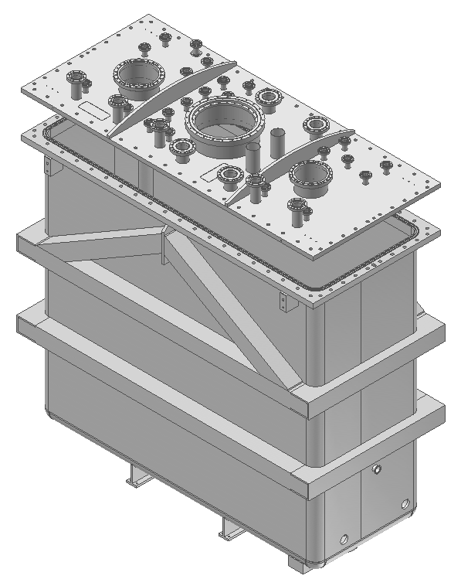
Pressure Hazard
Pressure Equipment shall be designed following CERN Safety rules:
General Safety Instruction on standard pressure equipment (GSI-M2) EDMS 875610 → European directive 97/23/EC
In complement EN 13458 standard on “Cryogenics vessels – Static vacuum insulated vessels”
“pressure equipment” means vessels, piping, safety and pressure accessories, not exposed to open flame, and subject to a maximum allowable pressure greater than 0.5 bar
Vacuum insulated vessel PS<0.5 bar
Not considered as pressure vessel from European directive definition – No EC marking is requested
Acknowledgement Y.Leclercq

Slide 11
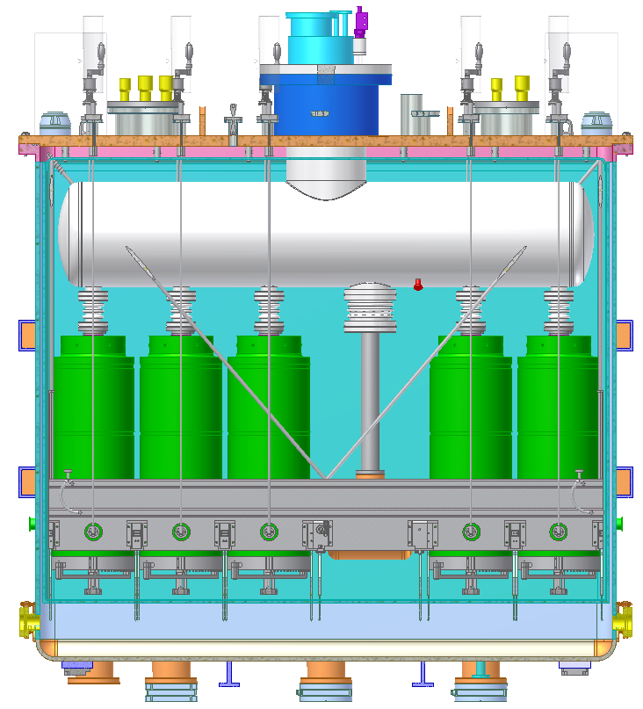
Pressure Hazard
Pressure Equipment shall be designed following CERN Safety rules:
General Safety Instruction on standard pressure equipment (GSI-M2) EDMS 875610 → European directive 97/23/EC
In complement EN 13458 standard on “Cryogenics vessels – Static vacuum insulated vessels”
For the LHe tank and the Solenoid:
PS → 4 bars
Considered as pressure vessel from European directive definition – EC marking is requested
Pressure and leak tests will be requested
Category II
Cavities → Category II but no CE marking will be requested
Acknowledgement Y.Leclercq

Slide 12
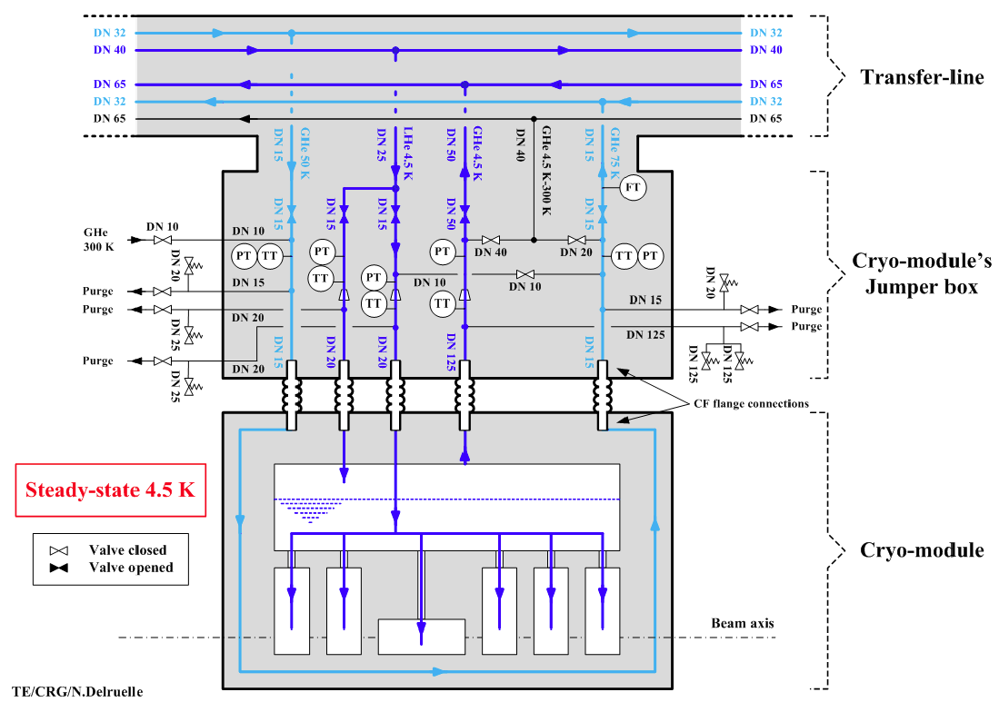
Cryogenic Hazard
In addition cryogenic installation shall comply with CERN rule :
IS47 “the use of cryogenics fluids” EDMS 335812
“The liquid container shall be protected against overpressure by a minimum of two
relief devices in parallel, preferably of different types…”
2 safety valves for all cryogenics equipment containing LHe
Acknowledgement N.Delruelle

Slide 13
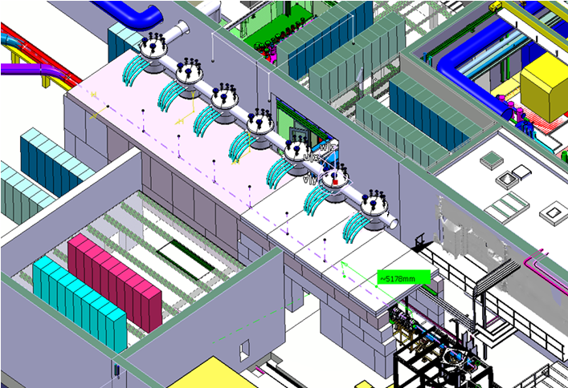
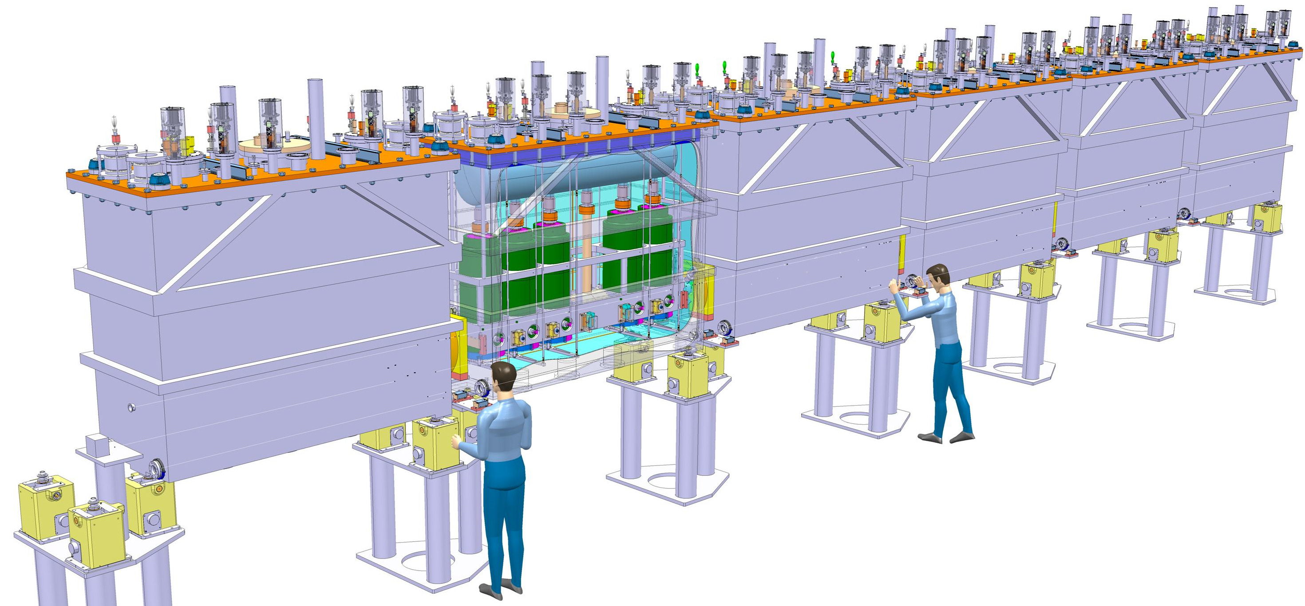
Cryogenic Hazard
Cryogenic Released Scenarios needed for safety devices sizing (Acknowledgement N.Delruelle)
Total loss of cryomodule insulation vacuum → 2 safety valves will release He outside of HIE-ISOLDE tunnel
No release inside tunnel → No asphyxia hazard for people
Collaboration N.Delruelle et C.Parente

Slide 14
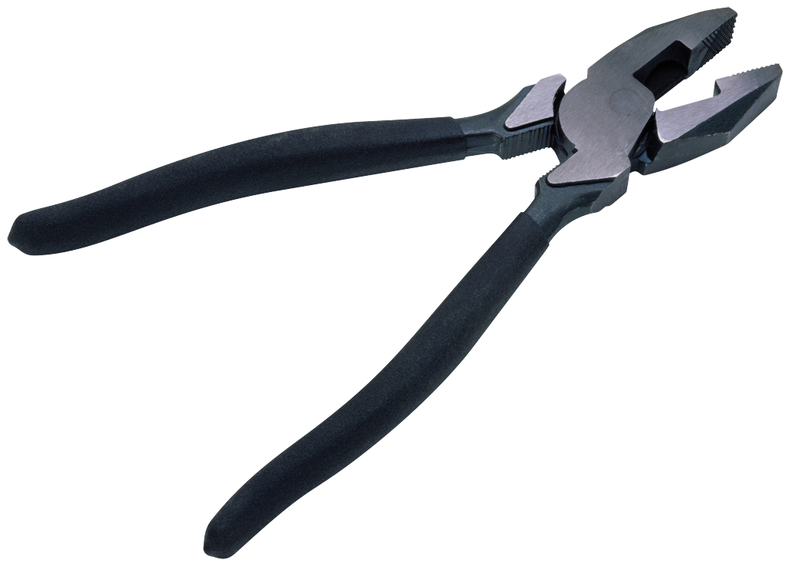
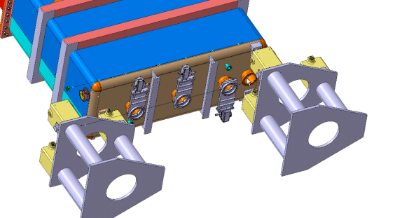
Cryogenic Hazard
Cryogenic Released Scenarios needed for safety devices sizing (Acknowledgement Y.Leclercq)
Total rupture of one connection between LHe tank and cavity → 1 safety valve (Final sizing to be done)
Two options open:
Collecting output from safety valves and routing to tunnel openings
No collecting but specific procedure to access the tunnel under discussion
Cryomodule insulation vacuum safety valve
Collaboration Y.Leclecrq et C.Parente

Slide 15
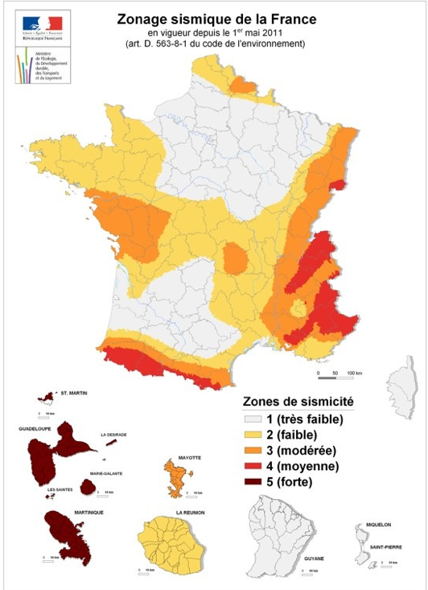
Seismic
Infrastructure and sensitive equipment shall be designed following CERN Sismic Safety rules:
The French territory is divided in five seismic zones from very low seismicity (seismic zone 1) to strong seismicity (seismic zone 5) – EDMS 1158454
CERN is classified as seismic zone 3

Slide 16
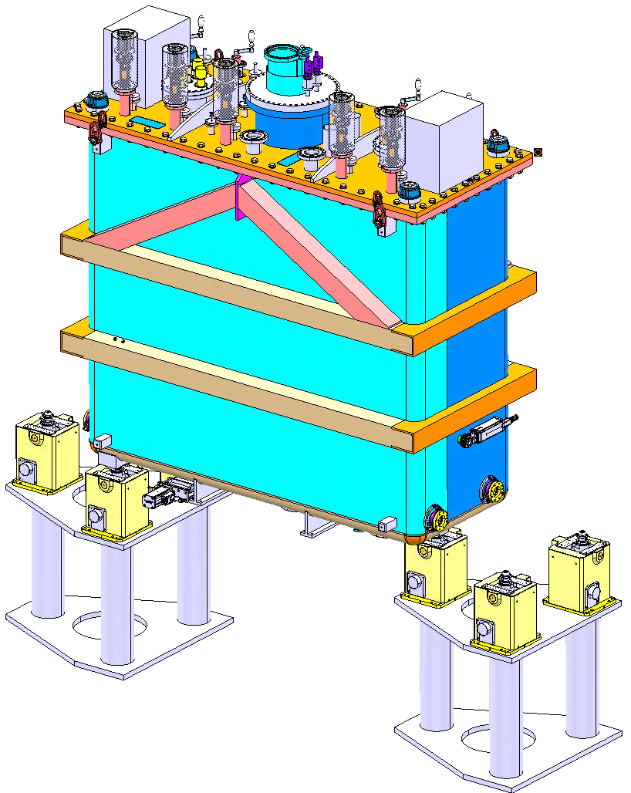
Seismic
All building including tunnel are concerned as well as some equipment:
Cryoplant
Cryomodules
Cryomodule/jack connection to comply with seismic rules
Jacks to comply with seismic rules
Acknowledgement Y.Leclercq

Slide 17
Conclusion
Radioprotection
Shielding
X-Ray measurements on going
Use of envelope case from Legnaro for shielding specification
No Access Control for the experimental Hall expected – to be confirmed by DGS/RP
General Safety
Option for cryogenic safety may allowed access when cavities are cold → to be confirmed by the safety unit DGS/SEE
Specific procedure before access may be needed

Slide 18
Acknowledgement
EN/HDO : Y.KADI,
BE/OP : E.SIESLING, D.VOULOT
BE-RF : M.FRASER
GS/SE : D.PARCHET, E.PEREZ-DUENAS
EN/CV : P.PEPINSTER, A.POLATO
TE/ABT : B.GODDARD
TE/CRG : N.DELRUELLE
TE/MSC : Y.LECLERCQ, D.SMEKENS, JP.TOCK, L.WILLIAMS
EN/STI : R.CATHERALL, Y.ROMANETS
EN/MEF : S.MARIDOR
EN/MME : V.BAROZIER
GS/DI : C.BEDEL
GS/ASE : D.CHAPUIS, D.RAFFOURT, F.SCHMITT
DGS/RP : A.DORSIVAL, J.VOLLAIRE
DGS/SEE : J. BATISTA LOPEZ, C.PARENTE, D.PHAN
CEA : V.BLIDEANU, A.VAN LAUWE
Thank you very much for your attention

Slide 19
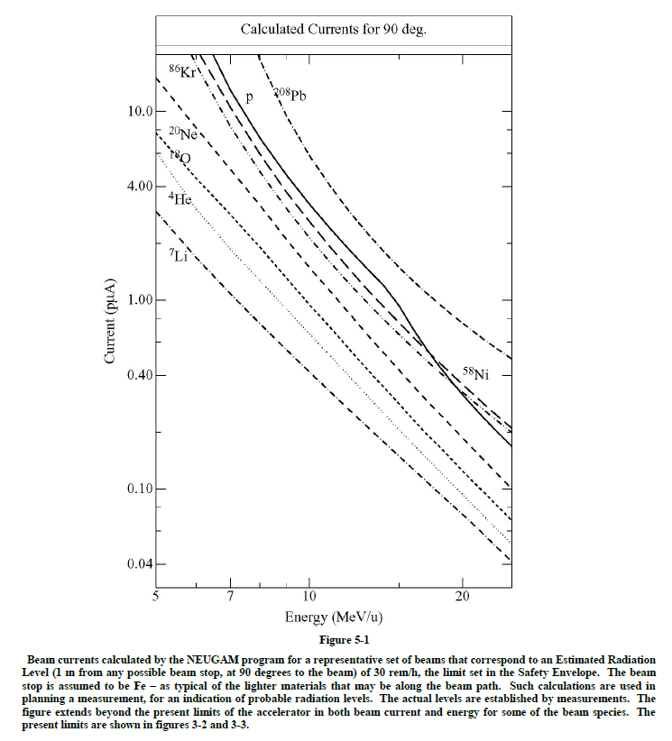
Radiation levels (Neugam code)
Reserved slides
2.5 pμA of Kr = 300 mSv/h
0.5 pnA expected = 60 μSv/h
Source : ATLAS (ANL) Safety Assessment Document
30 rem/h = 300 mSv/h

Slide 20
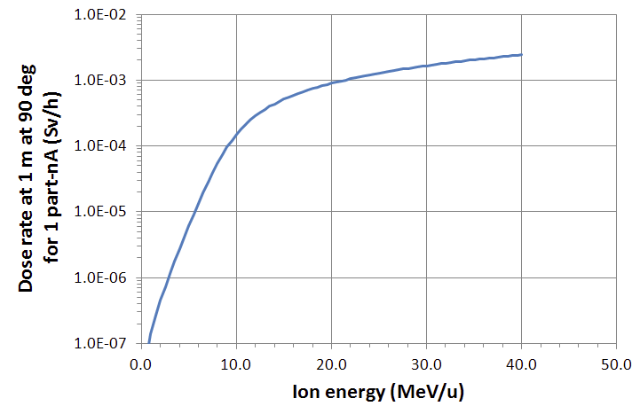
Reserved slides
Neutron dose rate at 1 m and at 90° from the interaction point of ions bombarding a
medium mass target (Fe, Ni or Cu) from Moritz, L. TRIUMF ISAC2 safety report. s.l. : TRIUMF, 2006.

